Slide 1











Jinping Underground Nuclear Astrophysics (JUNA) Experiments
Xiaodong Tang for the JUNA collaboration
Institute of Modern Physics, Chinese Academy of Sciences
Joint Department for Nuclear Physics, Lanzhou University of Institute of Modern Physics, Chinese Academy of Sciences
Solar Fusion Cross Sections III - N3AS, Berkeley, July 26-29, 2022
Thanks NSFC, Yalong power, THU, CAS and CNNC

Slide 2
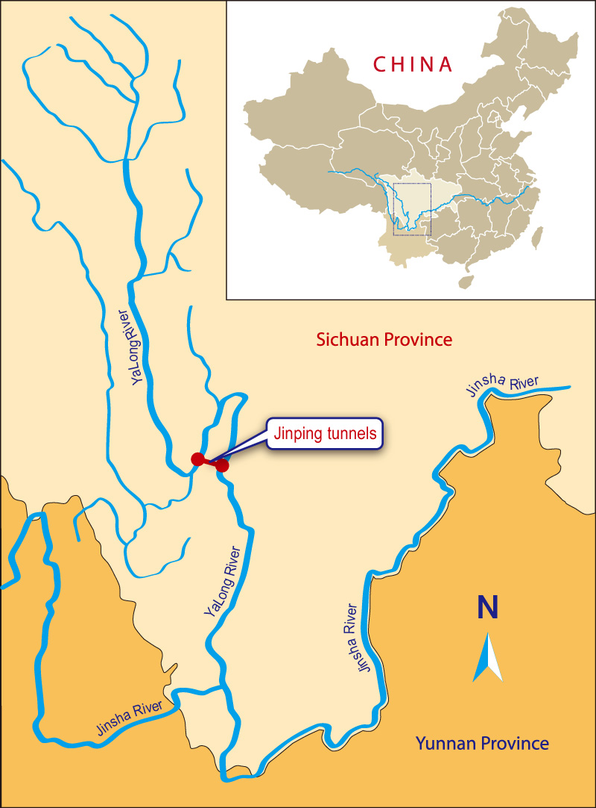

China Jinping Underground Laboratory(CJPL)
1) By flight
Beijing to Xichang
~3 hours
Shanghai to Xichang
~4 hours
Lanzhou to Xichang
~2 hours
2) By car
Xichang to CJPL
~3 hours
(home of Panda)

Slide 3
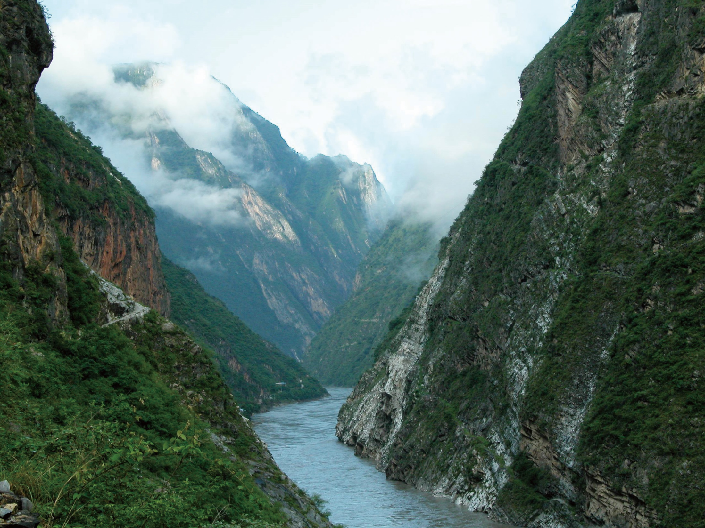

Slide 4
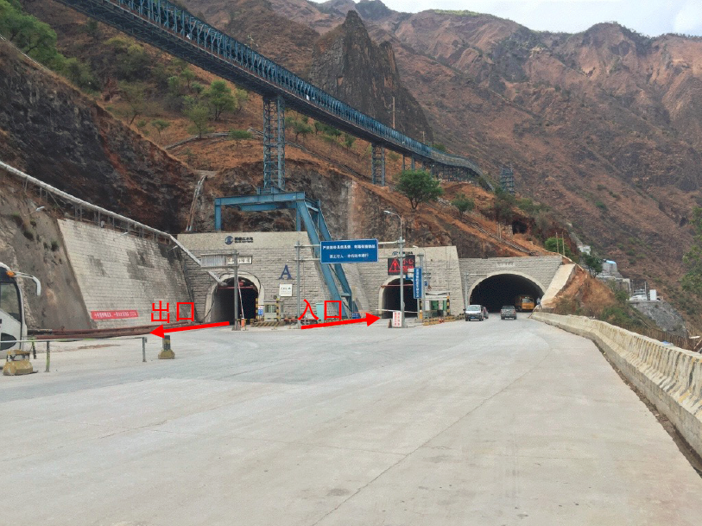

Slide 5
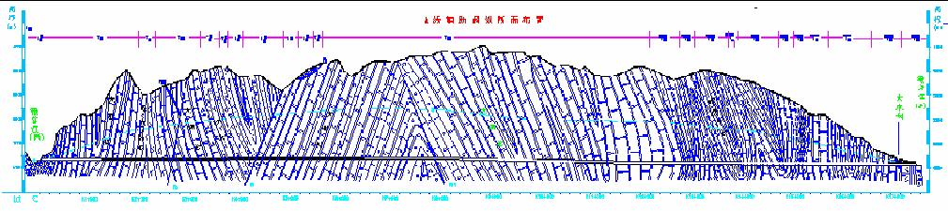
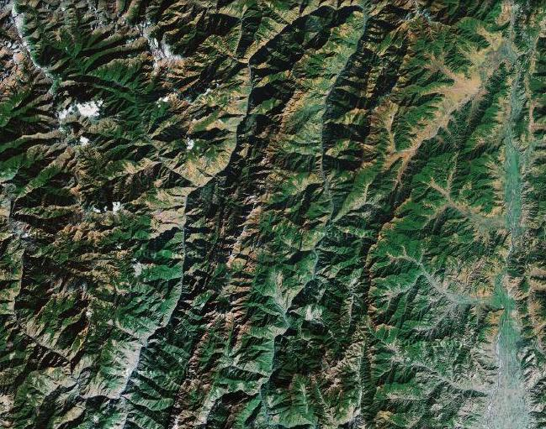
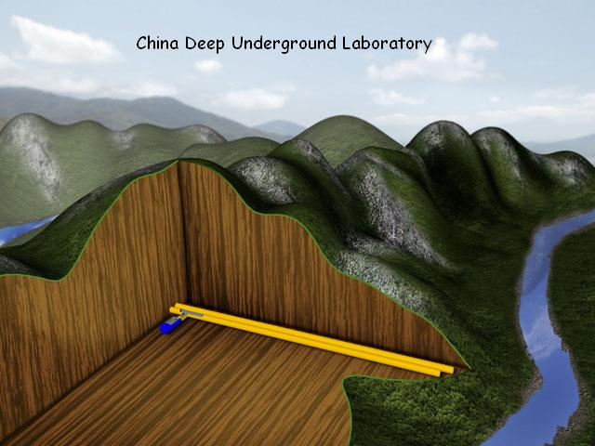
China Jinping Underground Laboratory
中国锦屏地下实验室
2400m
2400m
8750m

Slide 6
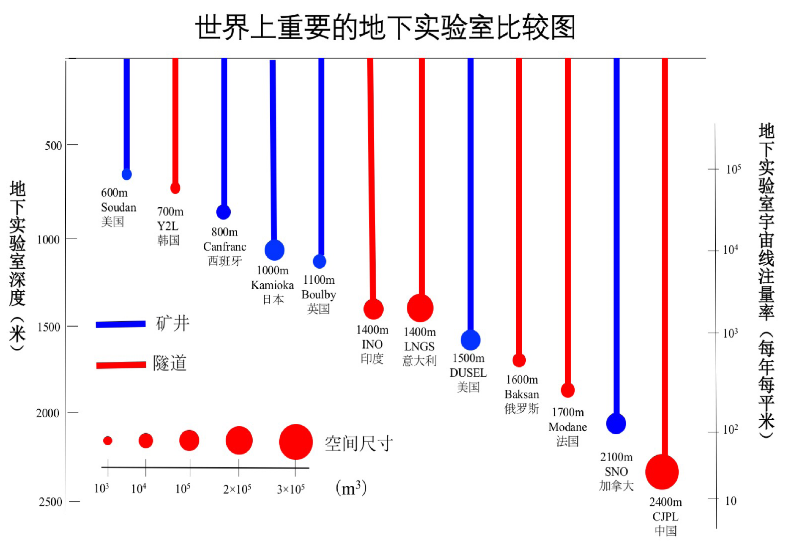
Major underground laboratories
Comparison of wold underground laboratory
cosmic
ray rate
/m²/a
depth
m
vertical
horizontal

Slide 7
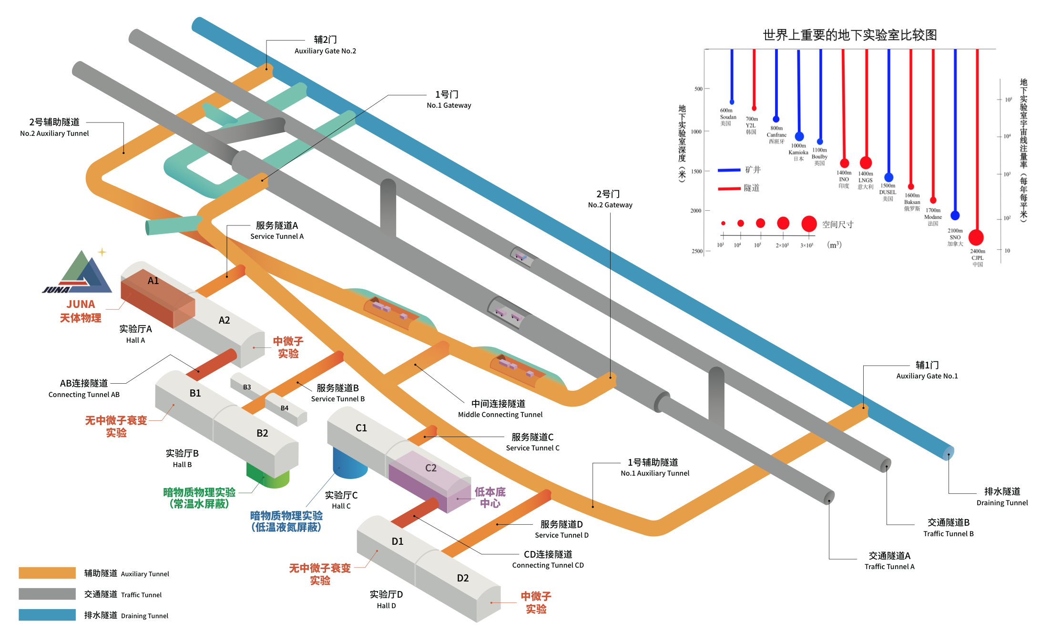
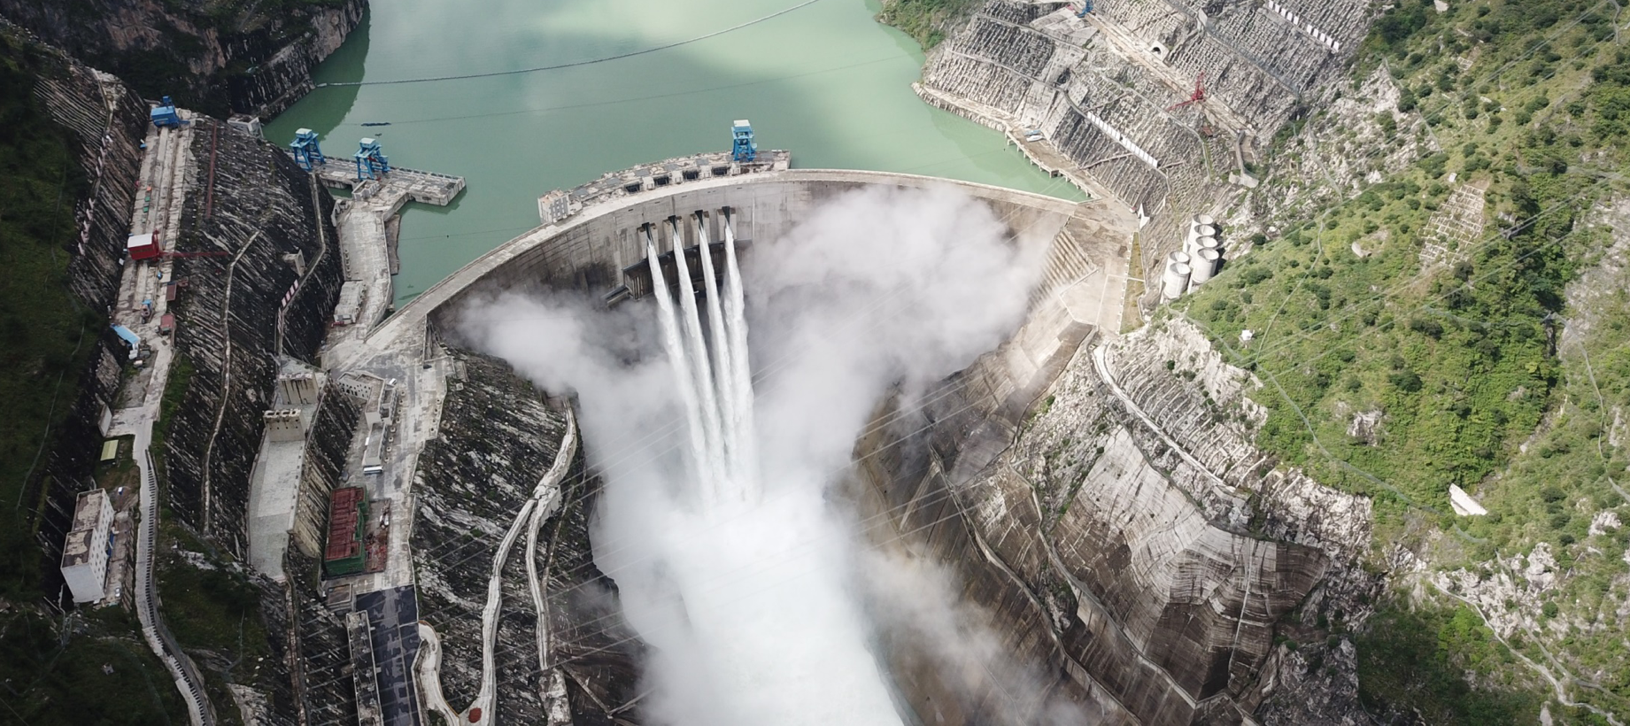
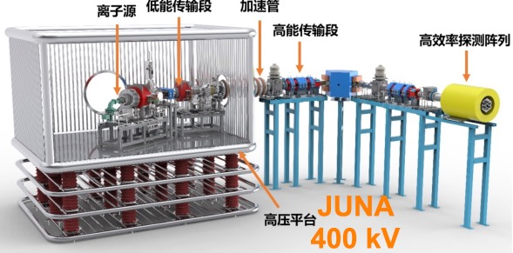
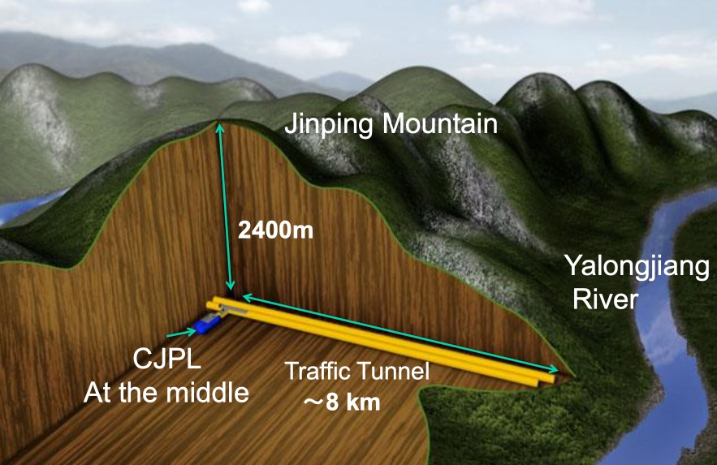
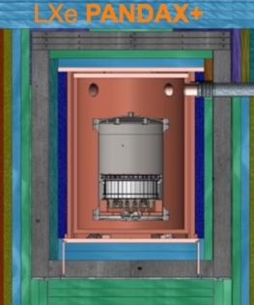
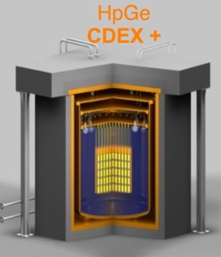
CJPL-II
Space: 300,000 m³
锦屏山
double
beta decay
dark matter
雅砻江
dark matter
double
beta decay
neutrino
锦屏深地实验室
交通洞

Slide 8
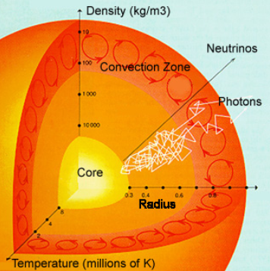
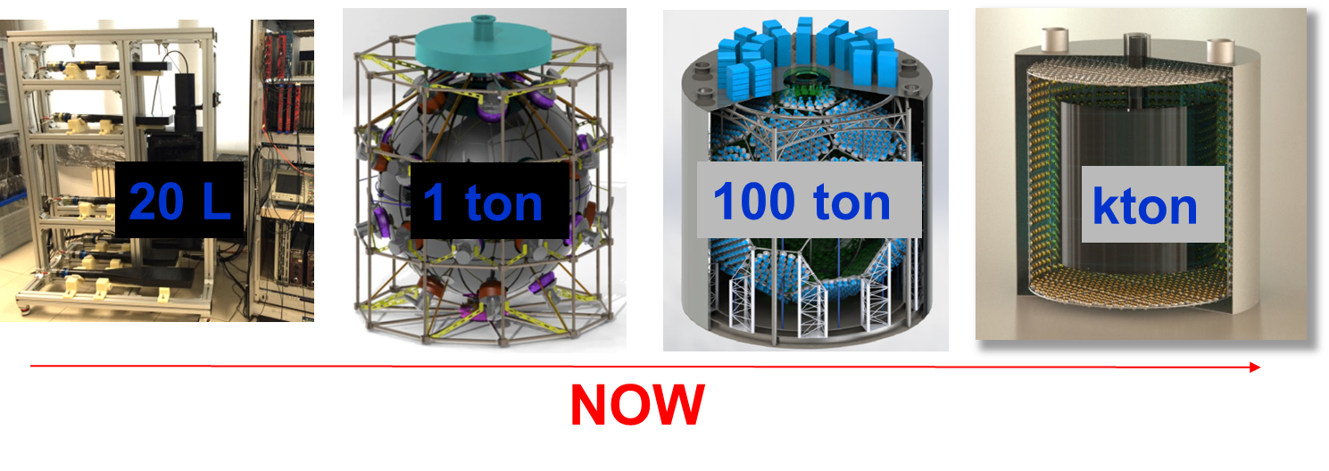
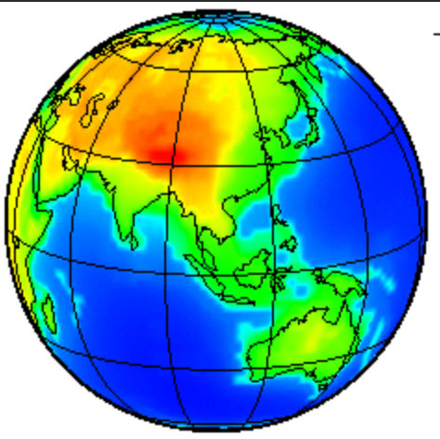
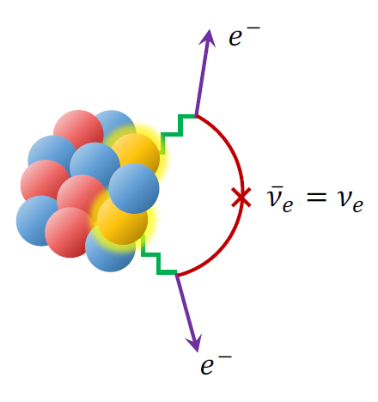
Jinping Neutrino Experiment
Roadmap
Construction of a hundred-ton scale detector, feasible for water of liquid scintillator in 5 years
Primary solar and geoneutrino neutrino detection in 5-10 years.
More physics results from the hundred-ton detector and plan for a larger detector 10-15 years
http://jinping.hep.tsinghua.edu.cn/Publications.php Courtesy: Z. Wang (Tsinghua University)

Slide 9

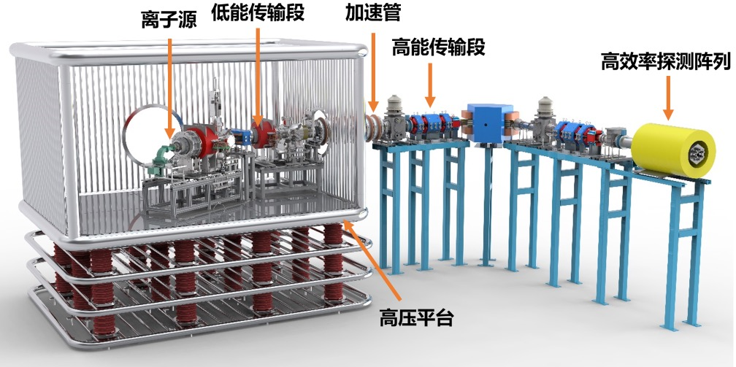













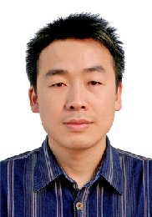
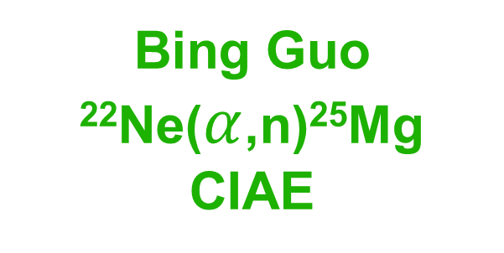
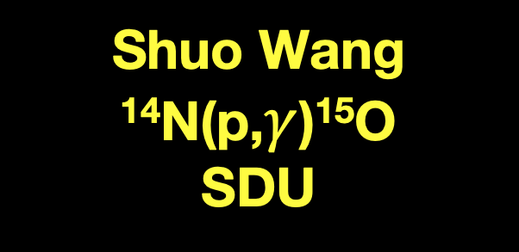
JUNA Management
Group leader
ECR
LET
ACC
Acc. installation
Arjun Li
HET
BGO/³He
A1 construction
Hongwei Yang
Weiping Liu
12C(α,γ)16O
HV table
Yangping Shen, CIAE
Jun Su, BNU
Site support
Xiaopan Cheng
PI
Acc. operation
Long Zhang
Bing Guo
²²Ne($α$,n)²⁵Mg
CIAE
Bao Quncui,CIAE
Liangting Sun, IMP
Ion source and acc.
Shuo Wang
¹⁴N(p,$γ$)¹⁵O
SDU
Zhihong Li
25Mg(p,γ)26Al
CIAE
Jianjun He
19F(p,α)16O
19F(p,γ)20Ne
BNU
Gang Lian
Lab. exp. sup.
CIAE
Xiaodong Tang
13C(α,n)16O
Ion source IMP
Jun Su, BNU
Supported by the National Natural Science Foundation of China, Grant No. 11490560, 2015
Notes:
单位改中文

Slide 10
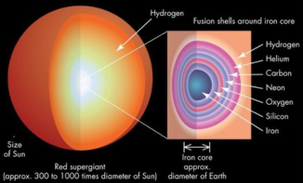
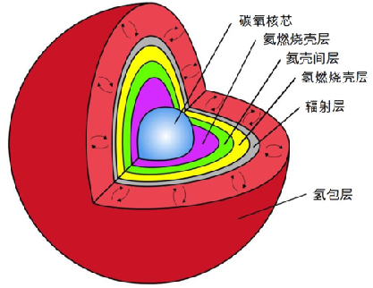
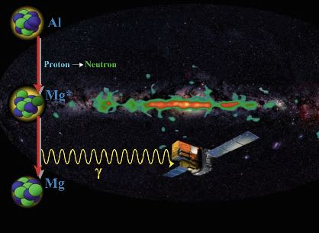
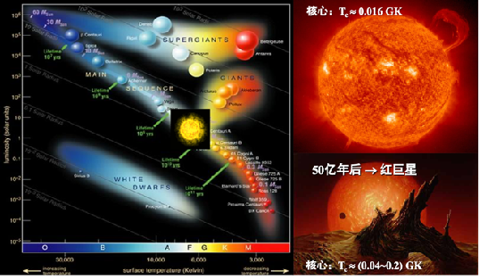
Goals to be accomplished with JUNA-I
Physics | Reaction | Before JUNA | Desired
Massive star | 12C(α,γ)16O | 60% 890 keV | 20% 220-380 keV
s-process neutron source | 13C(α,n)16O | 60% 230 keV | 10% 190-230 keV
Galaxy ²⁶Al source | 25Mg(p,γ)26Al | 20% 92 keV | 5% 50-300 keV
F aboundace | 19F(p,α)16O | 80 % 189 keV | 5 % 50-250 keV

Slide 11






JUNA funding
NSFC $2.9+M
CAS $0.65M
CNNC $1.6 M
CJPL-II／Tsinghua ～$3+M
Detectors（NSFC $1.3M）
Electronics, shielding (NSFC $1.0M）
Ion source (CAS $0.65M), accelerator (CNNC $1.6M)
Lab CJPL II（CNNC, Tsinghua，NSFC $3+M）
total $8+ M
Need to apply for JUNA II and welcome international contribution

Slide 12
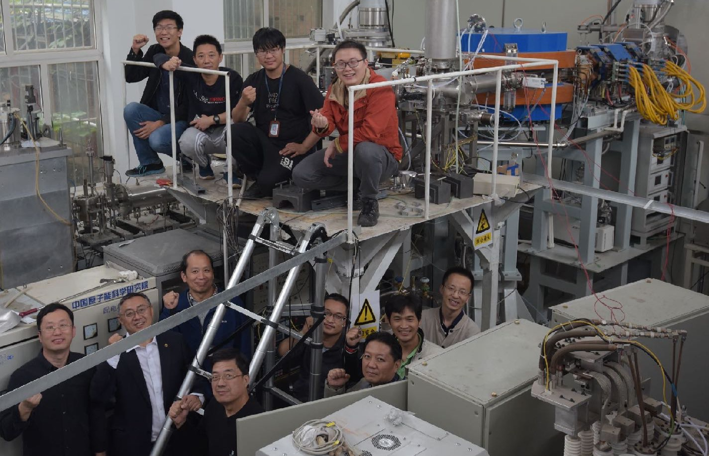
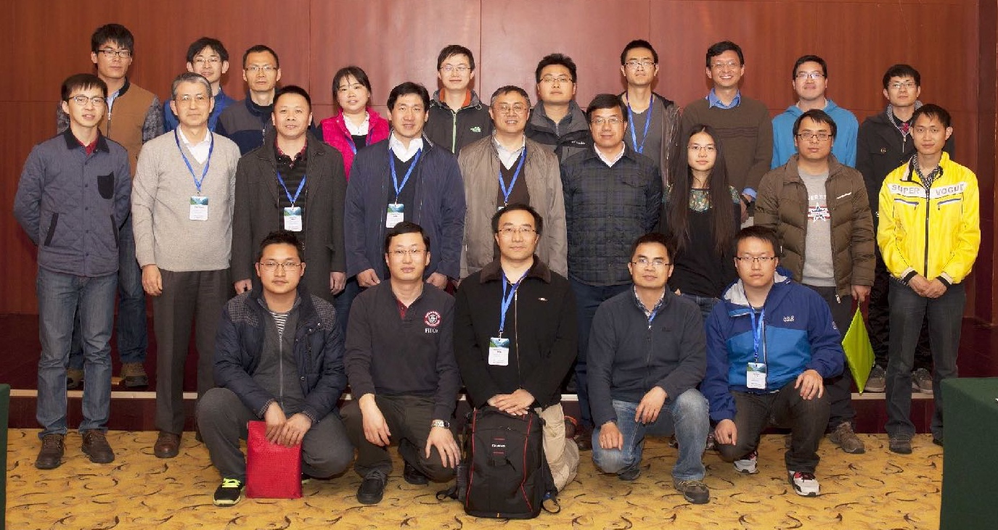
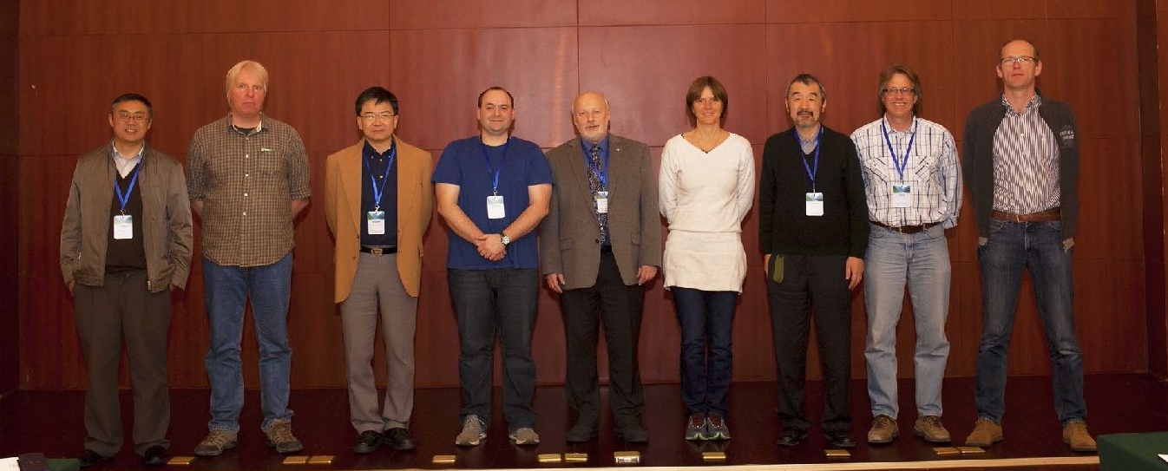
JUNA Team
中国原子能科学研究院：柳卫平，李志宏，连钢，崔保群，郭冰，陈立华，颜胜权，李云居，张龙，曹富强，廖俊辉，曾晟，谌阳平，张昊，陈晨，南巍，南威克，李歌星
近代物理研究所：唐晓东，孙良亭，武启，张宁涛，高丙水，陈涵，焦韬瑜
北京师范大学：何建军，苏俊，张立勇，李鑫悦，陈银吉，盛耀德，王泺欢
四川大学：安竹，黄宁，罗小兵，王鹏
山东大学：王硕
深圳大学：李二涛，甘林
中山大学：方晓，安振东
Weiping Liu¹, Zhihong Li¹, Jianjun He², Xiaodong Tang², Gang Lian¹, Zhu An⁴, Qinghao Chen³, Xiongjun Chen¹, Yangping Chen¹, Zhijun Chen², Baoqun Cui¹, Xianchao Du¹, Changbo Fu⁵, Lin Gan¹, Bing Guo¹, Guozhu He¹, Alexander Heger⁶, Suqing Hou², Hanxiong Huang¹, Ning Huang⁴, Baolu Jia², Liyang Jiang¹, Shigeru Kubono⁷, Jianmin Li³, Kuoang Li², Tao Li², Yunju Li¹, Maria Lugaro⁸, Xiaobing Luo⁴, Shaobo Ma², Dongming Mei⁹, Yongzhong Qian¹⁰, Jiuchang Qin¹, Jie Ren¹, Jun Su¹, Liangting Sun², Wanpeng Tan¹¹, Isao Tanihata¹², Peng Wang⁴, Shuo Wang¹³, Youbao Wang¹, Qi Wu², Shiwei Xu², Shengquan Yan¹, Litao Yang³, Xiangqing Yu², Qian Yue³, Sheng Zeng¹, Huanyu Zhang¹, Hui Zhang³, Liyong Zhang², Ningtao Zhang2, Qiwei Zhang¹, Tao Zhang⁵, Xiaopeng Zhang⁵, Xuezhen Zhang², Zimin Zhang², Wei Zhao³, Zuo Zhao¹, Chao Zhou¹
1China Institute of Atomic Energy, Beijing, China，
²Institute of Modern Physics, Lanzhou, China
3Tsinghua University, Beijing, China，
4Sichuan University, Chengdu, China
5Shanghai Jiaotong University, Shanghai, China，
⁶Monash University, Melbourne, Victoria, Australia,
7RIKEN, Institute of Physical and Chemical Research, Wako, Japan，
⁸Konkoly Observatory of the Hungarian Academy of Sciences, Hungary，
9South Dakota State University, Brookings, South Dakota, US
10Minnesota University, Minneapolis and Saint Paul, Minnesota, US，
11University of Notre Dame, Notre Dame, Indiana, US，
¹²Osaka University, Suita, Osaka, Japan
13Shangdong University, Beihai , China
澳大利亚莫纳什大学：Alexander Heger
日本大阪大学: 谷畑 勇夫
日本理化学研究所：久保野 茂
匈牙利科学院：Maria Lugaro
美国南达科他大学: 梅东明
美国明尼苏达大学：钱永中
美国圣母大学：谭万鹏
国际咨询委员会（IAC）
M. Wischer （圣母大学，委员会主席）
本林 透 （日本理化学研究所）
王子敬 （台北中央研究院）
C. Brune （俄亥俄州立大学）
M. Junker （意大利国家核物理研究院）
D. Robertson （圣母大学）
F. Strieder （南达科达矿业理工学院）
D. Leitner （加州大学伯克利分校）
岳骞 （清华大学）
特别致谢
雅砻江流域水电开发有限公司，锦屏水力发电厂、锦屏地下实验室管理局，清华大学，上海交通大学

Slide 13
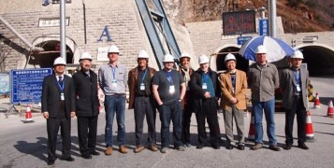


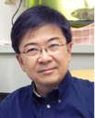

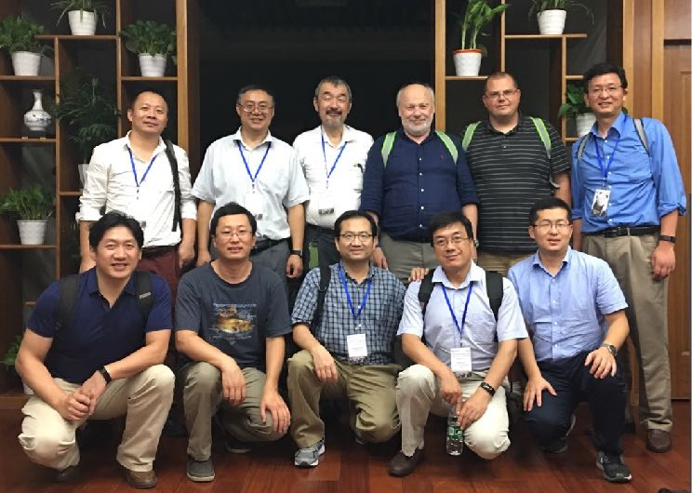

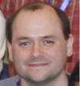
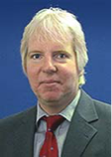


JUNA IAC
M. Wiescher | UND
T. Motobayashi | RIKEN
H. Wang | TCAS
C. Brune | Ohio
M. Junker | INFN
D. Robertson | UND
F. Strieder | SDSMT
D. Leitner | LBL
Q. Yue | THU
IAC, CJPL，Mar. 1, 2016
Mini IAC, Shanghai, Sept. 19, 2017
1st meeting July 2015，1st formal IAC meeting March, 2016, 2nd mini meeting Sept. 2017

Slide 14
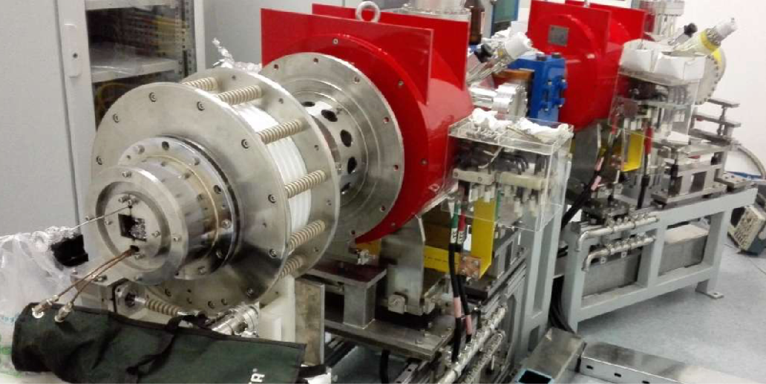
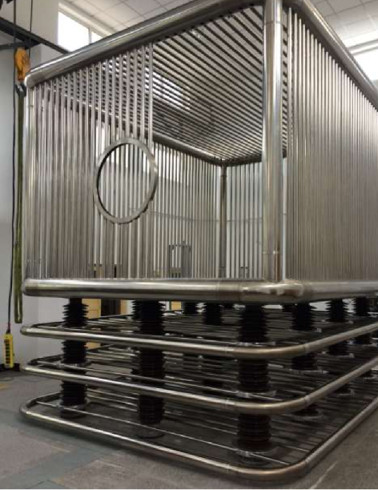
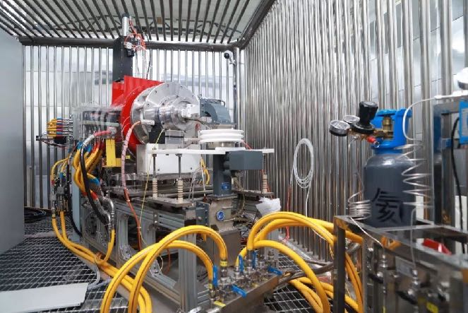
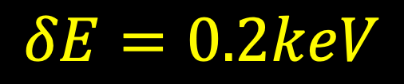
Ion source and accelerator
WPL et al., Sci China 59 (2016) 642001
Ion source 1 mA in Jul. 2016, 16 mA in Oct.
Accelerator HV platform installed in Aug. 2016
First proton beam of 260 keV and 3 mA in May 2017
Beam | Intensity pmA | Energy keV | ECR GHz
H⁺ | 12 | 400 | 2.45
He⁺ | 10 | 400 | 2.45
He⁺⁺ | 1 | 800 | 14.5
ECR
LET
ACC
HET
BGO/³He
HV table
$$δE=0.2keV$$

Slide 15
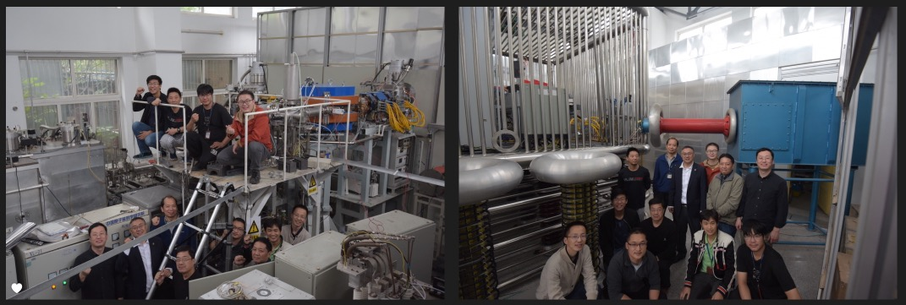
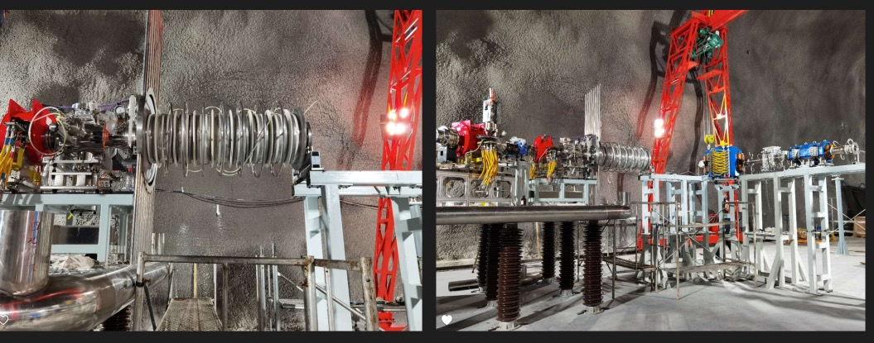
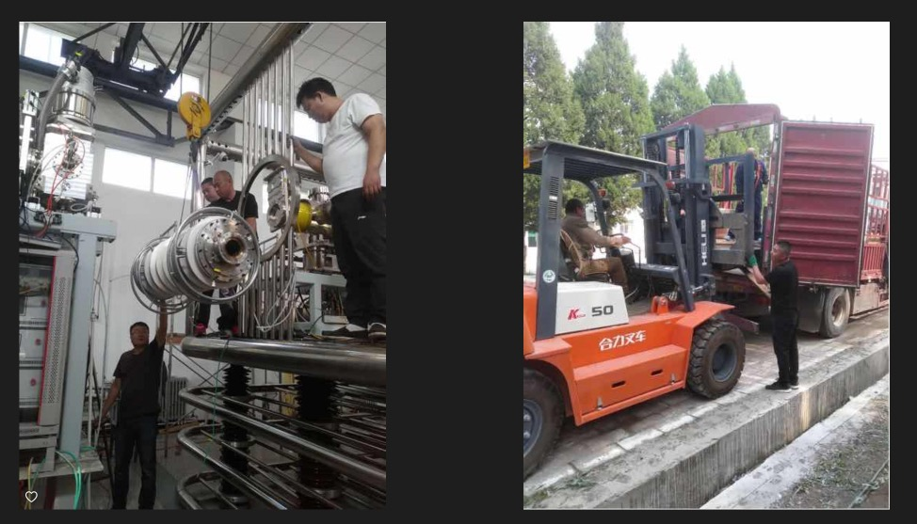
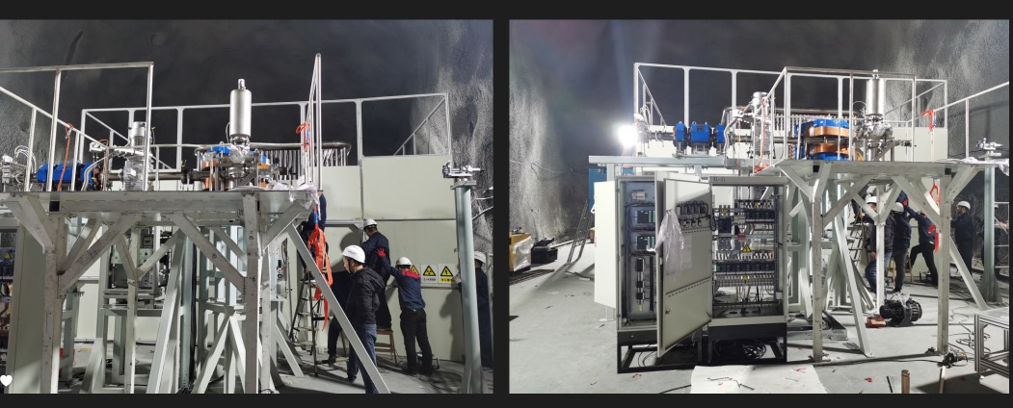
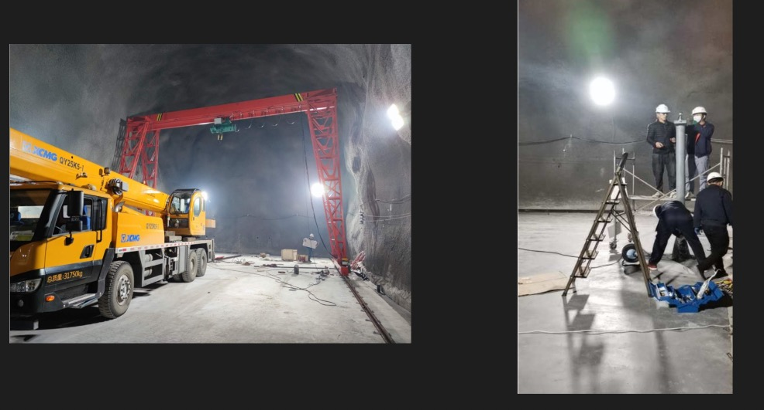
2020.10-2020.12
WPL et al., Sci China 59 (2016) 642001
farewell in ground
ECR source and ace. tube
disassemble and transport from Beijing to Xichang
setup JUNA lab in CJPL II A1
beam transport and detector

Slide 16
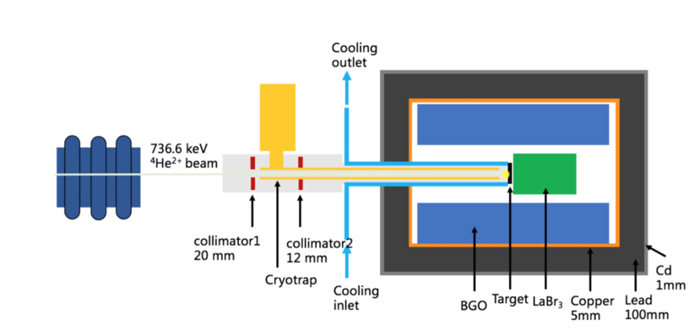
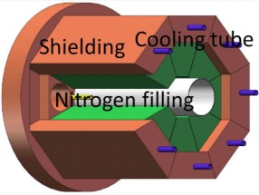
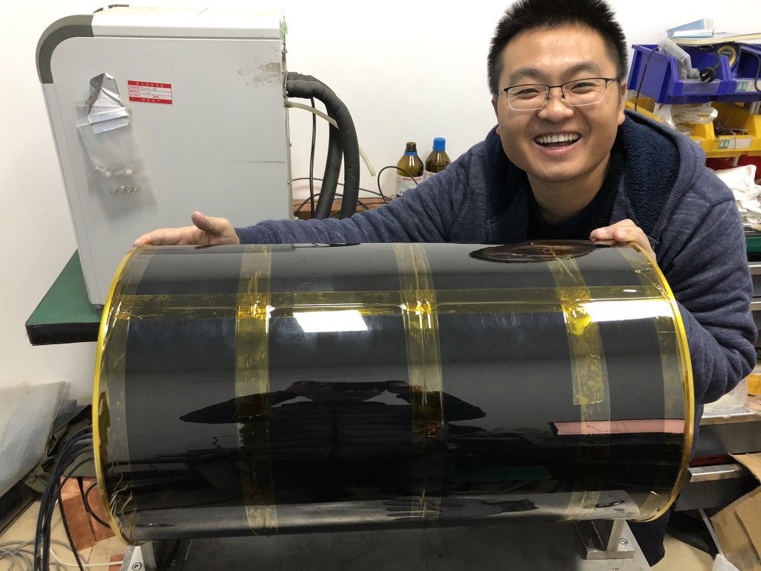
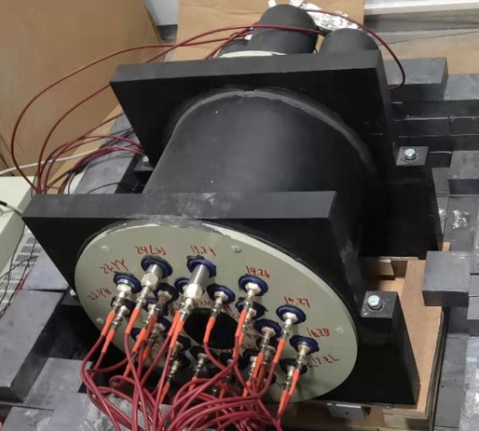
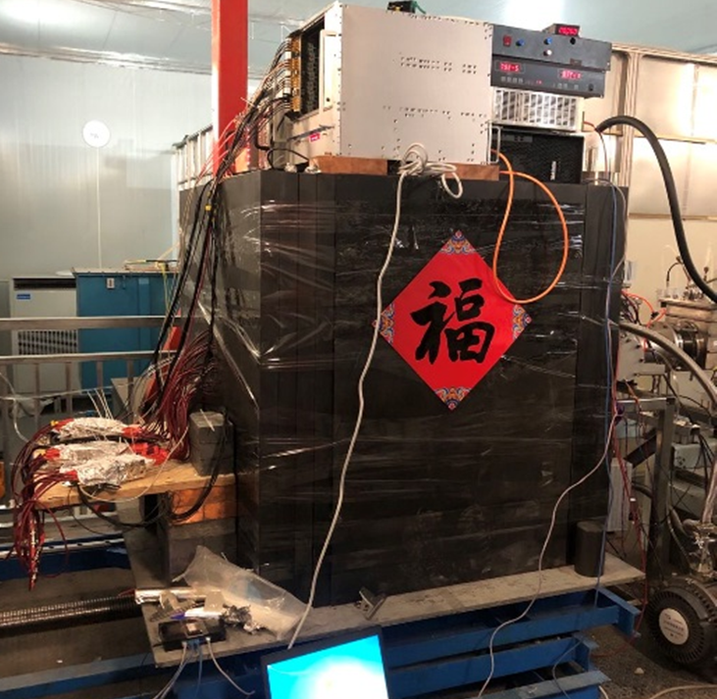
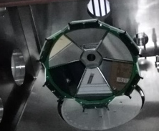
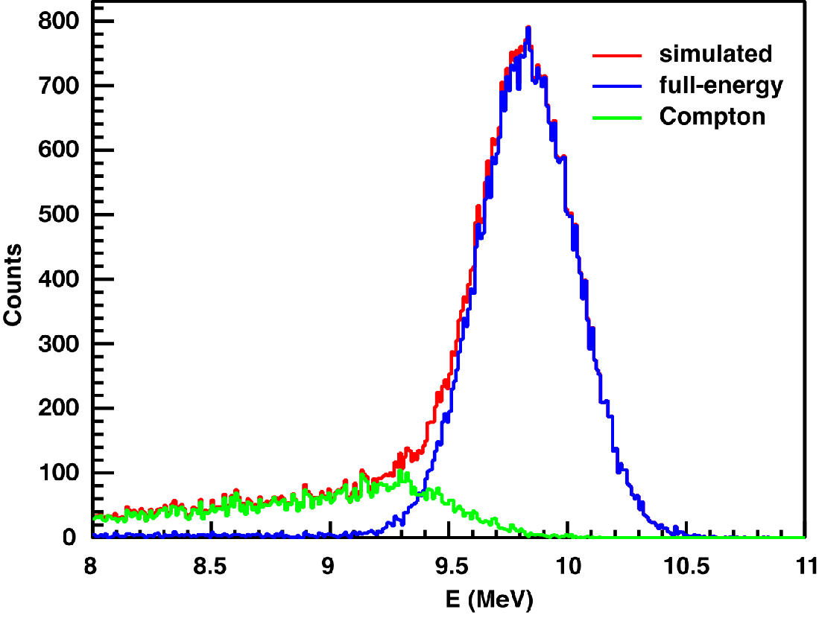
Detection systems
Cooled
BGO array
LaBr₃+BGO array
BGO array
FEPE>60 %
FWHM<10%
(E_{γ} = 7.76 MeV)
³He detector array
26%for 2.5MeV neutron
Silicon array
Notes:
创新研发伽马、中子和带电粒子探测器，其中BGO探测器能量分辨大多国际最好水平。

Slide 17
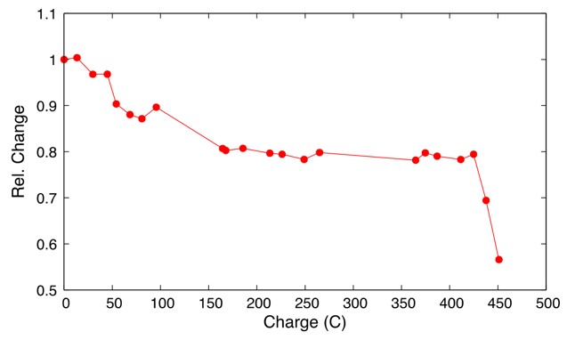



Target technologies
核反应靶 target | 采用技术 technology | 发表文章 publication | 国外记录 world best | 我们达到 JUNA
12C | Filter cathodic vacuum arc FCVA | 1 patent | 100 C | 400 C
25Mg | rotation+ Cr coating | NST31(2020)91 | 20 C | 300 C
13C | Enriched thick | In preparation | >100 targets | 3 targets ~500 W
19F | Implantation+ Cr coating | NIMB 438(2019)48 496(2012)9 | 0.02 mA | 1 mA
Notes:
解决了高功率靶的关键技术，耐辐照性达到国外的3-10倍，保障深地核天体物理实验。

Slide 18




Summary of first compain (2022.1-2022.4)
reaction | previous status | JUNA results | exposure C | intensity, mA
12C(α,γ)16O (18O(a,γ)22Ne) | 60% 890 keV ~10⁻¹¹ b | Upper limit 552 keV ~10⁻¹² b | 1034 | 1.0
13C(α,n)16O in press | 60% 230-300 keV | ~15% 240-1900 keV | 350 | 0.5-2.0
25Mg(p,γ)26Al Sci Bull,67(2022)125 | 21% 92 keV | 8% 92 keV | 1225 | 1.5
19F(p,αγ)16O 19F(p,γ)20Ne PRL 127(2021)152702 | 80 % 189 keV 300 keV | 5 % 72 keV 200 keV |  | 1.0
7Li(α,γ)
11B(α,γ)
LUNA2021，意大利

Slide 19

Listed as major achievement in the talk of President Xi
May 28, 2021

Slide 20

Campaign with BGO array
~2400 m overburden at CJPL
high intensity proton beam~ 10 mA
4π BGO γ-ray
high durability target
²⁵Mg

Slide 21




JUNA vs. LUNA
Er=92 keV
意大利
LUNA
本实验
中国
JUNA
25Mg(p,γ)26Al
52 days(S+N)， 370 C exposure
events：410
$ωγ$：2.9(6)×10⁻¹⁰ eV
15 days(S+N)， 1008 C exposure
events：1225
$ωγ$：3.8(4)×10⁻¹⁰ eV
Notes:
从今年元旦开始，我们用15天完成了实验测量。右图给出了92 keV能级的实验谱，和意大利LUNA实验室的结果相比，我们在能量分辨，束流曝光量，效应计数都有明显优势，大大减小了实验误差。

Slide 22






Results for ²⁵Mg(p,γ)²⁶Mg
BRIF in-direct
JUNA underground
JUNA ground
J. Su, .., WPL*, Science Bulletin, 67(2022)2

Slide 23



¹⁹F(p,αγ)¹⁶O
new ¹⁹F(p,α)¹⁶O still can not explain F over abundance
JUNA
most precise data, cover Gamow energy window
L.Y. Zhang, J. Su, J.J. He* et al., Phys. Rev. Lett. 127(2021)152702

Slide 24






New excitement from JUNA ¹⁹F(p,$γ$)¹⁸Ne：
CNO break out, explain Ca in oldest known star
13.6 billion years old
SMSS0313-6708 13.5 B Yr
“warm” CNO
JWST
13.1 B Yr
Nature 506 (2014) 463
new resonance ！
13.1 billion years old
JUNA paper submitted

Slide 25


¹³C(α,n)¹⁶O reaction
Cover energy up to 800 keV
Highest beam intensity in underground
Need to remove D⁺

Slide 26

Neutron Detector Array
Thank A. Best (LUNA) for helping us choose the low-background 3He detector; C. Brune(Ohio) and J. DeBoer(CASPAR) for Angular distribution
1/265
1/4
LUNA, Csedreki NIMA (2021)
JUNA, Y.T. Li, T.y.Jiao, B.S. Gao, W.P.Lin et al. arXiv:2111.12552, NST(2022)

Slide 27

Highest beam current
JUNA Limit
JUNA Limit
Preparation + Beam time: Feb. 27 to Mar. 16, 2021
Notes:
Not for publicer45re4

Slide 28


S-factor of ¹³C(α,n)¹⁶O
T₉
Lin & Gao
JUNA data analyzed by B.S. Gao (IMP)
SCU data analyzed by W.P. Lin(SCU)
11% systematic uncertainty included
Consistent measurement from 0.24-1.9 MeV resolves the existing discrepancy
Agrees with the best LUNA fit at E_{cm}>0.2 MeV and the “low LUNA” fit at E_{cm}<0.2 MeV
15% systematically higher than the LUNA data

Slide 29

13C(α,n)16O reaction rate
    B. S. Gao et al., PRL in press 2022
Indirect measurement in Green
Direct measurement in Red
Compilation in Blue
Notes:
第四个成果：13C产生重元素中子源反应，取得最精确全面数据，澄清了国际上直接测量3倍的分歧；

Slide 30


Alpha Strength of the Threshold and Screening Potential
JUNA reduced width = -0.145+/-0.019 MeV^{1/2} at R=6.684 fm, modified ANC²=2.1+/-0.6 fm⁻¹ with Ex=6.356 MeV
Ue=0.78+/-0.43 keV agrees with Ue=0.937 keV predicted using the adiabatic limit, rules out other predictions.
Guo2 taken from Shen, Guo et al., PLB(2020)

Slide 31


Efforts towards holy grail in 70 years
Direct
ground
underground
Indirect
ANC
THM
Inverse
reaction
final goal
fix sub threshold
bkg free E1/E2
high energy
angular distribution
Astrophysical
constraints
E1/E2, R matrix
¹²C($α,γ$)¹⁶O
MSN BH
decay measurement
Cluster calculation
R matrix
extrapolation
fix E1
constrain
joint info
R. J. deBoer et al. , RMP 29(2017)035007

Slide 32


12C(α,γ)16O ：more sensitivity
FCVA implantation CTi thick targets
durability >280 C @800 keV He²⁺, with only 25% loss
BGO+LaBr3 veto
wide energy search for best S/N, 552 keV is best, other suffer from ${}^{18}O(α,γ)^{22}Ne$ contaminations
sensitivity of 10⁻¹² b @Ec.m. = 552 keV

Slide 33


12C(α,γ)16O ：more sensitivity, near Gamow window
Preliminary
Bayesian method
552

Slide 34
Future plan from 2023-2025
Ion source
Accelerator
Detector
Target
Signal
Background
Analysis
Improvement
Construction
parallel beams
Jan. 2015
Project start
May 2017
Beam on ground
Dec. 2020
beam underground
May 2021
Exp. Phase 1
June 2023
Exp. Phase 2
~2025
JUNA 2 MV machine
Reaction | Goals
12C(α,γ)16O | try 1X10⁻¹³ b limit 450 keV
13C(α,n)16O | 20%, , 10⁻¹² b 200 keV
25Mg(p,γ)26Al | 10% try 58 keV resonance
22Ne(α,n)²⁵Mg | Bing Guo, CIAE
14N(p,γ)¹⁵O | Shuo Wang, SDU
More reactions | Need your proposal!
Reaction | Plan
12C(α,γ)16O | inverse kinematics
¹²C+¹²C | Ecm <2 MeV
¹⁶O+¹⁶O | Ecm < 3 MeV
More reactions | Need your proposal!
Reaction | Achieved with ca. 1 emA beam
12C(α,γ)16O | 1X10⁻¹² b limit 552 keV
13C(α,n)16O | 10%, 10⁻¹² b 230-600 keV
25Mg(p,γ)26Al | 5% 92 keV
19F(p,αγ)16O 19F(p,γ)²⁰Ne | 5 %,72-344 keV, PRL 5 %,188-344 keV
Proposals/Collaborations are welcome!

Slide 35

Contact: wangshuo_wh@sdu.edu.cn

Slide 36

Standard will reduce most of systematic uncertainties
Collaboration is essential!
Beam current normalization
Target thickness, stability
Detector efficiency
Stopping power
Data fitting
Proposing experiments at other facilities to cover wider energy range with better intensity, cross check or just for better science
LUNA
JUNA
CASPAR
Felsenkeller
LENA
CIRCE
Notre Dame
Ohio
SCU
LEAF@IMP
….

Slide 37



JUNA IAC

