Slide 1
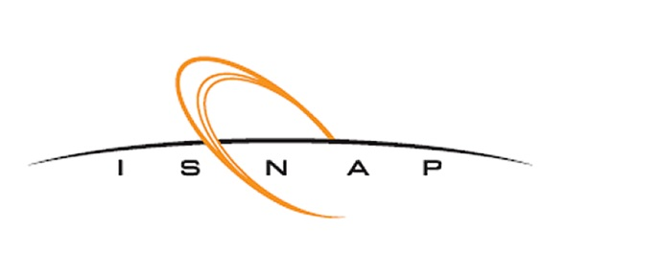



CASPAR
Underground Nuclear Astrophysics
Slides prepared by:
Dan Robertson
So please give James a break – Just this once

Slide 2


CASPAR – Collaboration
Compact Accelerator System for Performing Astrophysical Research
Michael Wiescher (Notre Dame PI)
Daniel Robertson (Technical Director)
Manoel Couder
Joachim Goerres
Anna Simon-Robertson
2 Graduate Students (Currently)
Frank Strieder (School of Mines PI)
3 Graduate Students (Currently)

Slide 3
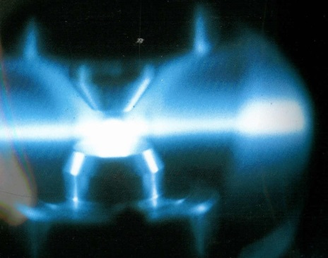
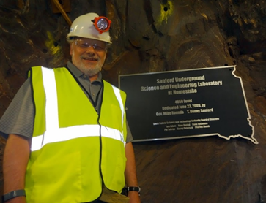
CASPAR – Going underground
“I am going to already assume that with LUNA-MV, JUNA & the Felsenkeller the case for underground measurements is clear.”
Increase of reaction yield
  Increasing beam intensity
  Long campaign measurements
  Improving target stability
Background reduction
  Cosmic radiation background
  Environmental decay background
  Beam / impurity induced background
Detection sensitivities & tricks
  Higher efficiencies
  Cleaner materials
  Better discrimination

Slide 4
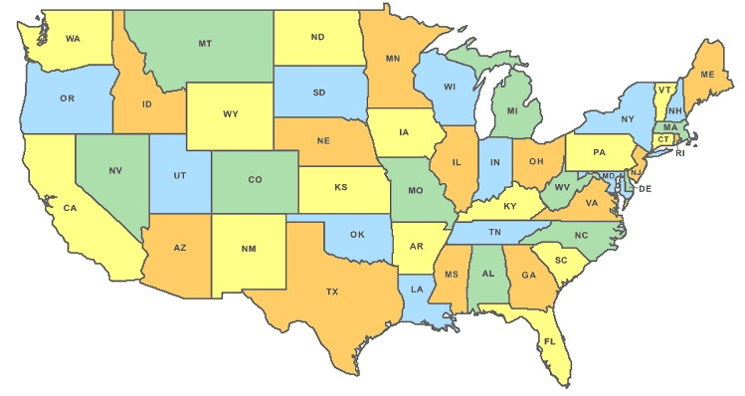
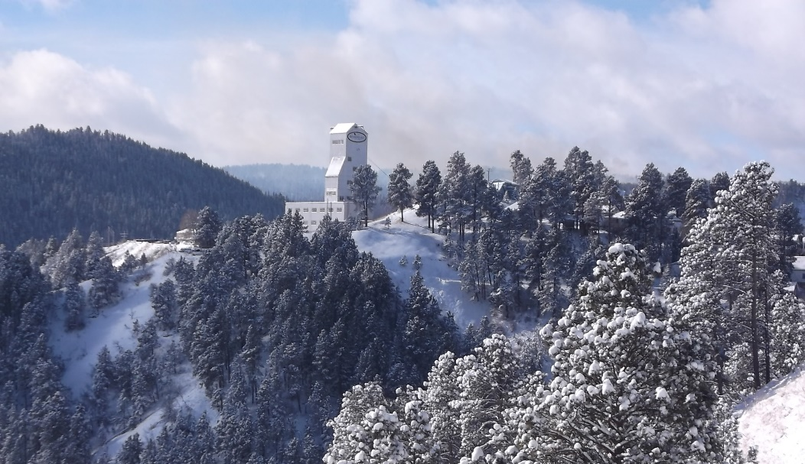
CASPAR – Location Geographic
Black Hills, SD
Lead, SD
Notre Dame, IN
Facility site is in Lead, SD at the Sanford underground Research Facility (SURF)
Local collaborating institution is 1 hour from site
Multiple science facilities operational at same location
Large onsite facility management and support staff 24/7
Continuous monitoring and available tech support of local conditions

Slide 5
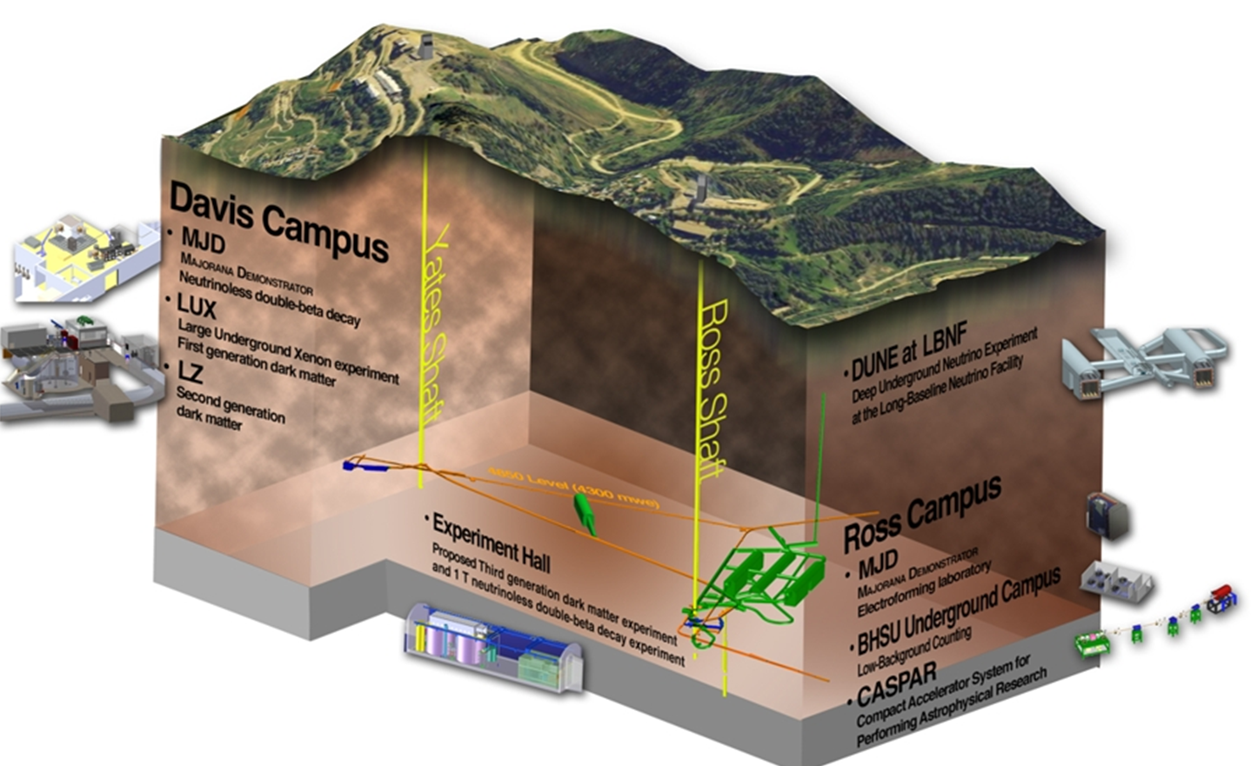
CASPAR – Location Underground (1/2)
4300 mwe Shielding
Sanford Underground Research Facility
(4850L)

Slide 6
CASPAR – Location Underground (2/2)
4,850 ft below surface of black hills – Old Homestake Gold Mine
Results in 4,300 meters water equivalent of shielding
  Vertical muon flux equal to 4.4 x 10⁻⁹µ / cm² / s
Two shaft access, with CASPAR connected closely to the Ross shaft for ease of transport
CASPAR lab is stand alone facility with no shared infrastructure
Currently located near LBNF-DUNE facility (Under construction)
Surrounding utilities under extensive upgrade due to location of DUNE construction
  Should help in expansion and upgrade goal

Slide 7
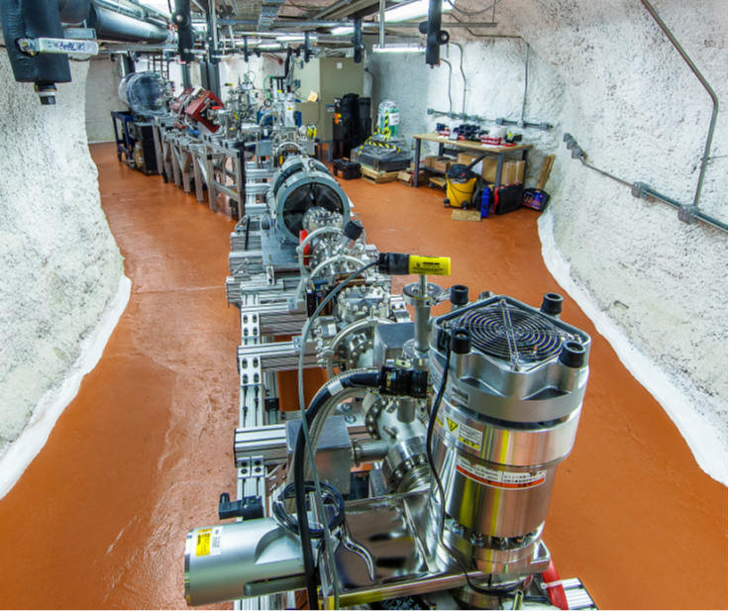
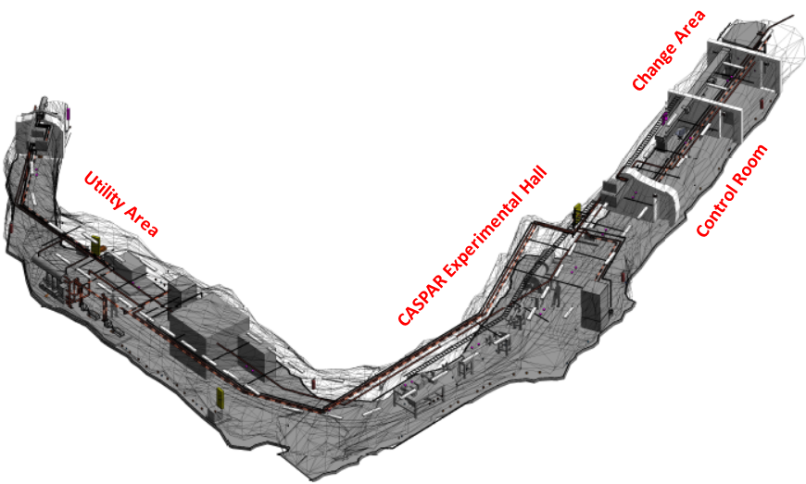
CASPAR – Facility Layout
Accelerator & beamline location

Slide 8
CASPAR – Beamline Layout (1/2)
BEAM

Slide 9
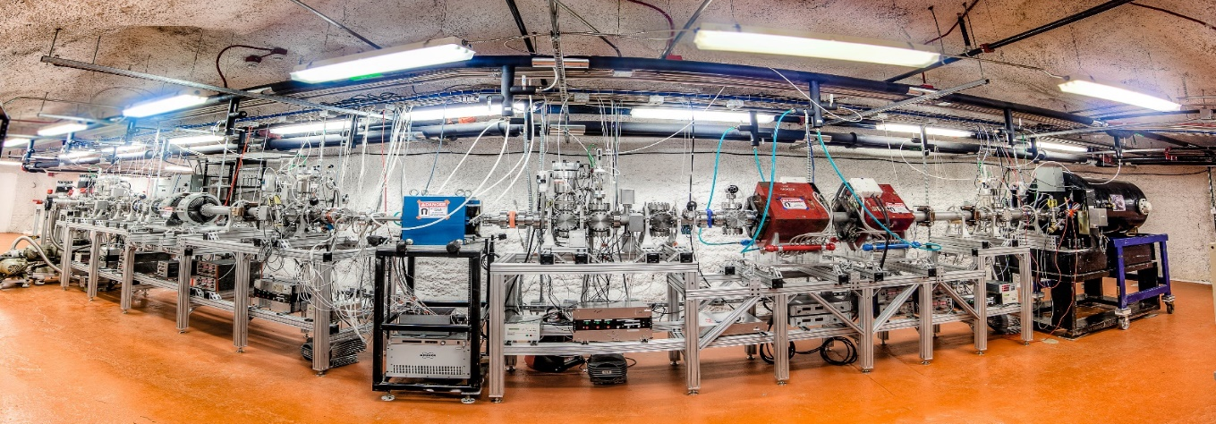
CASPAR – Facility & Stats
1 MV JN Model Van de Graff Accelerator | Voltage range ~ 150 kV – 1.1 MV
Gas fed radio frequency source | Proton beam and alpha beam to target, 200 – 250 μA
Analyzing magnet | 25-degree, with 0-degree and “mass-2” ports
Beamline and pumping | All conflat system with magnetic levitation turbo pumps and dry scroll backing pumps
Typical vacuum operating range | 3 x 10⁻⁸ Torr
Target stations | Extended, recirculating, windowless gas target & Solid target stations interchangeable
Workforce | Graduate student, postdoc and faculty driven. No operators.

Slide 10
CASPAR – Timeline & Situation
2018: First commissioning experiments
  Standard accelerator calibration measurements
  Start of ¹⁴N(p,γ)¹⁵O campaigns (Frentz et al)
2019: First neutron measurements
  Start with investigation of target contaminant background reactions
  ¹¹B(α,n)¹⁴N (Thesis)
2020 – 2021: ²⁷Al(p,γ)²⁸Si (Gomez et al), ¹⁸O(𝛼,𝛾)²²Ne (Dombos et al), ²²Ne(a,g)²⁶Mg (Submitted), ²²Ne(a,n)²⁵Mg (Finalizing analysis), ⁷Li(a,g)¹¹B (Analysis ongoing)
Mid – 2021: CASPAR placed in stand-by mode due to blasting of new cavities nearby
Summer 2023: CASPAR rebuild and recommission for operations, expect to be fully operational by end of the year

Slide 11
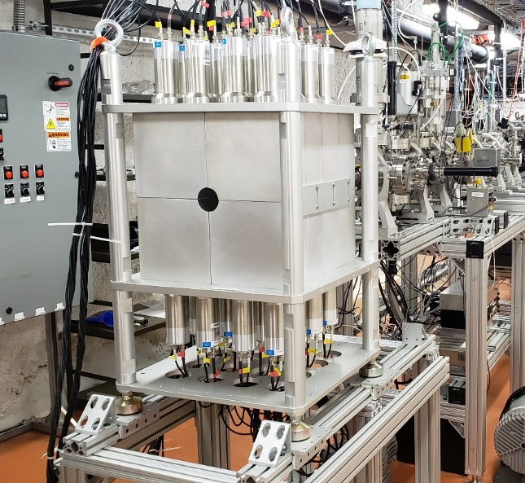
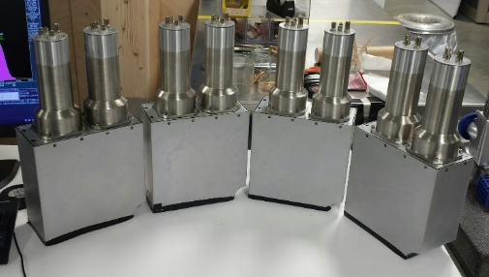
CASPAR – Developments
On-going developments prior to start-up
Development of integrated passive/active shielding system for Total Absorption Spectrometer (HECTOR)
  Reduce environmental and intrinsic backgrounds
Inclusion of energy sensitive neutron detectors
  Identify and quantify background reactions from material contaminants
New target making processes and further detector testing for utilization in an underground environment
EJ301D neutron detectors

Slide 12
CASPAR – Moving Forward
CASPAR will stay focused on the (p,γ), (α,γ) and (α,n) reaction regimes
The broad energy range although not ideal is still a substantial overlap between aboveground and underground measurements
Discussions underway with funding agency for equipment and system upgrades
  Aim to increase longevity and upper limit on voltage
Initial 3-year campaign extremely successful (despite COVID and shutdown for blasting)
Next science program due to begin in 2023 for 4-year campaign
Outcome of this meeting will steer priorities for CASPAR upcoming

Slide 13
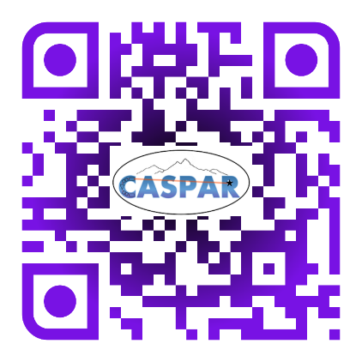
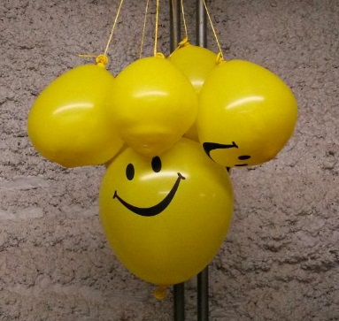
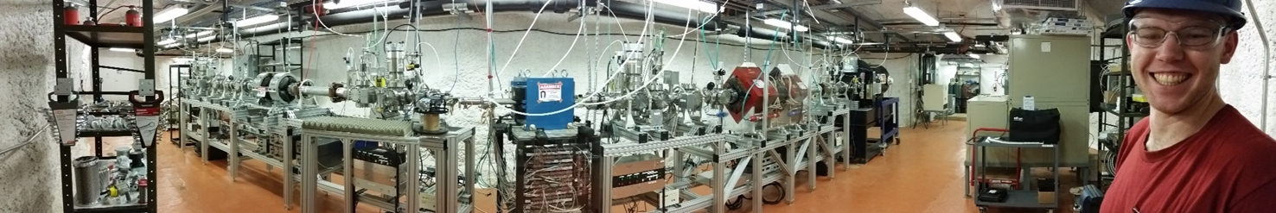
CASPAR – Thank You
Thanks to James for stepping in for me, and I am sorry I was unable to attend
Please feel free to contact me for further questions or comments drobert4@nd.edu
Science program funding NSF-1615197 & NSF-1913746
Infrastructure support: South Dakota Science & Technology Authority

