Slide 1

Astrostatistics for Exoplanets
Guillem Anglada-Escudé
Staff Scientist, ICE-CSIC & IEEC
ICE- CSIC summer school 2024

Slide 2
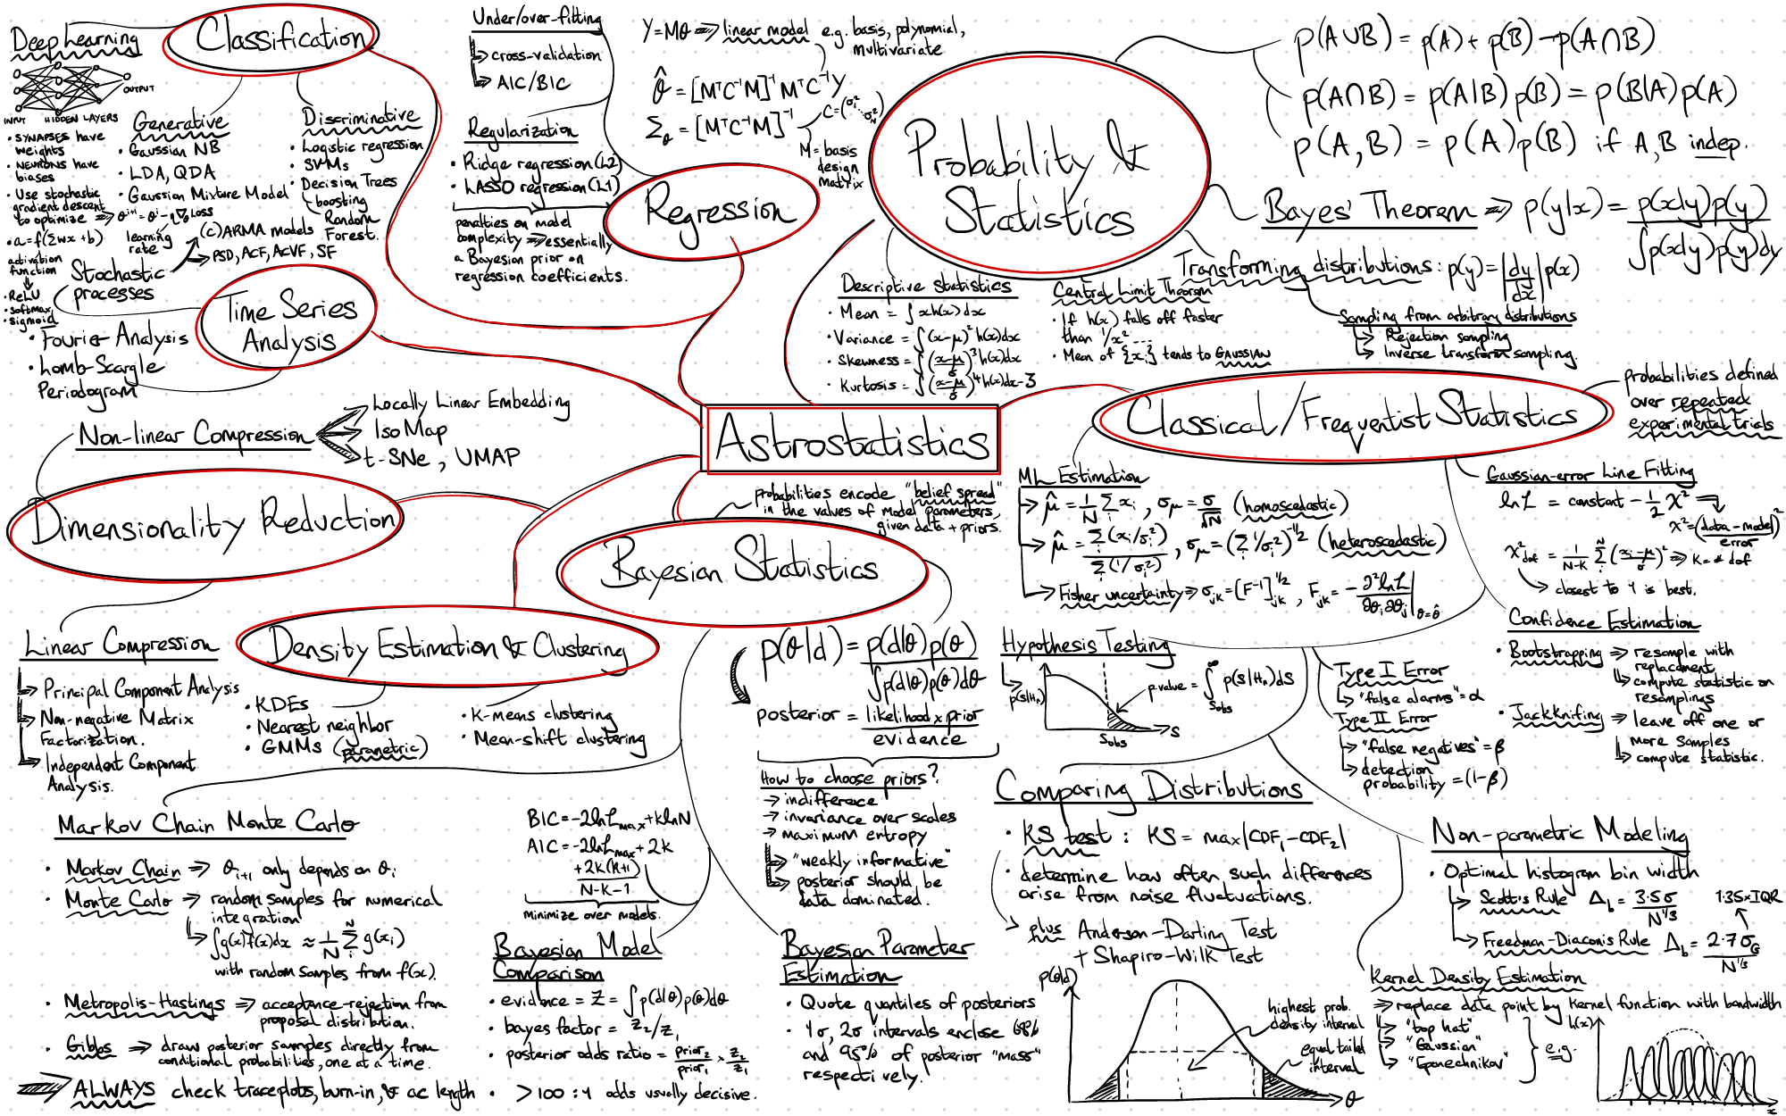
We’ll talk about
Credits: Steve Taylor (Vanderbilt)
Detection and characterization (in a statistical sense)
The merit function : the likelihood
How to combine different datasets
Bayesian versus Frequentist tools
Bayesian characterisation
Linear versus non-linear problems
Model inversion and machine learning
Tips and recommendations
A full course on the topic
https://github.com/dgerosa/astrostatistics_bicocca_2024
ICE- CSIC summer school 2024

Slide 3
It is all about model comparison
Or more precisely, comparison of the performance of different models against the data, which is the observed ‘truth’.
Image of the sky with nothing in it
Experiment
Objective - Find alien life
Strategy - I will do it by detecting UFOs
Immediate goal - obtain an image of a flying saucer that appears every first Friday of every months near Montserrat
I detected a flying saucer -> Aliens exist -> We are not alone in the universe
Image of the sky with a ‘Detection’
ICE- CSIC summer school 2024

Slide 4

It is all about model comparison
Or more precisely, comparison of the performance of different models against the data, which is the observed ‘truth’.
While the data remains ‘true’, as more information comes in the interpretation of Alien life detection collapses like a house of cards…
ICE- CSIC summer school 2024

Slide 5
What is a detection?
DATA is truth
Two conditions shall be satisfied. The first one :
Statistical detection : The model compares favourably against the null hypothesis using some figure of merit
Typical statistical tests are based on ruling-out the null hypothesis on probabilistic grounds, but negation of null hypothesis cannot be the full story…
ICE- CSIC summer school 2024

Slide 6


What is a detection?
DATA is truth
Assuming we already have a ‘statistical detection’ of something we need
Statistical characterisation : The successful model shall be favoured against all plausible alternatives by a given threshold
Flying saucer
Frisbee
More data needed as both explanations have the same likelihood to be correct
Bayesian prior information also helps!
ICE- CSIC summer school 2024

Slide 7
Finding a merit function
… or why do we use the leasts squares statistic.
ICE- CSIC summer school 2024

Slide 8
The likelihood function - Philosophical considerations
Models
Interpretations
Opinions
Papers
Reality (Universe)
Instruments
Likelihood function
Preprocessing
Data reduction
ICE- CSIC summer school 2024

Slide 9

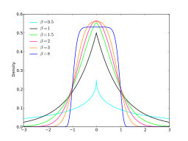
The likelihood function - your model for the data
Likelihood function
Statistically independent measurements
Statistically dependent measurements
Gaussian likelihood
Other error distribution…
Multivariate Normal uncertainties
Other multivariate error distribution…
Lorentzian
Gaussian processes
AR, ARMA, ARIMA, etc
\chi^2
Uniform
Discrete
Mathematically motivated
Physically motivated
Root Mean Square
Binomial
ICE- CSIC summer school 2024

Slide 10
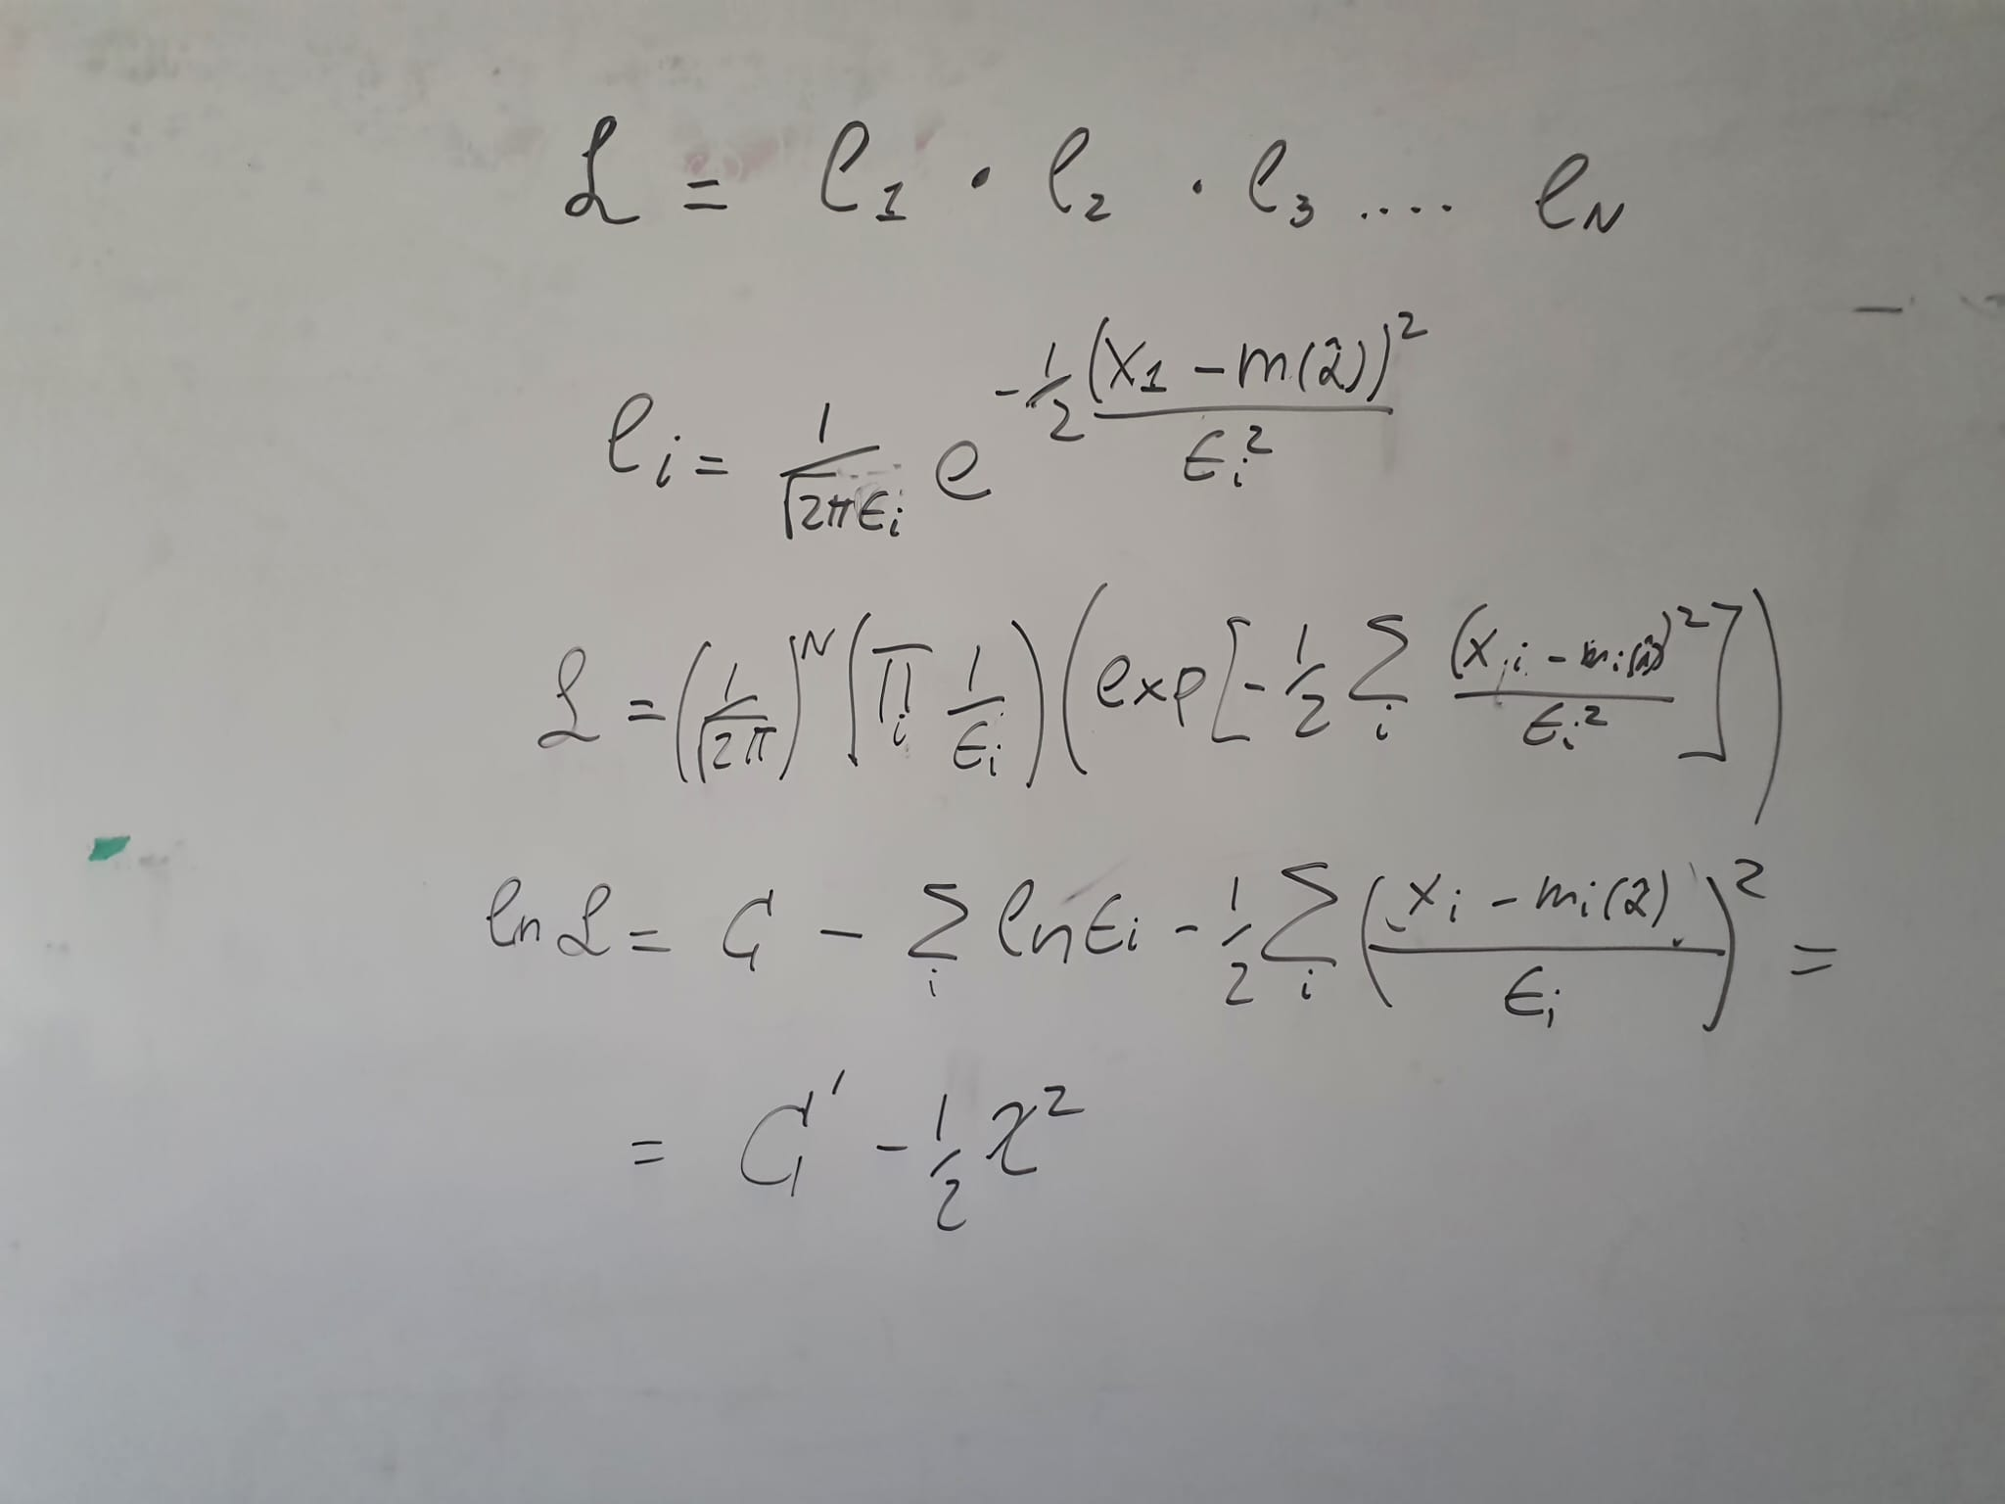
Example 1 : likelihood of independent datapoints
ICE- CSIC summer school 2024

Slide 11
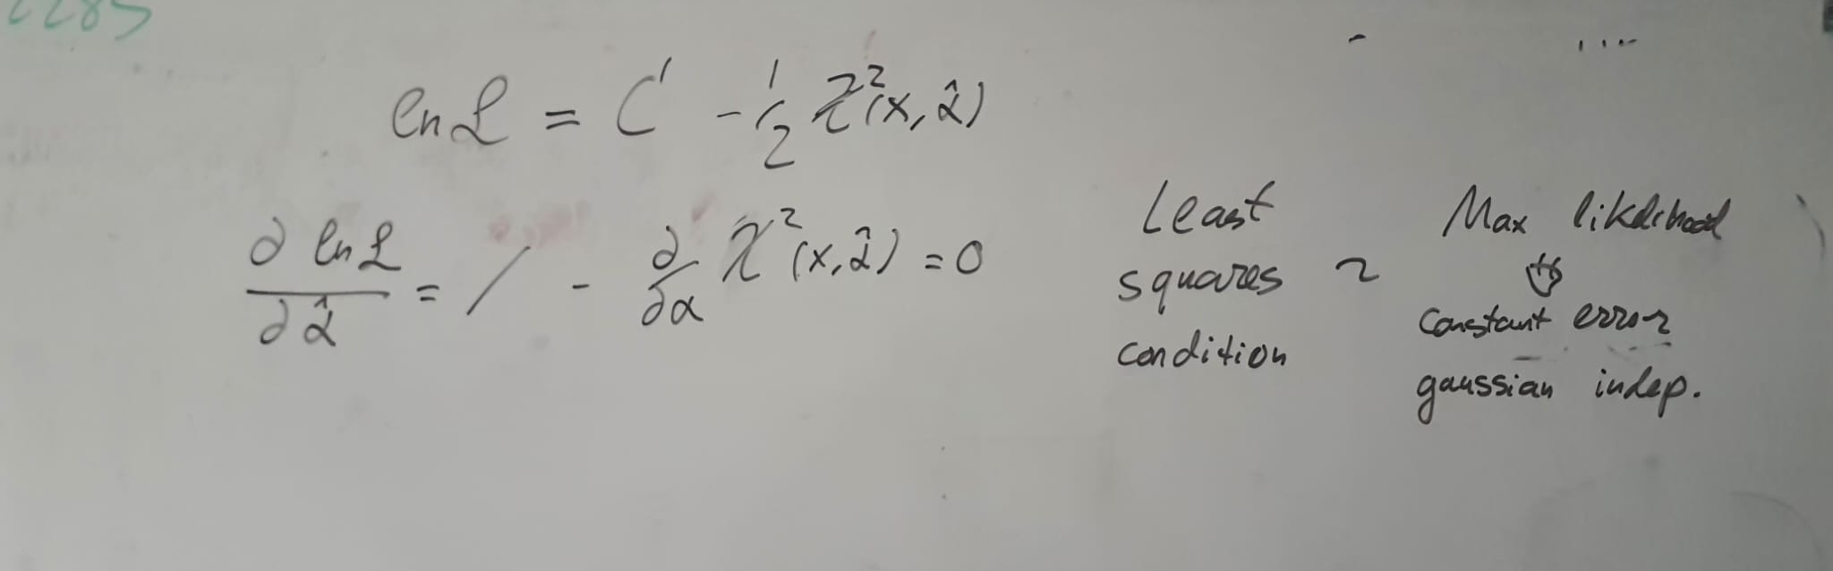
Example 2 : from likelihood to least squares fitting
ICE- CSIC summer school 2024

Slide 12
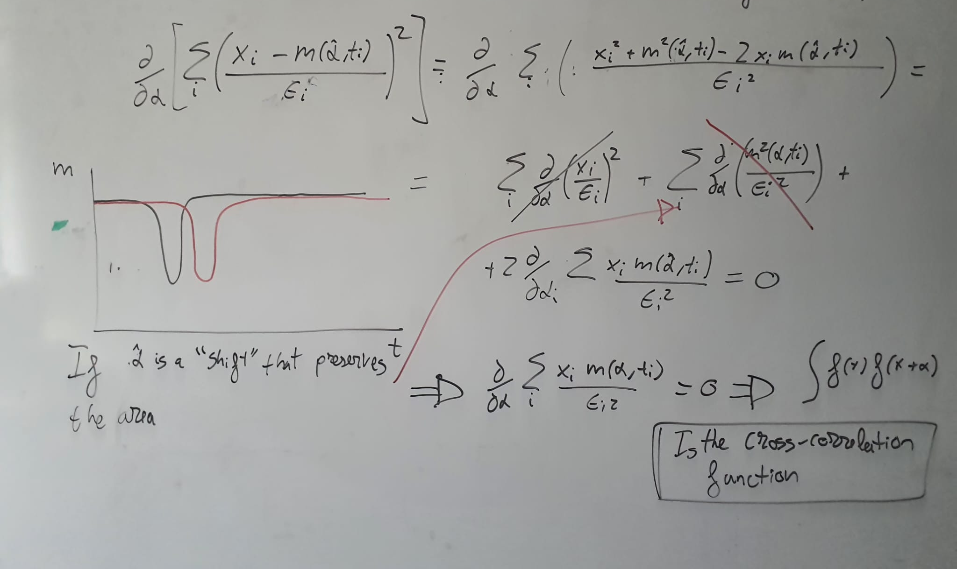
Example 3 : from likelihood cross-correlation
ICE- CSIC summer school 2024

Slide 13
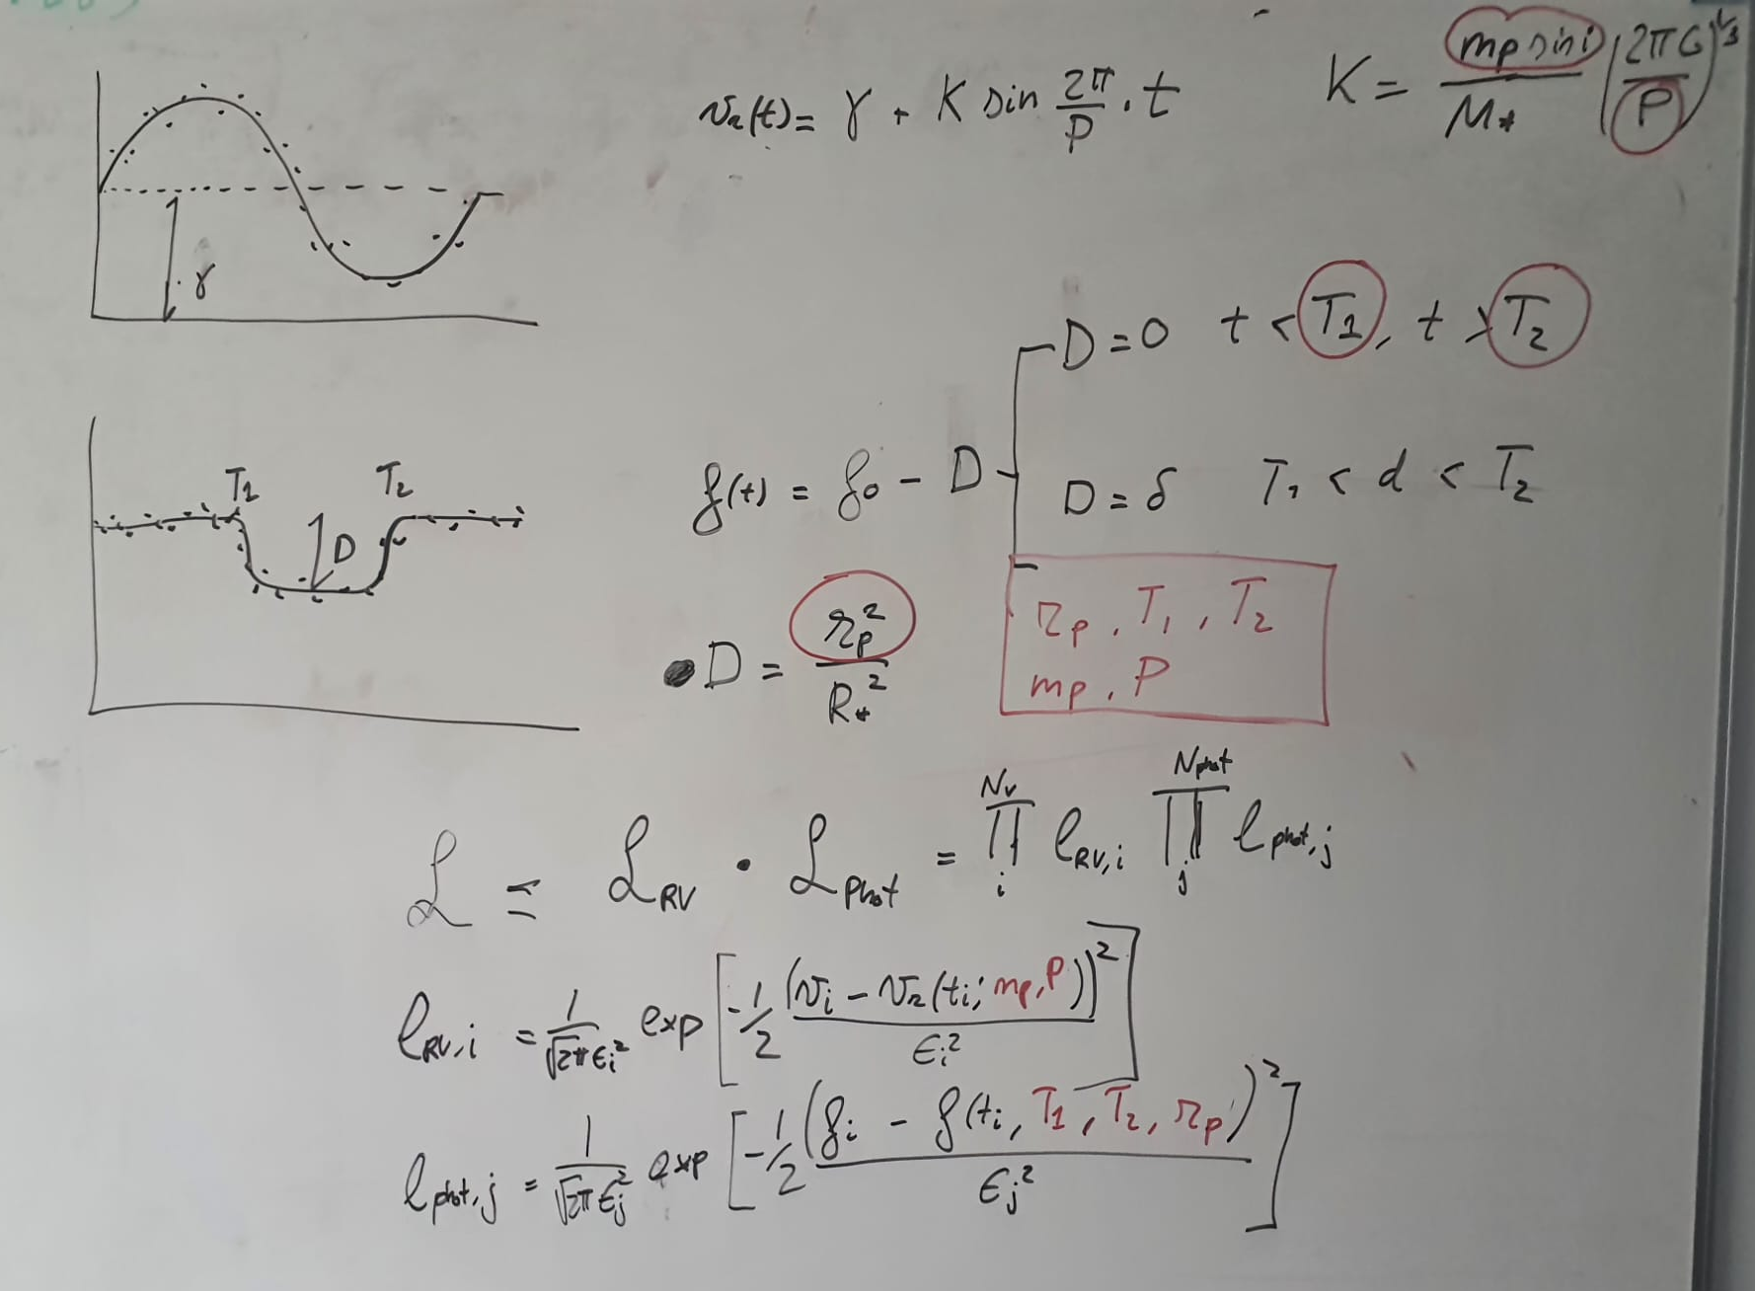
Example 4 : likelihood of independent datasets
ICE- CSIC summer school 2024

Slide 14
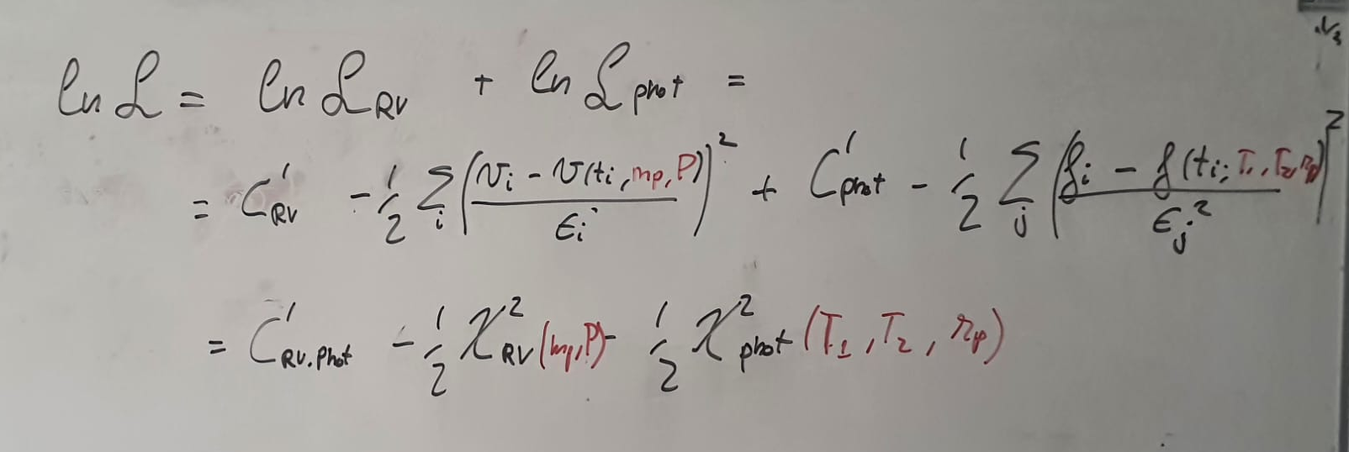
Example 4 : likelihood of independent datasets
ICE- CSIC summer school 2024

Slide 15
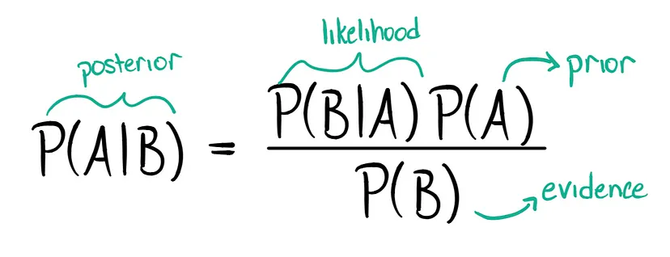
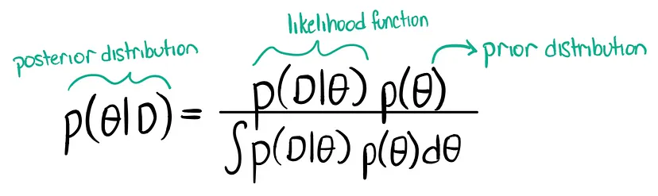
Frequentist versus Bayesian
D means Data
means Model
Likelihood function
ICE- CSIC summer school 2024

Slide 16
Frequentist versus Bayesian
In all cases, a solid understanding of the likelihood function is MANDATORY
Frequentist - What is the probability of random data fitting so well to this model
Bayesian - What is the probability of a Model fitting the data so-well
NULL HYPOTHESIS - In all cases one shall ALWAYS compare the outcome of an experiment against a null hypothesis
NESTED MODELS - For most cases, the null-hypothesis shall be INCLUDED as a particular case of the more complex one
Probability of the data D fitting the model
Probability of MODEL fitting the data
ICE- CSIC summer school 2024

Slide 17
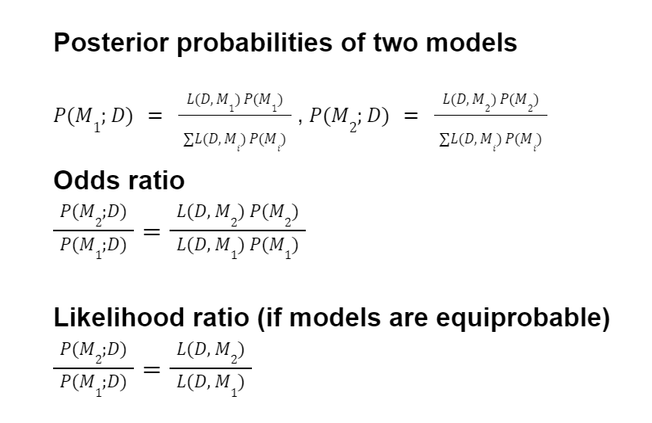
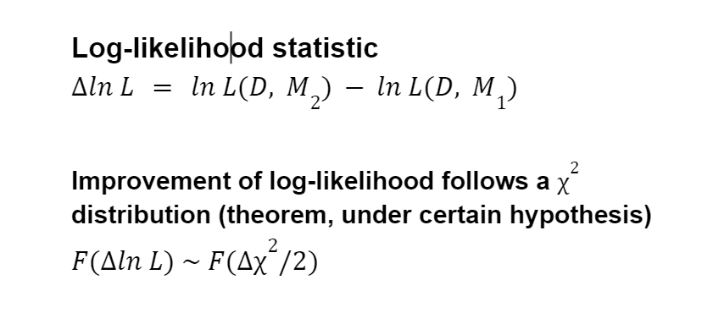
Frequentist tools - Odds ratio and log-likelihood statistic
USE 1 - DETECTION : Comparing NESTED models - Use chi^2 distribution tables (with Nnull and Nmodel parameters) to asses the confindence to which the null hypothesis is discarded.
USE 2 : CHARACTERIZATION : Comparing models with the same number of parameters, the ratio of likelihood is directly how much more probable is one model (e.g set of orbital parameters) against another. Typical threshold for unambiguity is R>150
You can also use Monte Carlo simulations of the noise of the null hypothesis to generate the noise distribution and produce your own calibration of your statistic.
Set a threshold (check literature, typically 99%, 3 sigma, 5 sigma, False Alarm probability, etc.) and if you beat it you can claim that your null hypothesis is discarded with a given probability. If so, you have a DETECTION, as long as you justify that other plausible explanations of your ‘SIGNAL’ are much less probable (CHARACTERIZATION)
PRO : it is fast and easy to compute, but only gives a very local descripcion of your posterior distribution (e.g. Errors, parameter correlations),
CONS : shall be calibrated all the time as data usually does not follow the requirements of the chi^2 theorem.
Also true, even if your likelihood is not Normal independent Gaussians!
Wilk’s Theorem
https://en.wikipedia.org/wiki/Wilks%27_theorem

Slide 18


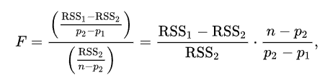
Frequentist tools - Odds ratio and log-likelihood statistic
Bayesian Information Criterion
https://en.wikipedia.org/wiki/Bayesian_information_criterion
Akaike information criterion
https://en.wikipedia.org/wiki/Akaike_information_criterion
F-test (Variances)
https://en.wikipedia.org/wiki/F-test
Wilk’s Theorem
https://en.wikipedia.org/wiki/Wilks%27_theorem

Slide 19
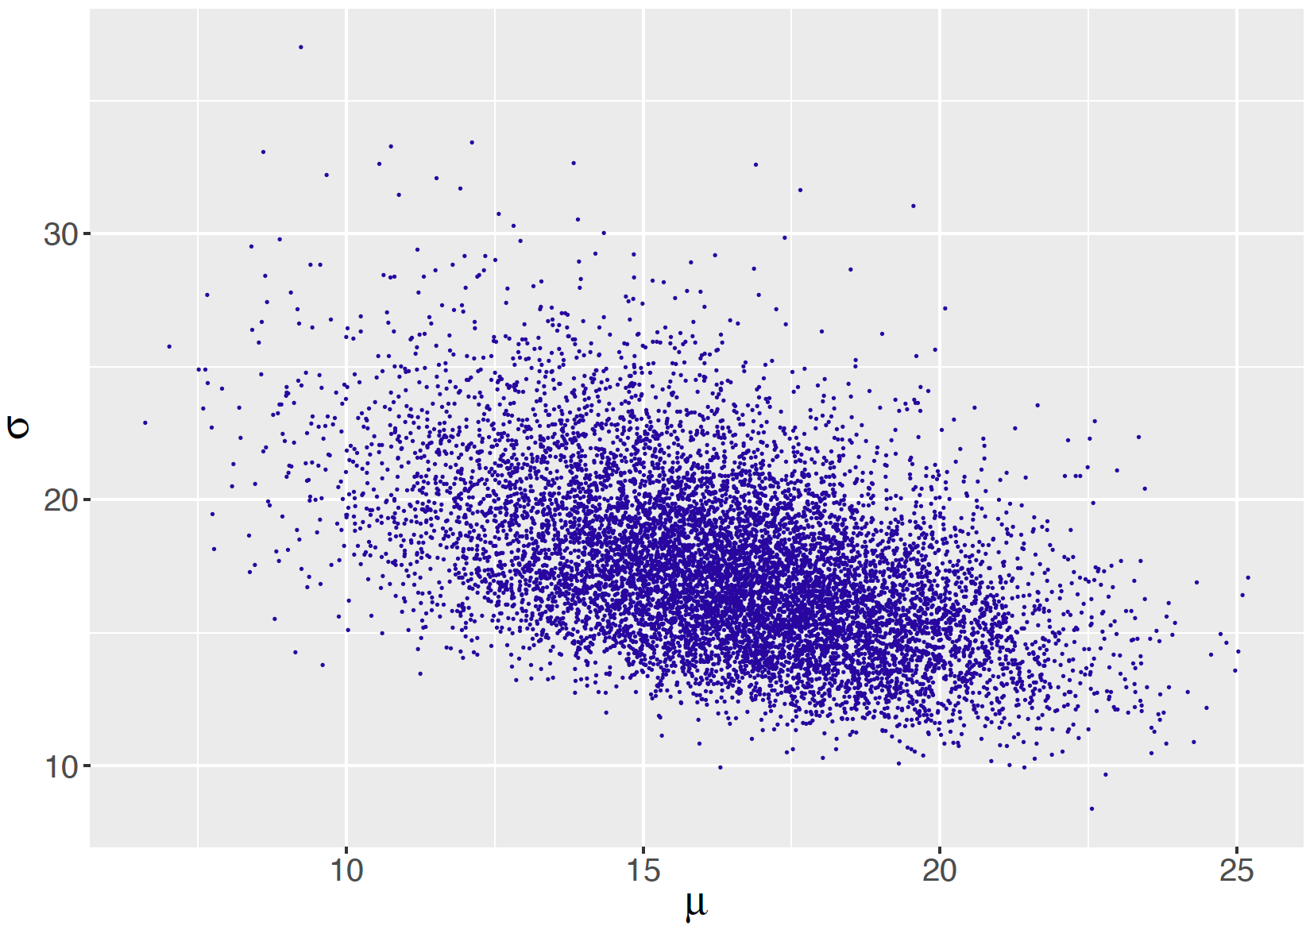
Bayesian tools - Posterior probability (ratio)
One can compare models even if not nested. One then shall perform the ‘Evidence’ integral… which is not always easy.
https://bayesball.github.io/BOOK/simulation-by-markov-chain-monte-carlo.html
For NESTED models, it is about calculating the integrated probability around you ‘detection’ parameters, and around ‘zero’. Steps :
Sample your posterior using MCMC
Compute the standard expected value and standard deviation of your detection parameter.
Numerically compute the integral of the posterior around the expected value and (say) 3-4 sigma from it.
Numerically compute the integral of the posterior around ‘zero’ and 3-4 sigma
Compute the ratio. If a threshold is passed, then you have a detection.
Repeat the process on other few regions of the parameter space where the posterior is not negligible (if needed) to ensure Statistical characterisation
ICE- CSIC summer school 2024

Slide 20
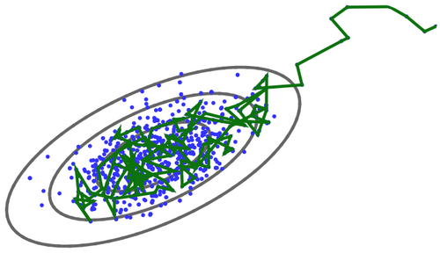
Bayesian tools - Monte Carlo Markov Chain
Non-linear solvers will help you converge to the local minima. MCMC is a way to both converge to optimal minima while sampling the posterior probability distribution on the space of parameters.
It is basically a random walker, that will accept the next step if the posterior (or likelihood) improves, and walk away with certain probability.
The result is a distribution what you can use directly to produce your paper table values (and uncertainties) by computing expected values numerically
MCMC walker sampling the posterior distribution of two (locally linear) parameters
ICE- CSIC summer school 2024

Slide 21
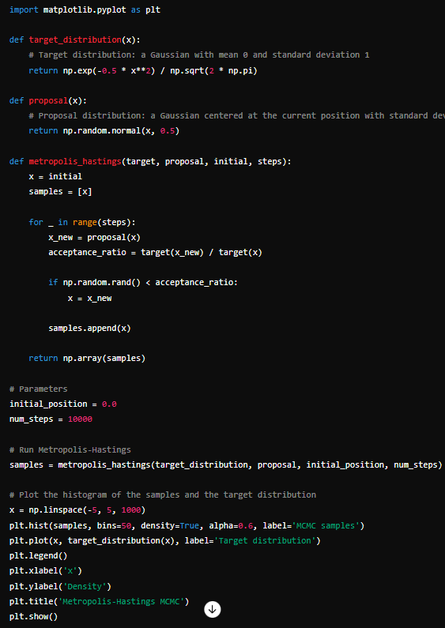
Bayesian tools - Metropolis-Hastings MCMC
ChatGPT prompt (July 2, 2024)
Can you provide me with a simple code to implement the metropolis algorithm for a Monte Carlo Markov Chain code?
ICE- CSIC summer school 2024

Slide 22
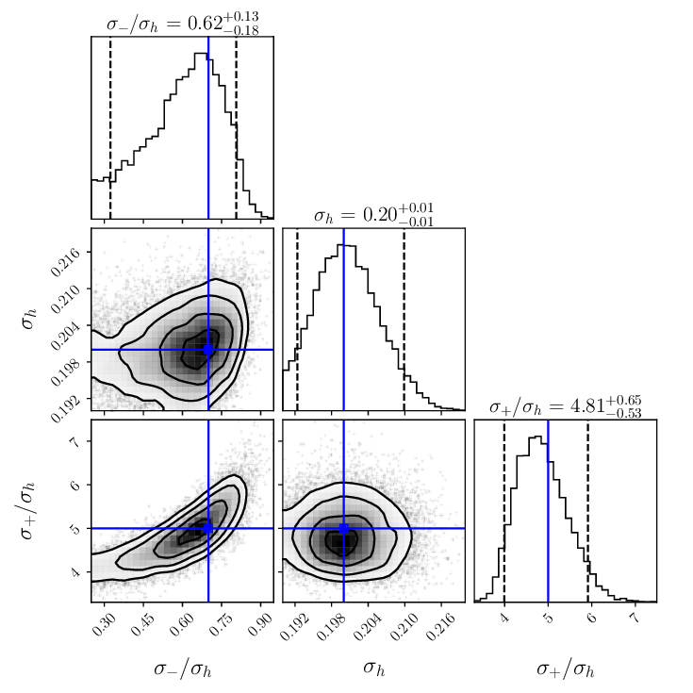
Bayesian tools - statistical characterisation of parameters
True power is on parameter estimation. An MCMC process produces a cloud of points reproducing your posterior distribution. provide meaningful ‘error bars’
(in)Famous corner plot example with 3 parameters
From an MCMC cloud it is trivial to compute
The expected values - Number that you will put in your paper results
Confidence intervals : integrate to the left and to the right until you have 68% of your probability which will be your 1-sigma error
Produce correlation plots which can be awesome…

Slide 23
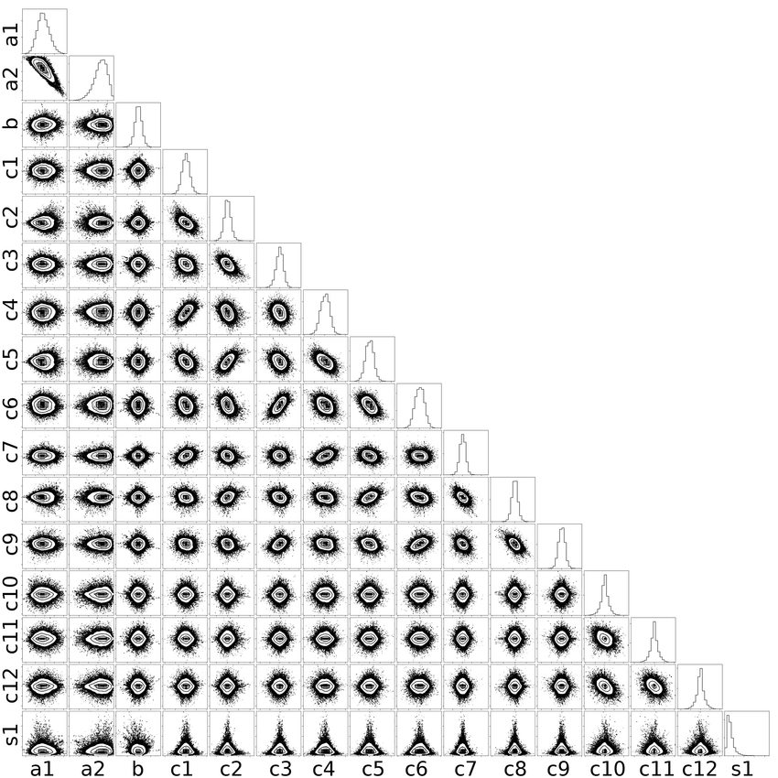
Bayesian tools - statistical characterisation of parameters
…or horrible!
Request - do NOT put corner plots like this in a paper (or at least move it to the appendices). Showing a couple MCMC samplings of the most relevant parameters is sufficient to illustrate a few key points or degeneracies
Corner plot with 16 parameters

Slide 24
Recommendation (personal)
Use frequentist log-likelihood ratios for quick examination for significance assessments of various models (with or without noise, one or two planets, etc).
If you feel confident with the algorithms, provide the evidence integrals performed with care with one of the available softwares (E.g. GEORGE/Python). Beware of non-linearities and local minima issues.
Run generous MCMCs and look at the (horrible) corner plots so you are sure non of your parameters is behaving strangely (discrete distributions, close to the edge, high degeneracy, etc).
Put expected values, and confidence intervals in tables, show one or two 2D plots of your more relevant variables (e.g. period, transit depth, molecule scale height, magnetic field intensity, etc.)
Read a few papers to get a grasp of what is used in your subfield.
Each subfield has its own thresholds and criteria to call for statistical detection.
On the other hand statistical characterisation thresholds are more universal (typically R>150).
If you are doing something VERY novel, DO NOT INNOVATE too much with your statistics, or no-one will believe it.
Bayesian is NOT ‘magic’ : what passes Bayesian tests shall also pass frequentist tests (and vice versa)
Unless you are SUPER excited and the result is super clear (e.g. verified independently) try to use sentences like
“The data is consistent with the presence of a planet…”,”We detect a signal…”
rather than
“We report the discovery of a planet…”, “We found 3 planets around…”
ICE- CSIC summer school 2024

Slide 25
Non-linear problems
Linear problems. The linearity condition comes from your math textbooks. A function f(a) is linear with a, if
f(a + b) = f(a) + f(b)
f(k * a) = k f(a)
Where this f is the optimisation condition to be solved. Linear problems can be analytically solved VERY FAST!
In data analysis, a non-linear problem can emerge
Intrinsically non-linear (e.g. Keplerian parameters)
‘Optimal’ condition for the ‘statistic’ is non-linear (e.g. gaussian log-likelihood with jitter)
Finding the optimal solution for non-linear problems requires iterative numerical procedures, even with the simplest of the ‘statistics’
ICE- CSIC summer school 2024

Slide 26
Non-linear problems - Simplest examples
Fully linear problem
Linear regression
(apparently) Non-linear problem
Linear regression with squared parameters
Non-linear problem due to statistic
Adding jitter to a Gaussian likelihood
General non-linear problem
likelihood function as a GP, model is a Keplerian solution
ICE- CSIC summer school 2024

Slide 27
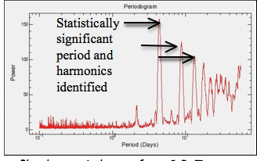
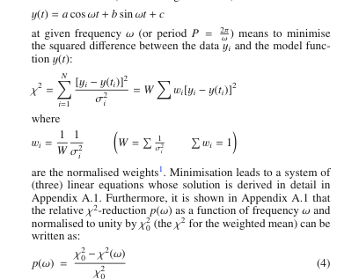

Nonlinear problems : periodograms
Finding the best sinusoid model that fits the data in a least squares sense.
One VERY nonlinear parameter (frequency 𝜈)
Three linear parameters (A and B amplitudes, and C constant offset)
Lomb-Scargle 1979-> Fix the non-linear parameter 𝜈, solve for the linear ones (regular linear regression), and repeat the process of all possible 𝜈 . Make a plot of the optimal value of the statistic as a function of 𝜈 (periodogram plot)
Zechmeister 2009, A&A
ICE- CSIC summer school 2024

Slide 28
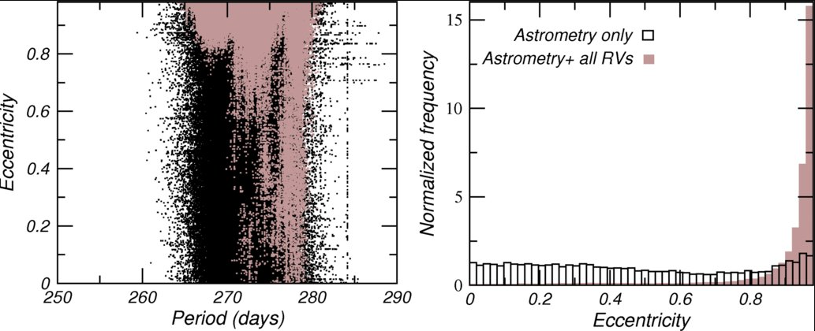
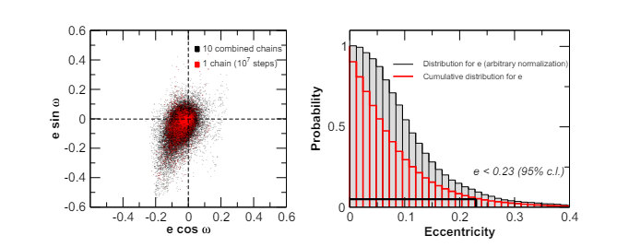
Examples
ICE- CSIC summer school 2024

Slide 29
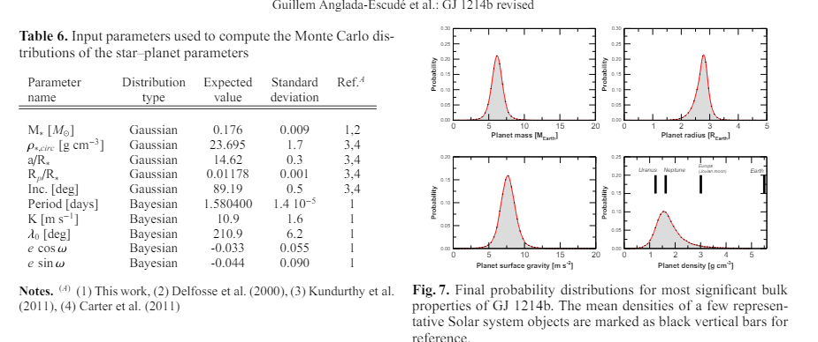
Examples
ICE- CSIC summer school 2024

Slide 30
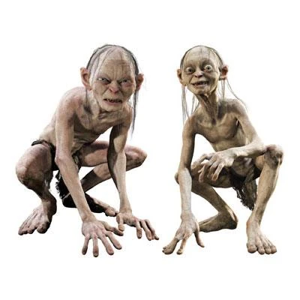
Noise models : from white noise to correlated noise
Your measurements may not be (fully) statistically independent. What this means? Means that, for some reason, the measurement of day 1 is related to the measurement of day 2.
The likelihood as a complete description of your data and model comes fully into focus here.
Modelling an effect as a Gaussian process or as an explicit part of a model is a matter of choice (or available information, or computational power…)
Likelihood function
Statistically independent measurements
Statistically dependent measurements
explicit part of a model
Covariances : Gaussian processes
ICE- CSIC summer school 2024

Slide 31
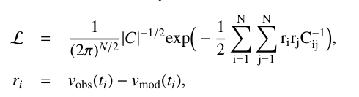
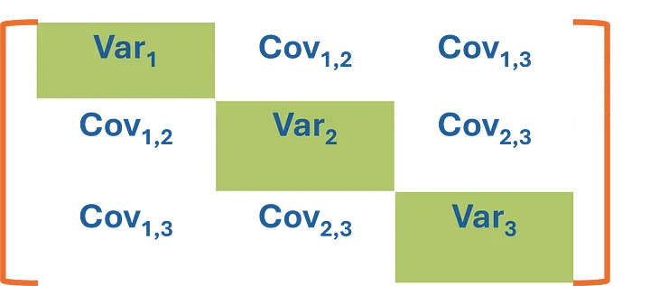

Gaussian Processes
ICE- CSIC summer school 2024

Slide 32
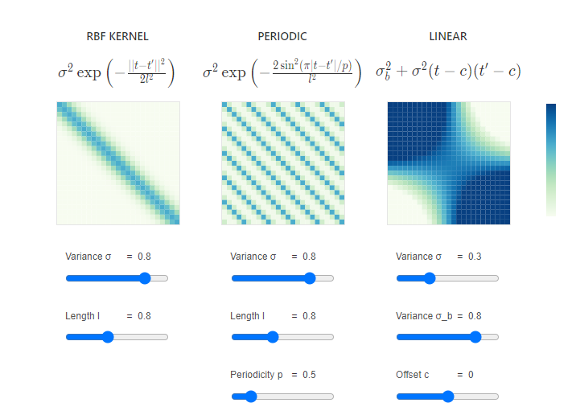
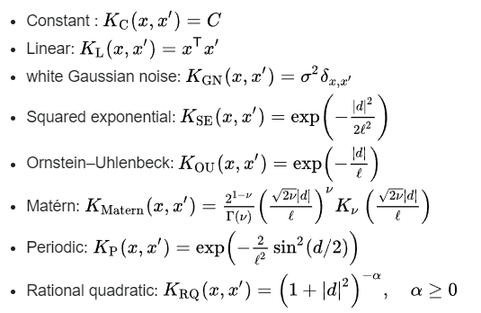
Gaussian processes : kernels I (math motivated)
https://distill.pub/2019/visual-exploration-gaussian-processes/
ICE- CSIC summer school 2024

Slide 33
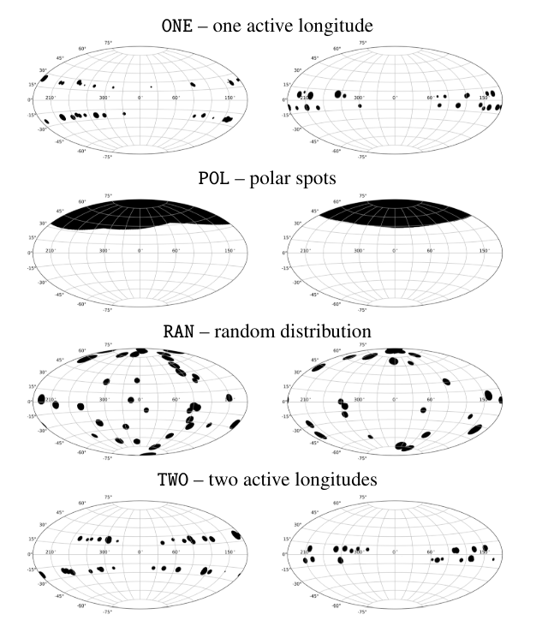
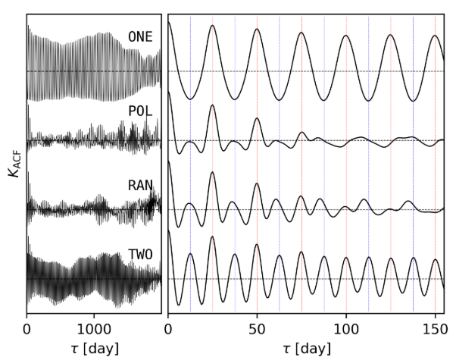

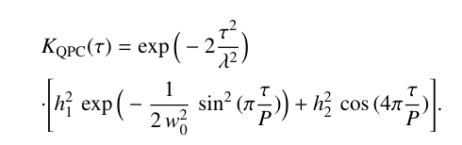
Gaussian processes : kernels II (physically motivated)
Perger, Anglada-Escudé… Ribas, J.C. Morales 2021 A&A
https://ui.adsabs.harvard.edu/abs/2021A%26A...645A..58P/abstract
ICE- CSIC summer school 2024

Slide 34
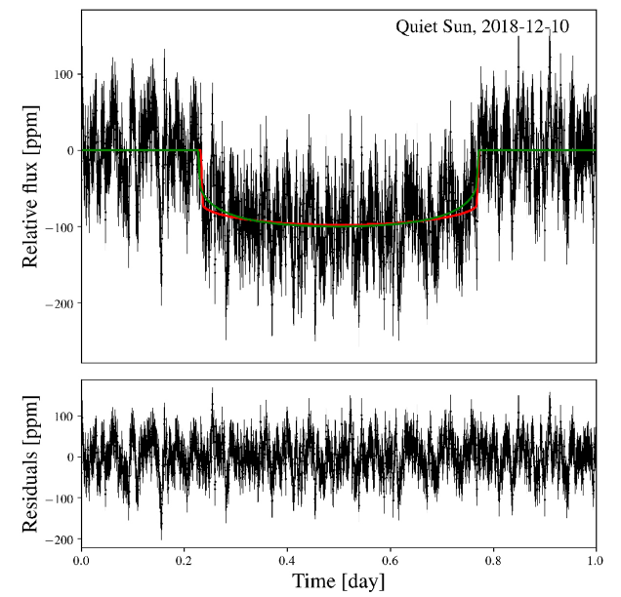
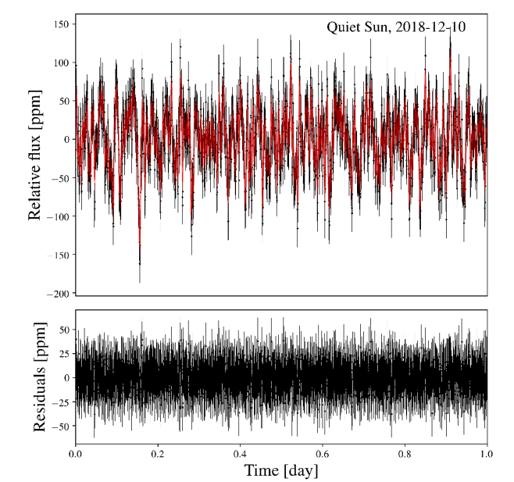
Gaussian processes - others
Mitigating flicker noise in high-precision photometry
I. Characterization of the noise structure, impact on the inferred transit parameters, and predictions for CHEOPS observations, A&A 2020
S. Sulis, M. Lendl, S. Hofmeister, A. Veronig, L. Fossati, P. Cubillos and V. Van Grootel
ICE- CSIC summer school 2024

Slide 35
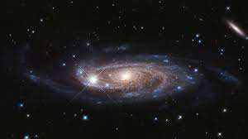
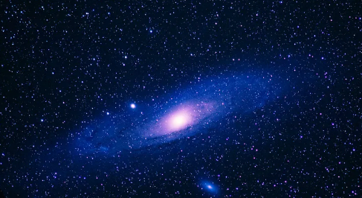
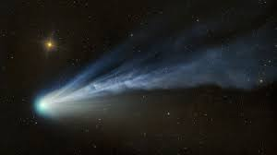


Model inversion problem and machine learning
Recovering the physically relevant parameters from your data can be challenging (nonlinear models, statistics, noise, sampling, etc).
… but it is even worse.
Having perfectly sophisticated simulation and codes able to reproduce realistic data does NOT imply that you know can recover the physically relevant parameters from it.
Simulations are an ‘injection’ from parameter space to data (look at your algebra textbook). Exploring the cosmos involves finding the ‘inverse’ of this injection, which may not always exist, or can only be partially solved (so-called degeneracies)
ICE- CSIC summer school 2024

Slide 36
Inversion of highly complex models - classic approach
Nothing else to add. It is what you have seen!
ICE- CSIC summer school 2024

Slide 37
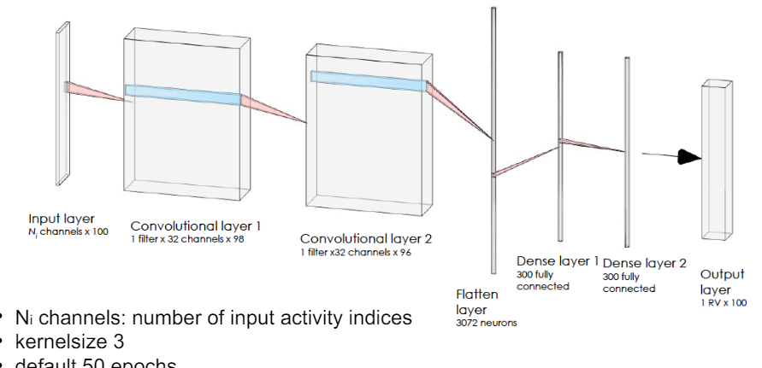
Inversion of highly complex models - Machine learning/AI
Instead of fitting, generate a large sample of realistic observations and train algorithms to extract the relevant information without explicitly coding everything (Manuel’s Perger lecture on Thursday!)
Input : simulated observations
Output : simulated precision measurements
The algorithm tunes itself to find the sufficient inverse problem
ICE- CSIC summer school 2024

Slide 38
Other uses of Machine learning/AI
Classification
Population analysis
Measuring dimensionality
Image reconstruction
Abstract writing for talks
…
There are supervised and unsupervised techniques, which have different uses.
Again, see Manuel’s lecture on Thursday
ICE- CSIC summer school 2024

Slide 39
Summary
Understand your fundamental statistics
Likelihood function : understand your data
Detection is a model comparison problem: null case vs possible models
Noise : it is part of the model of your data. Can be explicit or implicit (GPs)
Inversion of complex models - Algorithmic versus machine learning methods
Active research on : stellar ‘noise’, instrumental ‘noise’, combination of heterogeneous datasets & prior literature knowledge (see other lectures!)
This applies to EVERYTHING (spectra, photometry, time-series, imaging, intensity maps, bitcoin forecast, etc.), even to the strength of the connections in your brain training to make sense of all this information.
ICE- CSIC summer school 2024

