Slide 1
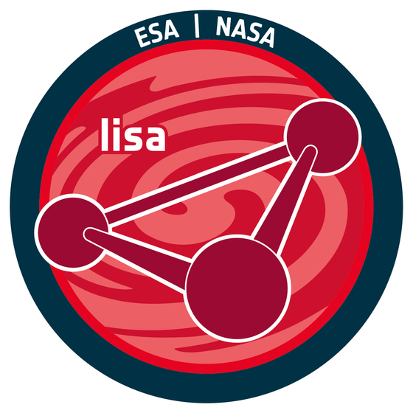
LISA Spain Meeting 2024
The LISA MISSION AFTER ADOPTION
Carlos F. Sopuerta
Institute of Space Sciences (ICE-CSIC & IEEC)

Slide 2
The Gravitational Wave Spectrum
Sismic+Newtonian
Noise
Credit: Ira
Thorpe (NASA)
$$f_{GW}^{}↓(λ_{GW}^{}↑)⟹L_{arm}^{}↑M_{GW−Source}↑$$

Slide 3
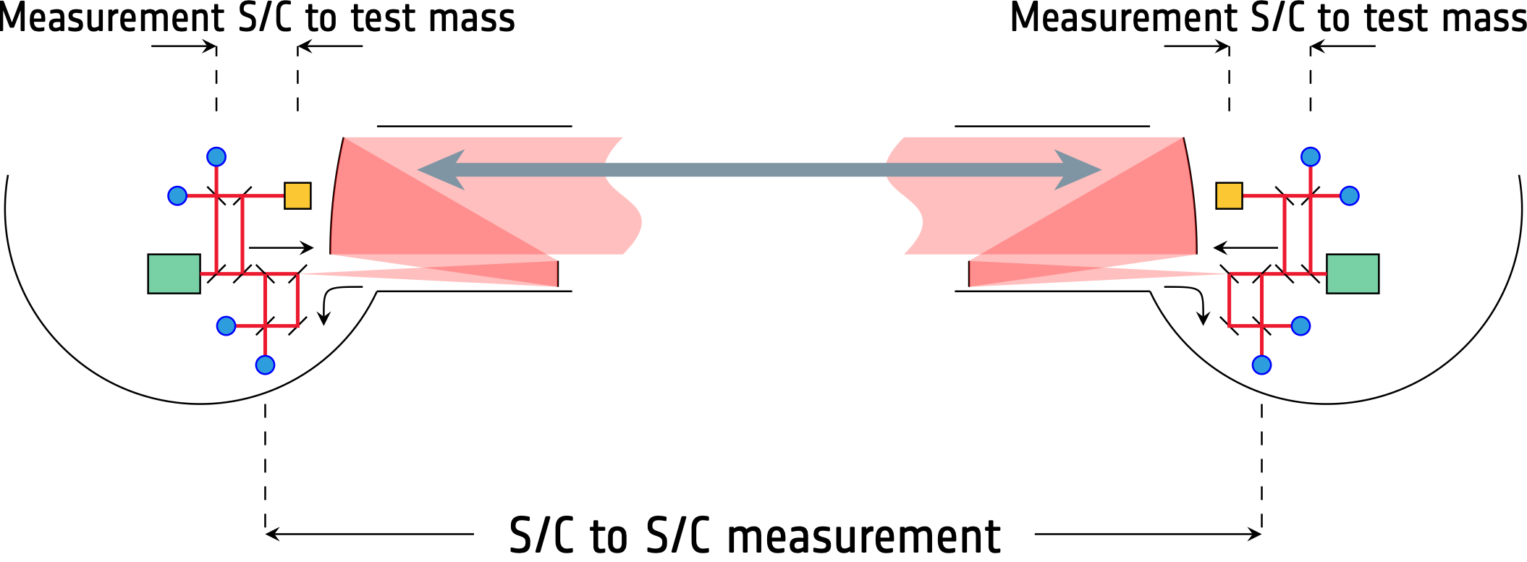
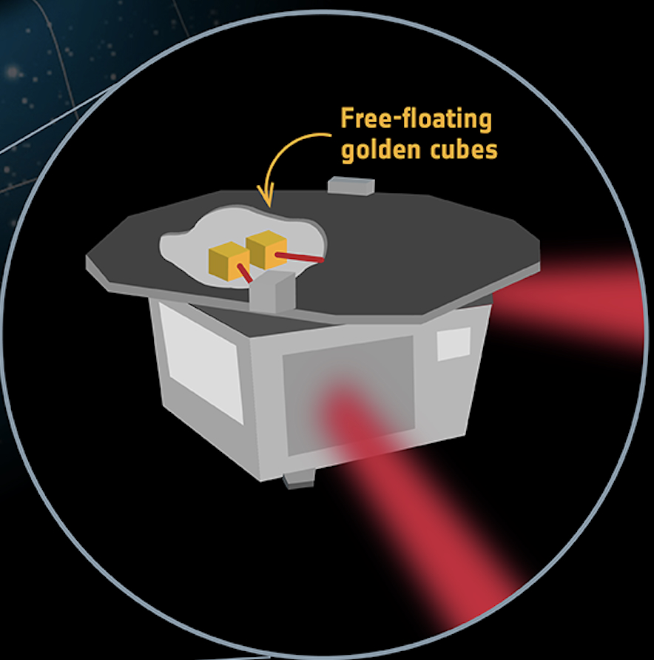
LISA mission concept after adoption
With such baselines we cannot use mirrors for reflection (LISA ≠LIGO in Space). Active mirrors with phase locked laser transponders on the S/C will be implemented.
Passive Orbits

Slide 4
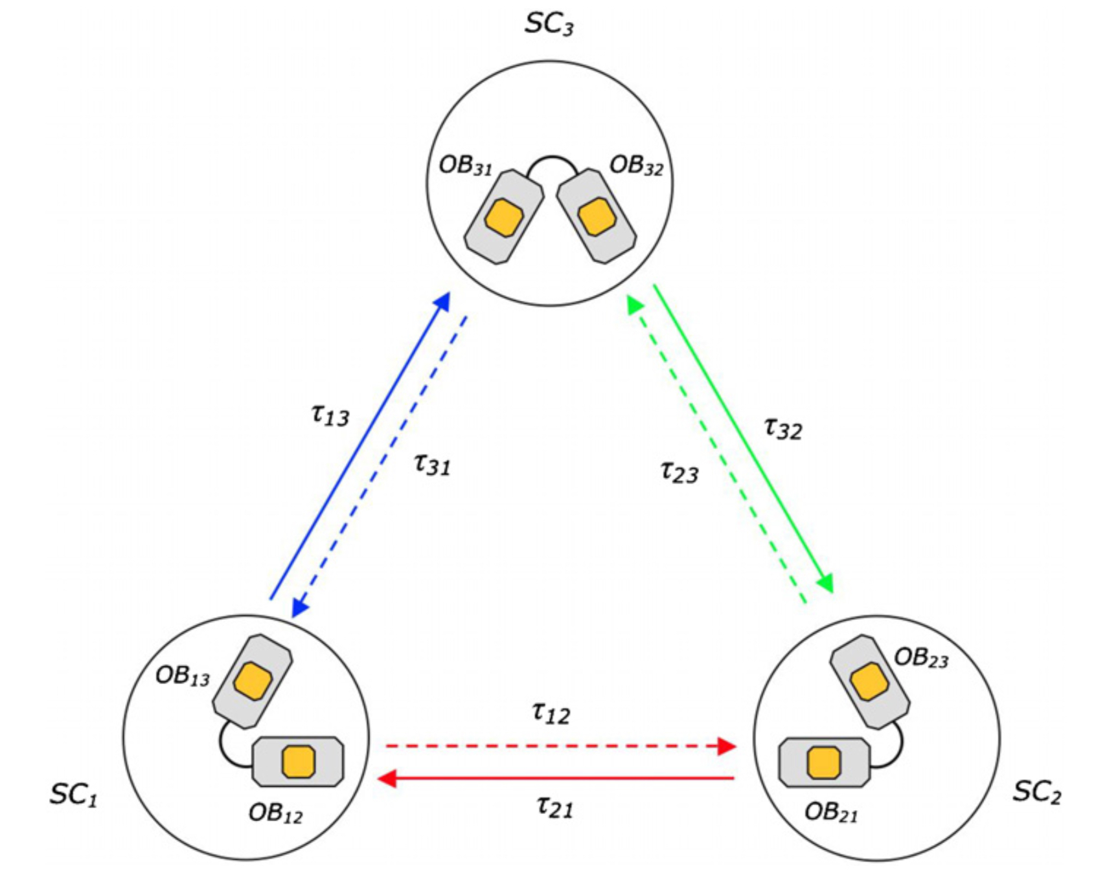
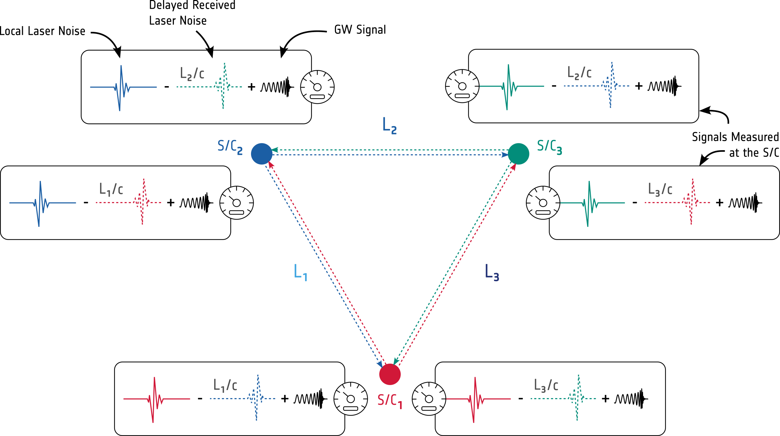
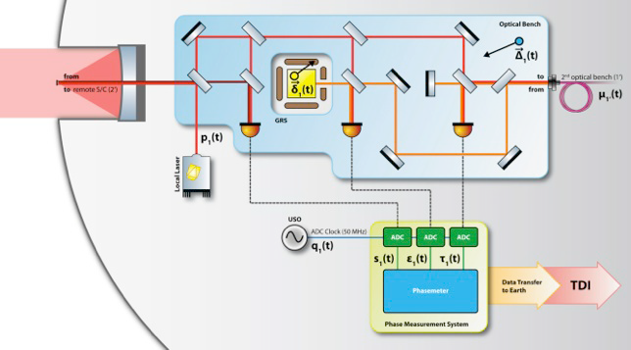
Gravitational Wave Detection from Space
Time-delay interferometry (TDI): Correlations in the frequency noise can be calculated and subtracted by algebraically combining phase measurements from different craft delayed by the multiples of the time delay between the spacecrafts.

Slide 5
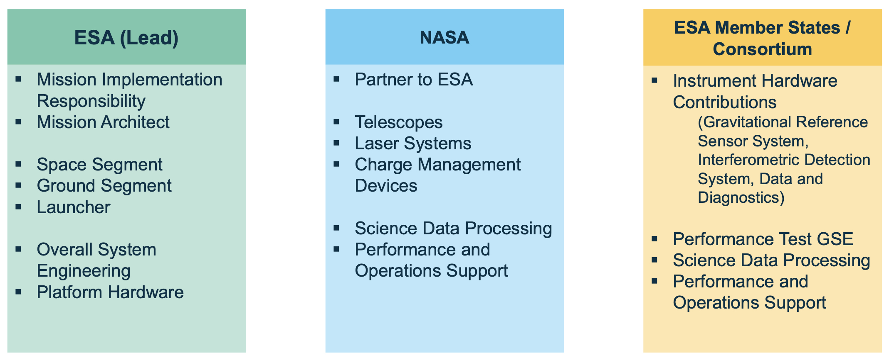
LISA “boundary conditions”
Main Players
Main Instrumental Contributions

Slide 6
How did we get here?
LISA after the selection: Future Missions Department
2023-2024: Mission Adoption Review (independent ESA review): Evaluated the mission definition maturity, technology readiness and implementation risks. A dedicated review panel was devoted to the mission programmatic elements including cost, schedule and interfaces with partners. Results are made available to the SPC and constitute, together with SSAC scientific assessment, the basis of ESA's recommendation to the SPC to implement the mission.
2017-2024: LISA went through the Mission Preparation Phase: The Assessment Phase (Phases 0 and A) and Definition Phase (Phase B1), separated by the Mission Formulation Review.
Passive Orbits

Slide 7
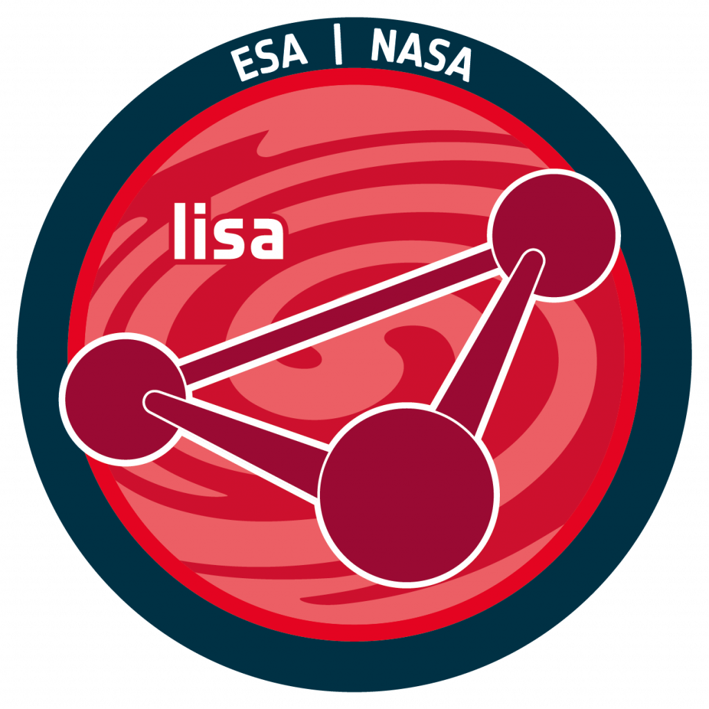
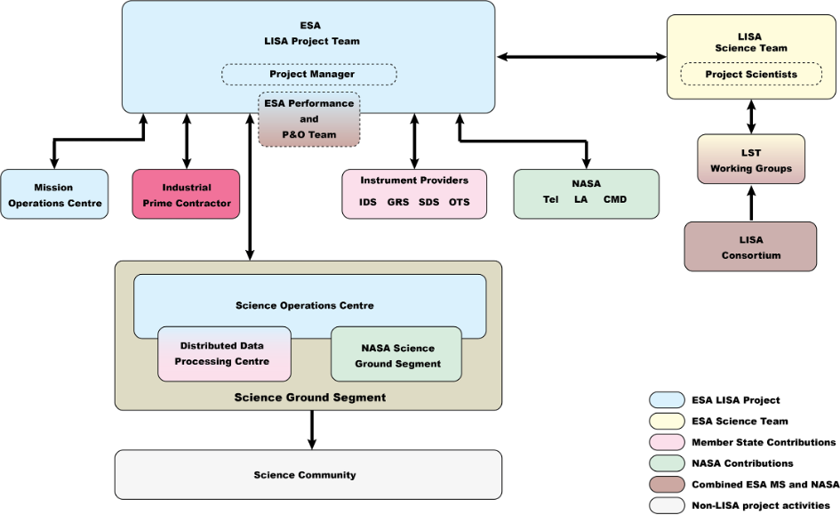
LISA Management Structure (Implementation Phase)
According to the
Science
Management
Plan (SMP)

Slide 8
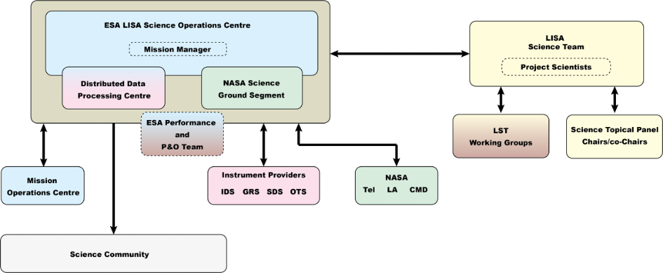
LISA Management Structure (Operations Phase)
According to the Science Management Plan (SMP)

Slide 9
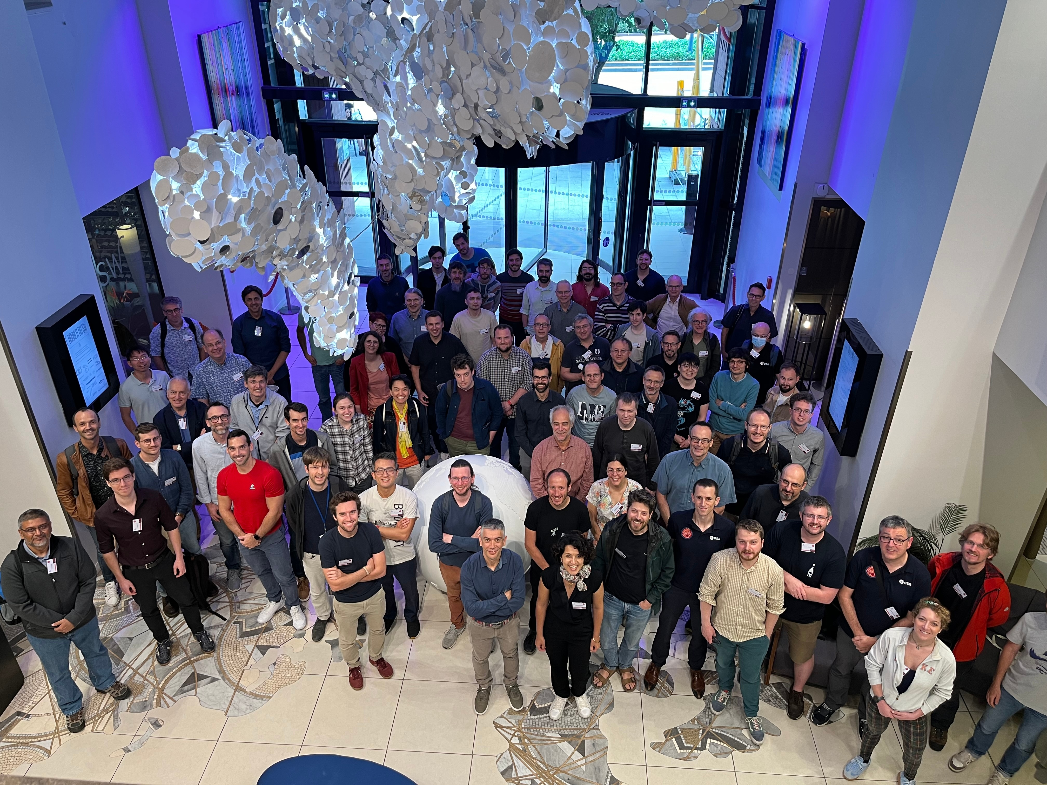
LISA Scientific Operations
Spanish Contribution to the LISA Ground Segment, as established in the Multi-Lateral Agreement (MLA) between ESA and member states:
Toulouse (France)

Slide 10
Acknowledgements
Work in LISA has been supported by contracts PID2019-106515GB-I00 and PID2022-137674NB-I00 (MCIN/AEI/10.13039/501100011033) and 2017-SGR-1469 and 2021-SGR-01529 (AGAUR, Generalitat de Catalunya). This work has been also partially supported by the program Unidad de Excelencia María de Maeztu CEX2020-001058-M (Spanish Ministry of Science and Innovation).
Many Thanks for your attention!

