Slide 1
Temperature and Magnetic Diagnostic subsystem in LISA
LISA Spain Meeting 2024
ICE, Barcelona

Slide 2
Outline
SDS Overview
Magnetics Subsystem
Audio-band magnetometer
Low-frequency magnetometer
Temperature Subsystem
Diagnostics Acquisition & Control Unit (DACU)
Summary

Slide 3
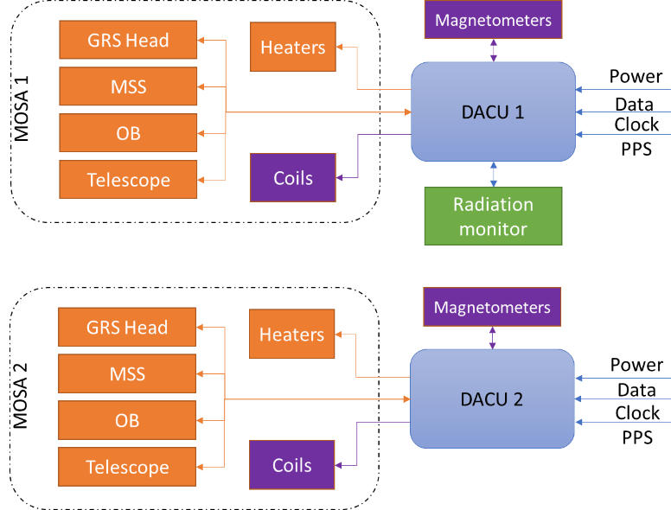
SDS Overview
Characterize and monitor the environment of LISA:
Charged particles
Temperature
Magnetic Field
Notes:
Moving Optical Subsystem Assemblies
MOSA Support Structure

Slide 4
SDS Product Tree
Science Diagnostics System
(items per s/c)
60000
DACU (2)
61000
HEAT (8)
64000
COIL (2)
66000
THER (48)
65000
RM (1)
63000
MAG (6)
62000
HARN (19)
67000
Mechanical Housing (2)
61100
Power Board (4)
61200
Control Board (4)
61300
Analog (4)
61400
Mechanical Housing (6)
62100
Magnetometer (6)
62200
Mechanical Housing (1)
63100
Sensors (1)
63200
Electronics front-end (1)
63300
NTC Sensors (40)
65100
PRT sensor (8)
65200
Harness DACU-RM (1)
67100
Harness DACU-MAG (6)
67200
Harness DACU-COIL (2)
67300
Harness connector bracket DACU-MOSA (2)
67400
Harness connector bracket GRS (2)
67500
Harness connector bracket Telescope (2)
67600
Harness connector bracket OB (2)
67700
Harness connector bracket MSS (2)
67800
Platform
GRS
OB, GRS, Telescope, MSS

Slide 5
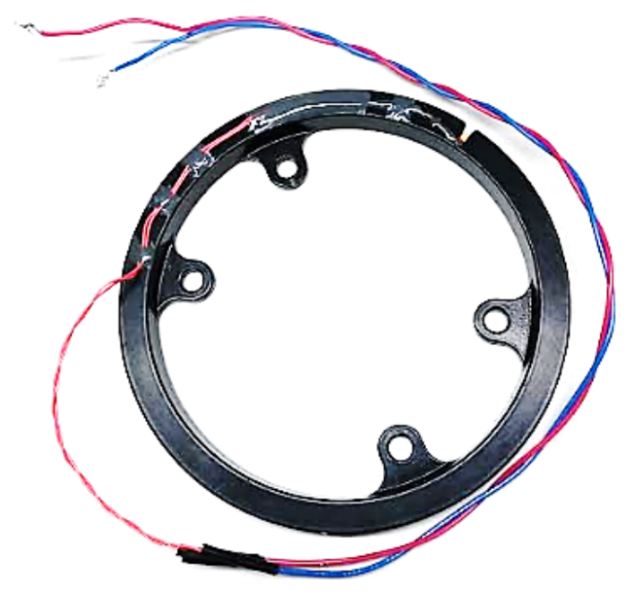
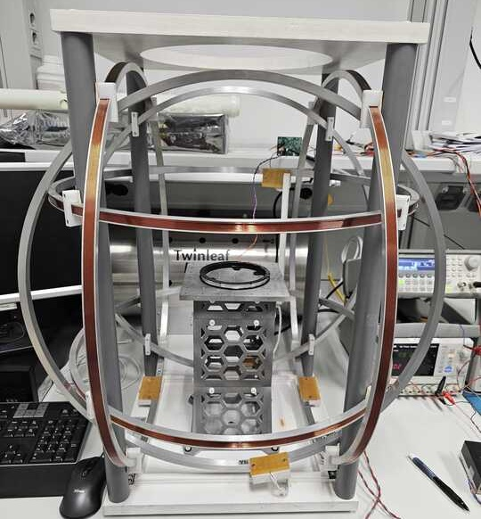
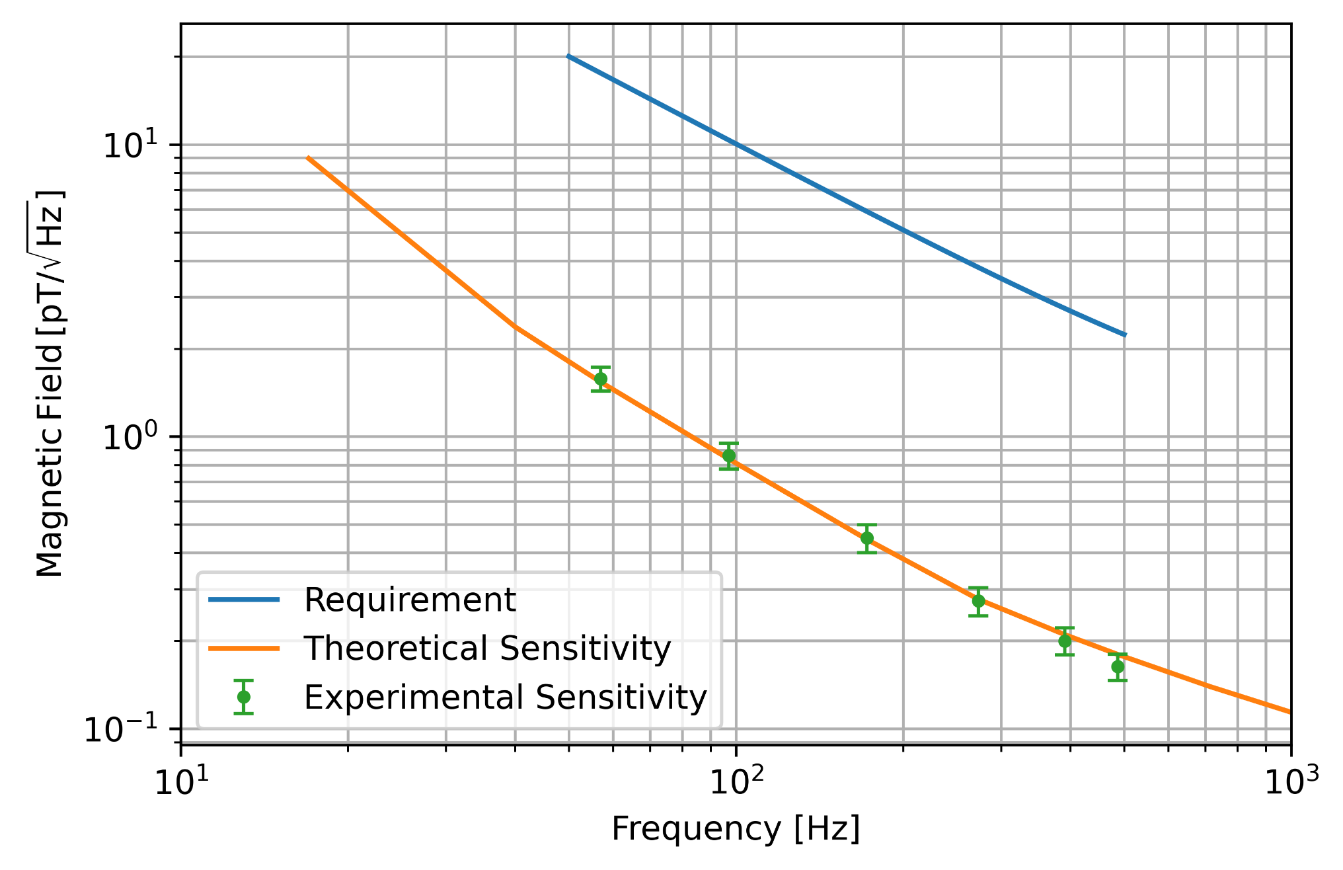
Diagnostics – Audio frequency magnetometer
Based on LPF coil and placed on the GRSH.
Sensitivity characterized, WIP for equivalent noise.

Slide 6
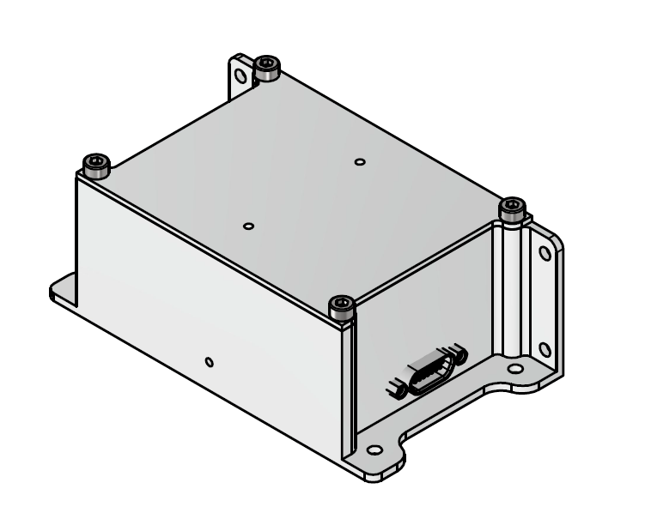
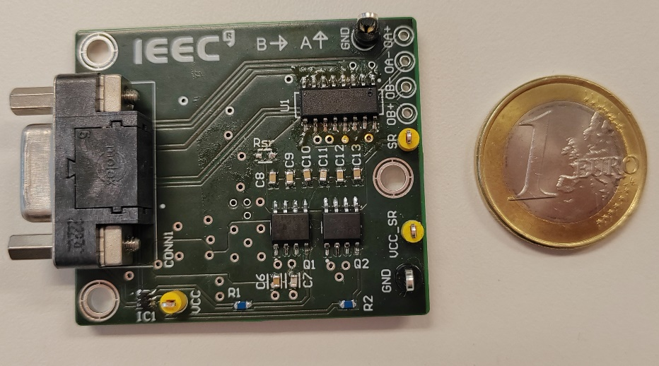
Diagnostics – Low-frequency magnetometer
Based on Anisotropic Magnetoresistive (AMR) 2-D sensors, allowing having less power dissipation and magnetic material content than fluxgate sensors. Thus, less impact at critical locations in LISA.
Performance sensing range: ± 10 µT with 2 % absolute accuracy.

Slide 7
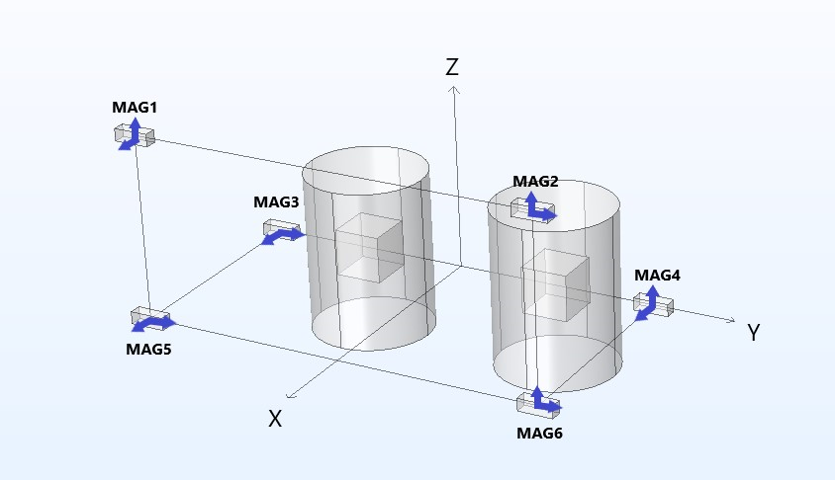
Diagnostics – Low-frequency magnetometer
They shall allow characterizing both the absolute magnetic field and its gradients in all three axes/directions. The proposed distribution is complaint with this, even in the case of failure of one of the magnetometers.

Slide 8
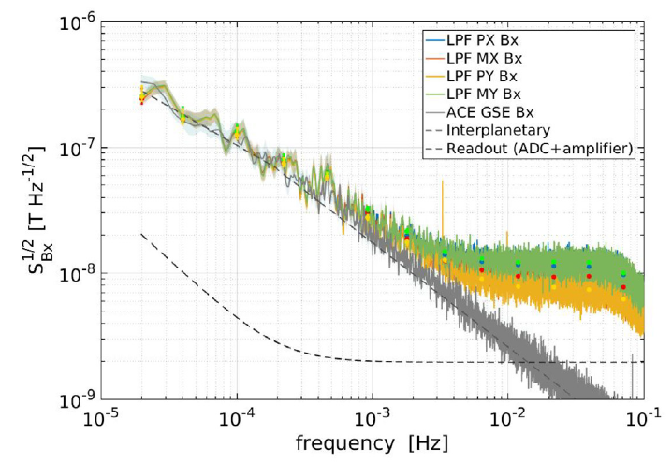
Low-frequency magnetometer requirements
• Stability from 0.1 Hz down to 0.1 mHz:
• Volume (W x L x H): 35 x 83 x 32 mm
• Max. power dissipation: 100 mW each
• Maximum mass: 140 g
• 6 sensors per spacecraft
• LPF used tri-axial fluxgates
$10{\left[1+{\left(\frac{1 mHz}{f}\right)}^{2}\right]}^{\frac{1}{2}} nT/\sqrt{Hz}$
[https://doi.org/10.1093/mnras/staa830]
8/14

Slide 9
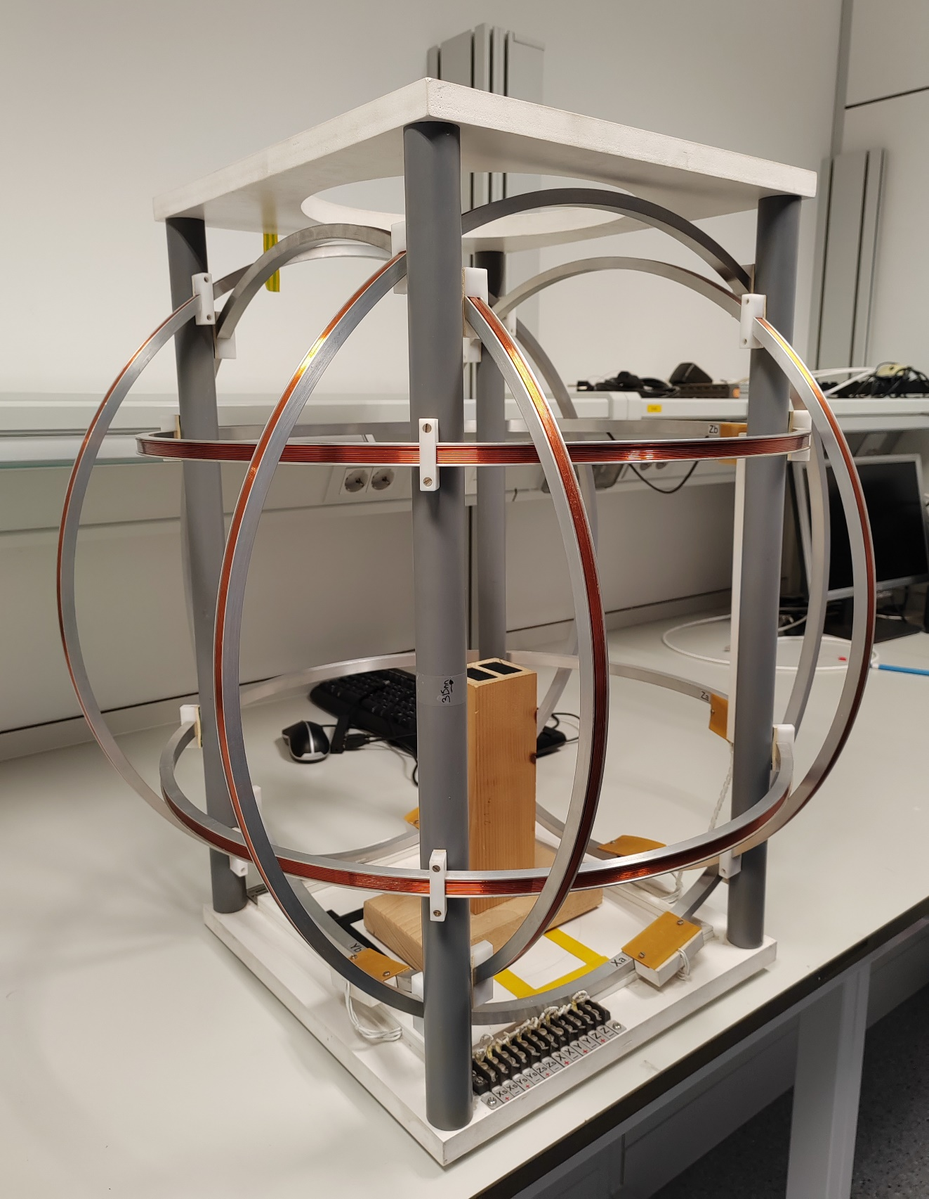
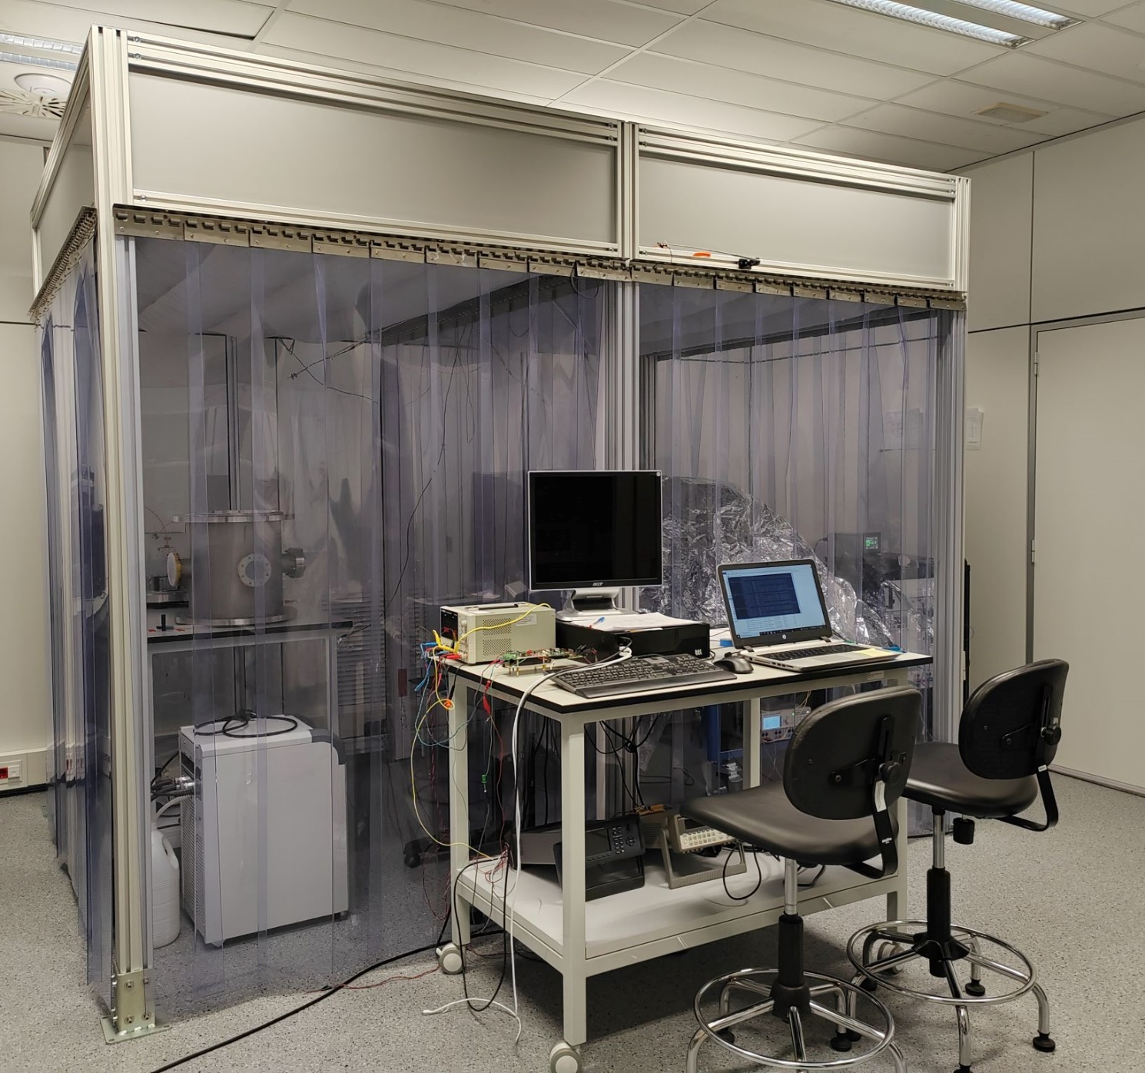
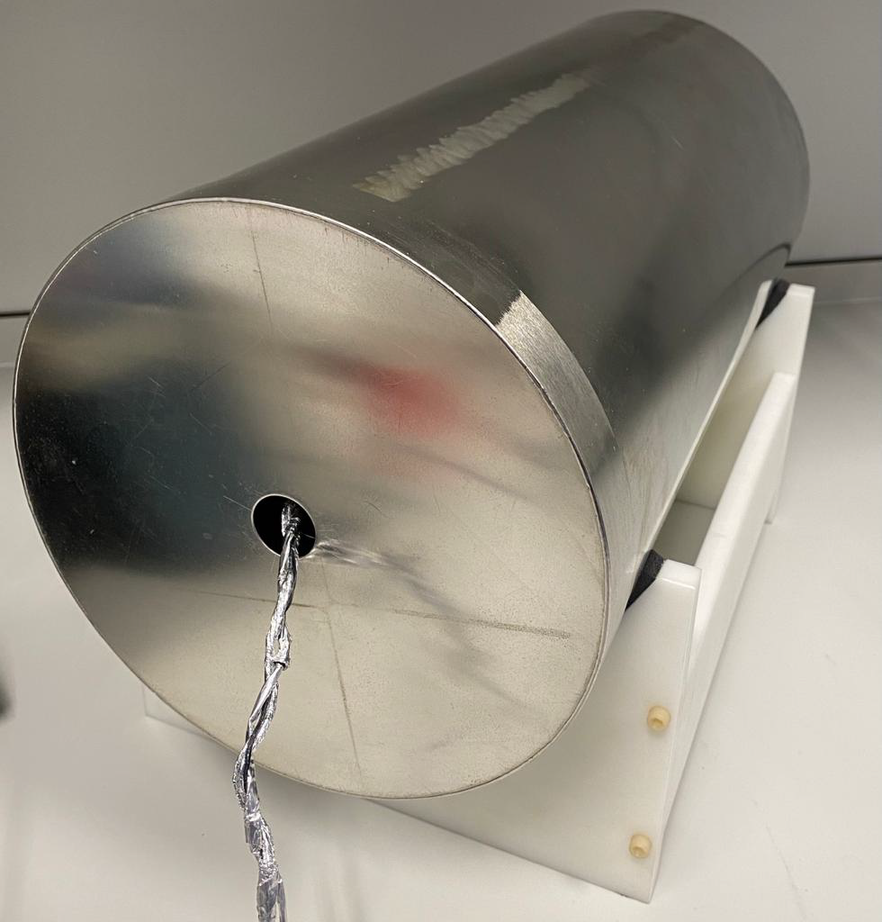
Magnetic Set Up
Helmholtz Coil
Temperature controlled chamber
Mu-metal chamber
9/14

Slide 10
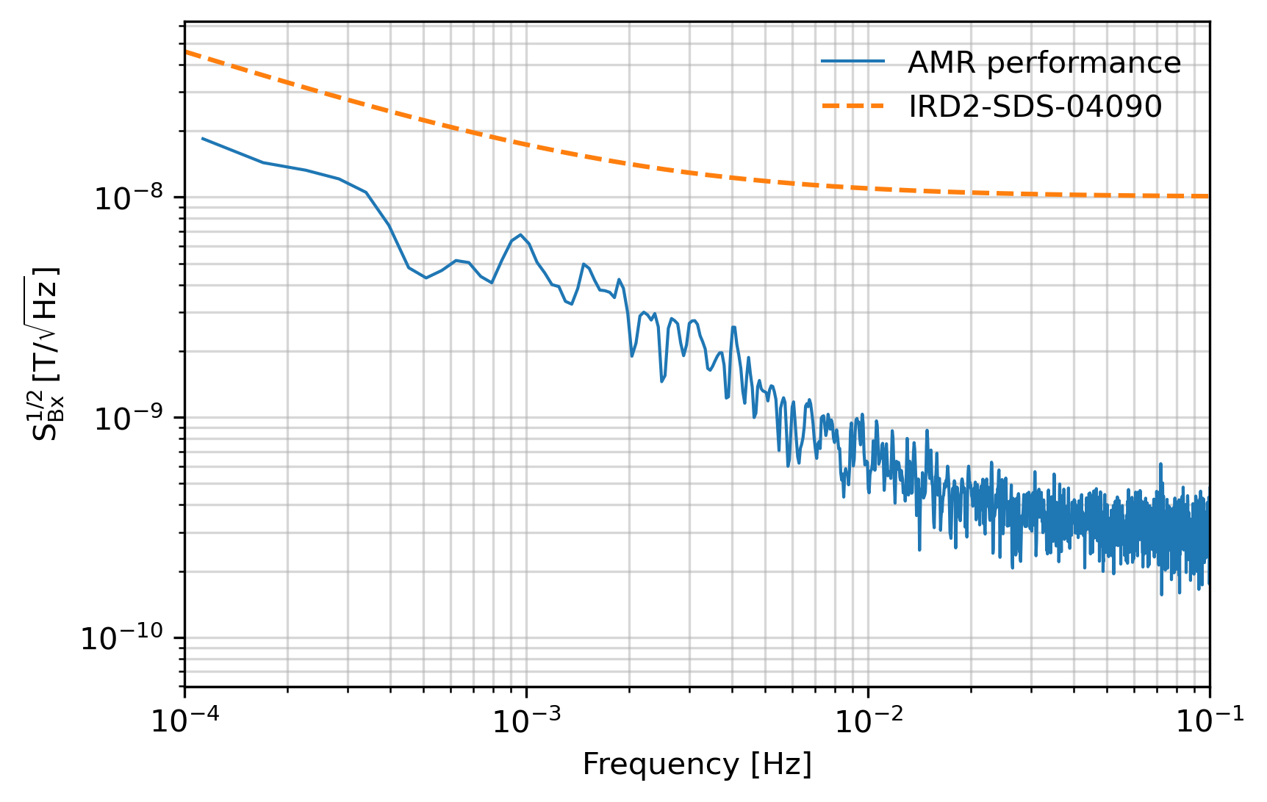
Diagnostics – Low-frequency magnetometer
Noise performance below requirements.
Conditions:
3 layers of mu-metal
Inside the ATCU

Slide 11
Diagnostics – Temperature sensors
Sensor's quantity is per MOSA (two per S/C, three S/C in the LISA constellation)
Unit | Sensors | Sensor kind | Temperature range | Thermal stability (0.1 Hz down to 0.1 mHz)
Telescope | 7 (6+1R) | 10k NTC | (-10°C) 0°C to +30°C | $10 {\left[1+{\left(\frac{2 mHz}{f}\right)}^{4}\right]}^{1/2}$ µK/$\sqrt{Hz}$
GRSH | 4 | 10k Pt RTD | (+5°C) +13°C to +27°C | $20 {\left[1+{\left(\frac{2 mHz}{f}\right)}^{2}\right]}^{1/2}$ µK/$\sqrt{Hz}$
MSS | 6 | 10k NTC | (-10°C) +6°C to +34°C | $10 {\left[1+{\left(\frac{2 mHz}{f}\right)}^{4}\right]}^{1/2}$ µK/$\sqrt{Hz}$
OB | 7 | 10k NTC | (-10°C) +6°C to +34°C | $10 {\left[1+{\left(\frac{2 mHz}{f}\right)}^{4}\right]}^{1/2}$ µK/$\sqrt{Hz}$
() = Aim for degraded performance range
Pt RTD placed at magnetic sensitive locations, but have reduced sensitivity

Slide 12
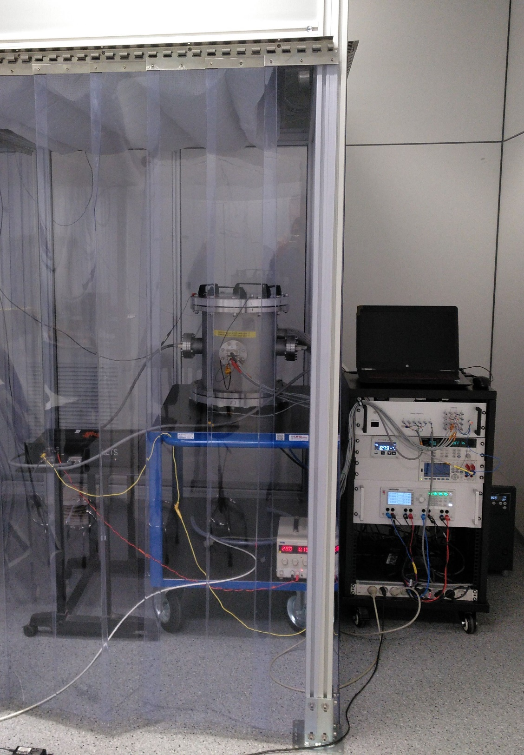
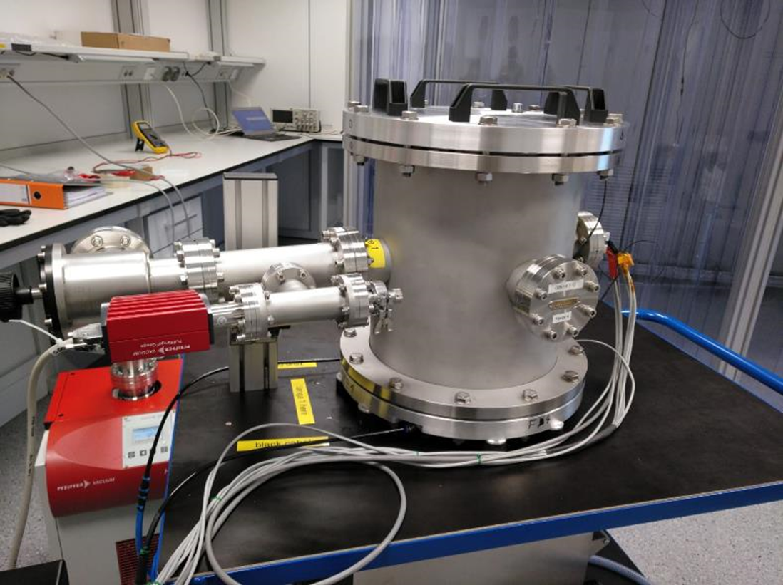
Diagnostics – Testing is challenging
Join us for a lab tour!
Layers placed inside a vacuum chamber to reduce convection thermal transfer
And inside ICE’s special thermal stabilized enclosure

Slide 13
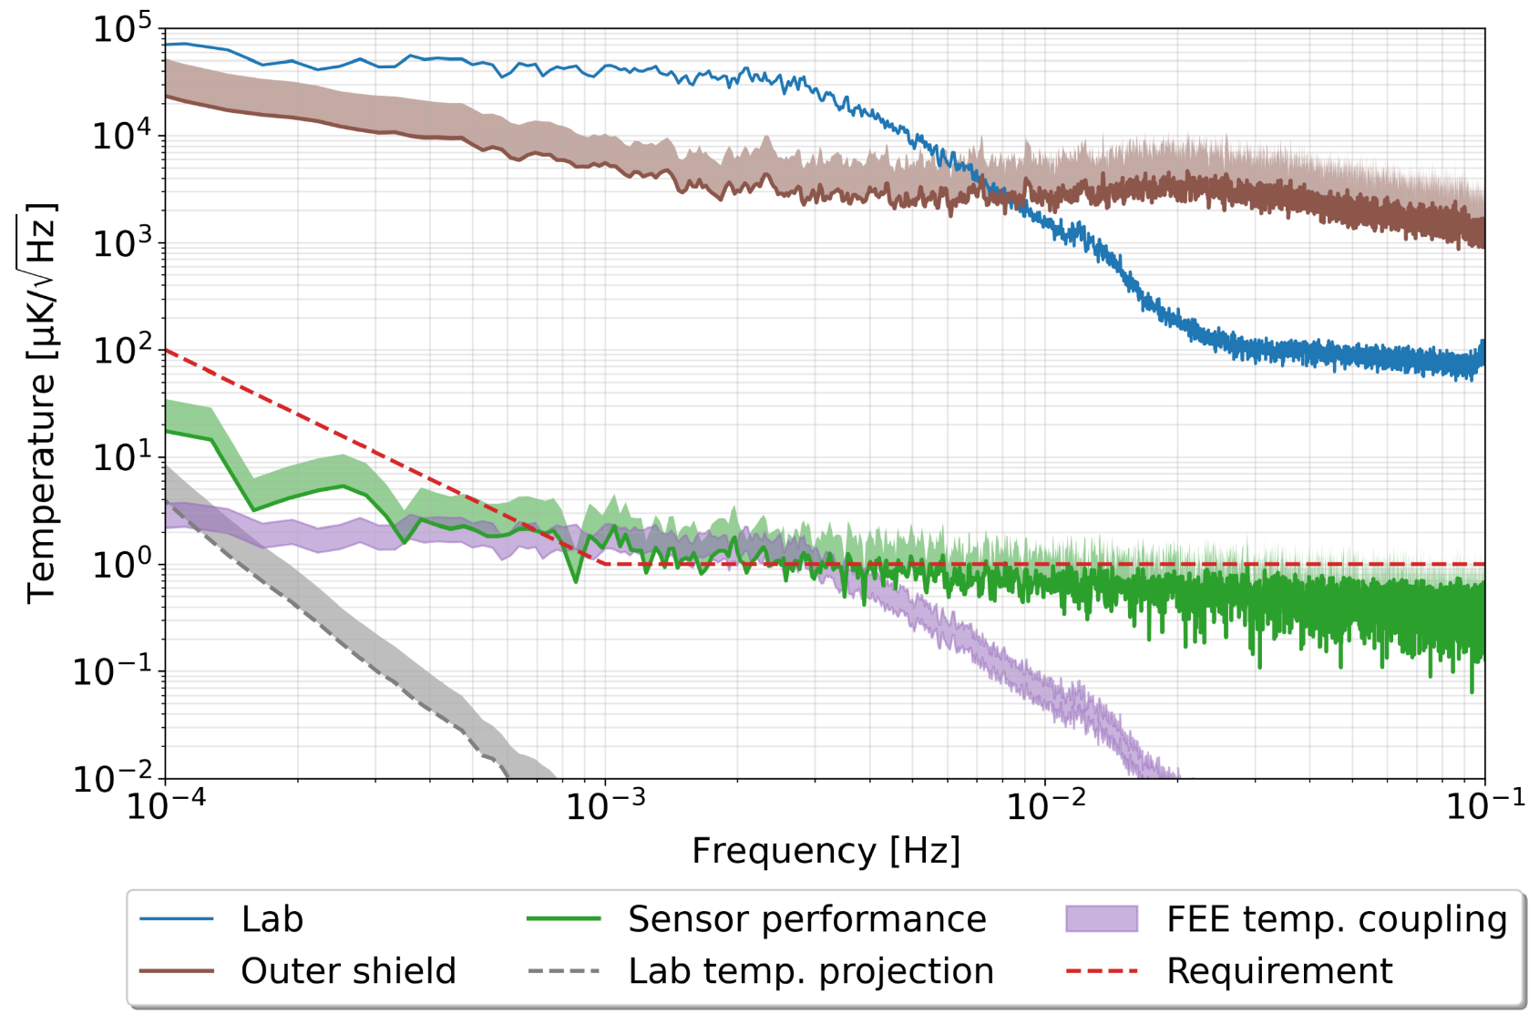
Diagnostics – Temperature sensors
LISA Enhanced Temperature Subsystem (LETS) -- ESA Activity
Results inline with objectives, but without multiplexing (expected degradation by a factor of $\sqrt{N}$) and only with NTCs (degradation expected for RTDs of a factor of ~3).
100 µW power dissipation
Roma-Dollase, D., Gualani, V., Gohlke, M., Abich, K., Morales, J., Gonzalvez, A., ... & Nofrarias, M. (2023). Resistive-Based Micro-Kelvin Temperature Resolution for Ultra-Stable Space Experiments. Sensors, 23(1), 145.

Slide 14
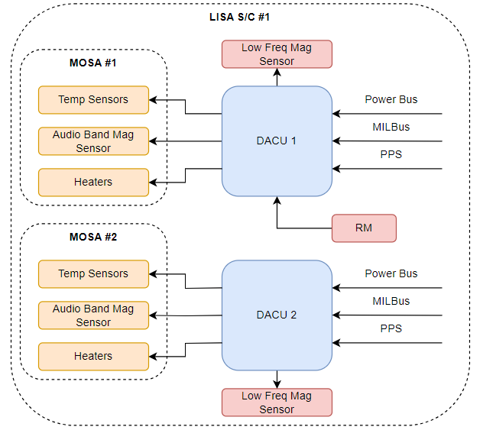
DACU: Functions
The DACUs (2) are in charge of:
Interfacing with the platform elements:
Power Bus
TLM/TLC with the OBC
PPS Synchronization
Acquiring (per DACU):
20 NTC Temperature Sensors.
4 Platinum RTD Temperature Sensors.
3 Low freq Mag Sensors.
1 Audio band Mag Sensor (Coil)
Actuate on (per DACU):
4 Resistors acting as heaters.
Interfacing the RM (one DACU):
Controlling and reading out the data of the radiation monitor
Provide regulated power to the radiation monitor

Slide 15
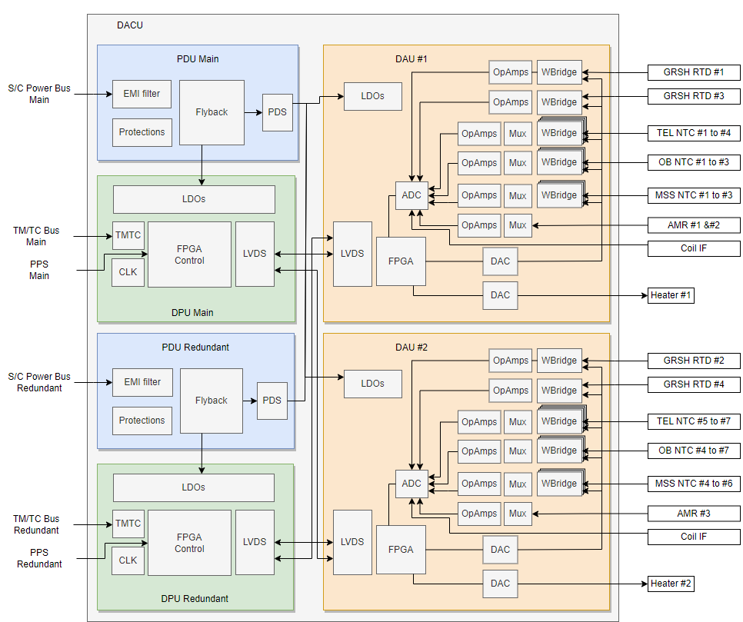
DACU: Architecture
The DACU will consist of 6 electronics boards:
2x PDUs (Main & Red):
Interface with the power bus (50V)
Protections
Internal power regulation and RM
2x DPUs (Main & Red):
Interface with the OBC via MilBus.
Receive the PPS from the platform
Control of the subsystem with the finite state machine
Synchronization of the system
Data processing
Interface the Data TLM with RM
2x DAUs :
Temperature sensors acquisition
Low freq mag sensors acquisition
Audio band mag sensors acquisition
Heaters excitation
Notes:
Two identical boards (DAUs 1 and 2) among which the different sensors and actuators are distributed.
In case of permanent failure of one of the boards all the sensors of that board would be lost.
Same approach as in LISA Pathfinder without any degradation of the reliability of the sensor monitoring.
There are performance reasons to not have the same sensor connected to two analog front-end circuits.
In a cold redundancy approach for DAUs, the unpowered circuit would require some input protection or switch, (since it would be still biased from the currently active board). That protections may degrade the performance when the circuit is used for measuring.
In a hot redundancy approach for DAUs, the two analog front-ends would be active at the same time. The input current noise may be added to the measurement, also greatly reducing the performance.
Having the sensor output connected to two measuring circuits will degrade the performance of the DACUs.

Slide 16
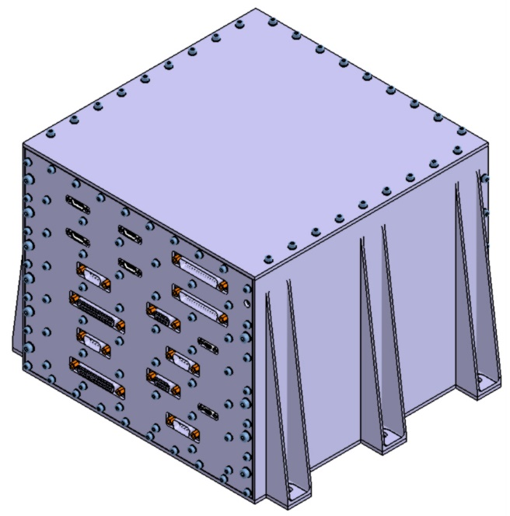
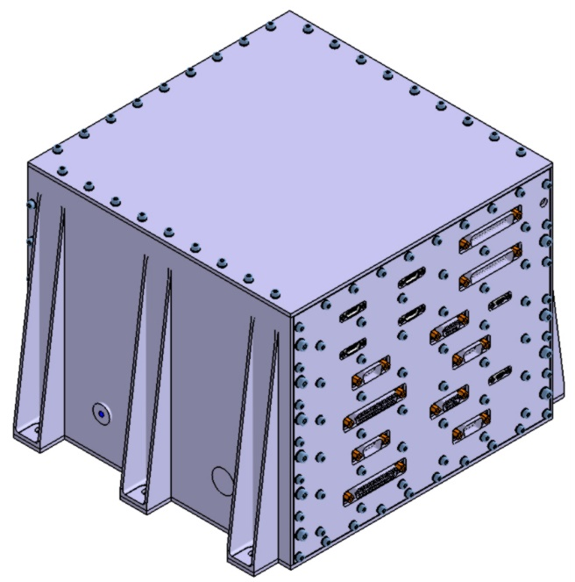
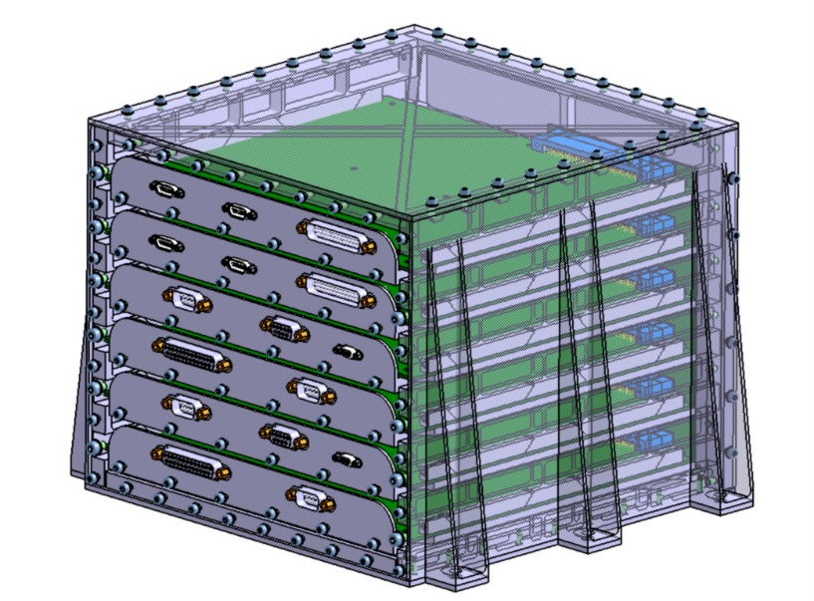
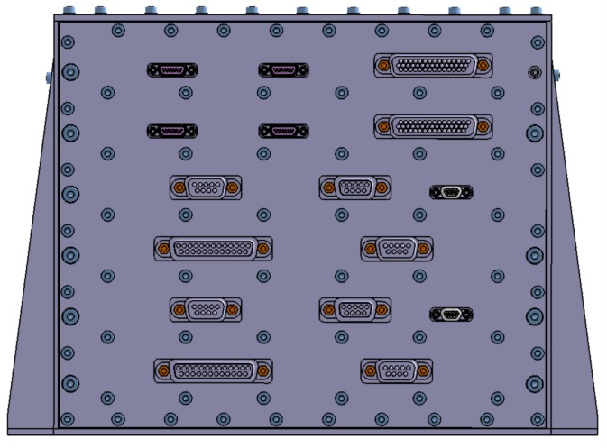
DACU: Size ad Mass Budget
Item | Total Mass (Kg) | Maturity Margin (%) | Maturity Margin (kg) | Mass with margin (kg)
DACU Structure (225 (h) x 280 (w) x 250 (l) mm) Thickness [3mm] | 4,505 | 20 | 0,901 | 5,406
Screwing | 0,296 | 20 | 0,0592 | 0,355
PCBs + Connectors + Internal Screwing | 2,165 | 20 | 0,433 | 2,598
EEE Parts (w/o Connectors) | 0,635 | 20 | 0,127 | 0,762
Total DACU Mass | 7,601 | - | - | 9,121

Slide 17
DACU: Data Budget
Nominal mode | Bit rate [bits/s] | Margin (%) | Bit rate with margin [bits/s]
Temperature sensors | 192 | 20 | 230,4
Magnetometers | 96 | 20 | 115,2
Coil | 48 | 20 | 57,6
Heaters | 0 | 20 | 0
Radiation monitor | 113 | 20 | 135,6
Housekeeping | 50 | 20 | 60
Total |  |  | 538,8
Actuation mode
Temperature sensors | 192 | 20 | 230,4
Magnetometers | 96 | 20 | 115,2
Coil | 48 | 20 | 57,6
Heaters | 256 | 20 | 307,2
Radiation monitor | 113 | 20 | 135,6
Housekeeping | 50 | 20 | 60
Total |  |  | 846,0
Debug mode
Total | 640.000 | 20 | 768.000,0
The data rate is assuming 32 bits samples. The budget assumes (per DACU):
24 temperature sensors being sampled at 0.25 Hz
3 (2-axis) magnetometers being sampled at 0.5 Hz
One coil being sampled at 0.1Hz
Heaters being sampled at 4Hz (only operating in actuation mode)
The radiation monitor is providing 4 histograms (1024 coincidence samples, 40 singles samples) each 600s
The debug mode assumes the sampling of a given 32 samples magnitude (a temperature sensor, for instance) at 20KHz. This mode would only be used in case of debugging needs.

Slide 18
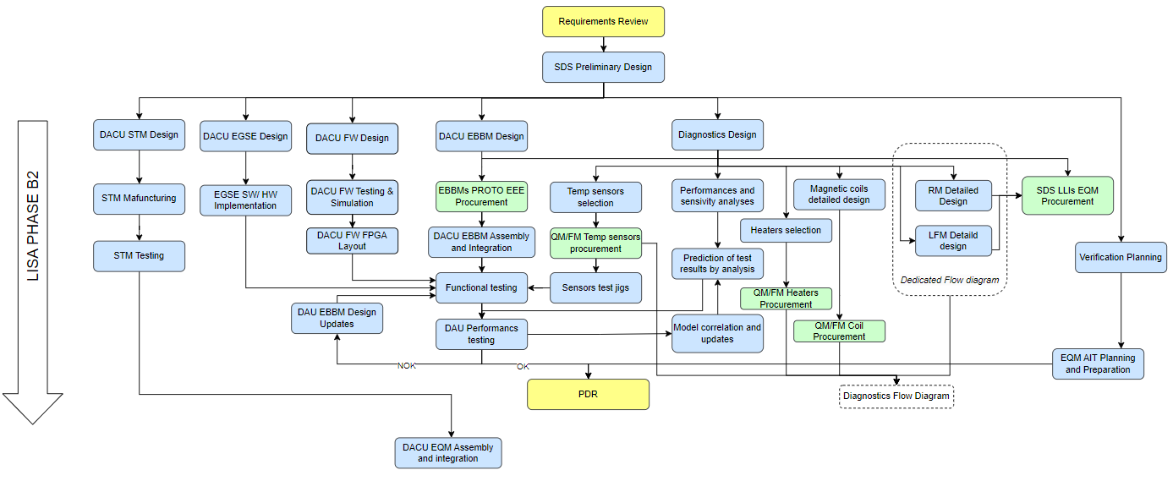
Road to PDR
Successfully passed adoption at beginning this year, next milestone is PDR.

Slide 19
Summary
De-risking activities have been done to valid the technical feasibility of the required instrumentation
Currently, the most challenging performance requirements measured with the developed instrumentation have been successfully achieved.
This paves the way for the next key milestone of the LISA instrumentation, the Preliminary Design Review (PDR) in mid-next year.

Slide 20
Thanks for your attention! Questions?

