Slide 1
Optical-based temperature sensors for future gravitational wave experiments
Sofia Sisteré Viñuales
ICE-IEEC
LISA Spain Meeting 2024
Notes:
My name is Sofia Sisteré and I am a part of Miquel Nofraria’s team working on several developments aiming at high precision temperature sensing. I work here as a photonics/optics engineer and miquel asked me to give this presentation about the developments we are carrying on with optical sensors. I hope you enjoy it.

Slide 2
Index
Optical-based Temperature Sensors
What is GLOW?
GLOW: Measurement concept
GLOW: Current development
What is LIRA?
LIRA: Measurement concept
LIRA: Current development
Final Thoughts
Notes:
First, a brief overview on optical temperature sensors. Why should we use them, why are we investing some time in developing solutions with them, What is their physical basis of work
Then we will jump into these two projects, one called LIRA the other called GLOW. I will explain their measurement concept and where are we with each. And then some final thoughts or conclusions.

Slide 3
Optical-based Temperature Sensors: Why?
Optical thermometry experiments have shown precision levels down to 𝒏𝑲∕√𝑯𝒛
There are two on-going projects based on different types of sensors.
High Sensitivity and Precision
Immunity to Electromagnetic Interference (EMI)
Lightweight
Low power requirements
Notes:
So, why do we need optical based temp sensors on spacecrafts? First of all, they have demonstrated amazing precision levels down to the nanokelvin. They are immune to electromagnetic interferences, they are lightweight and don’t require high powers. All advantatges.

Slide 4
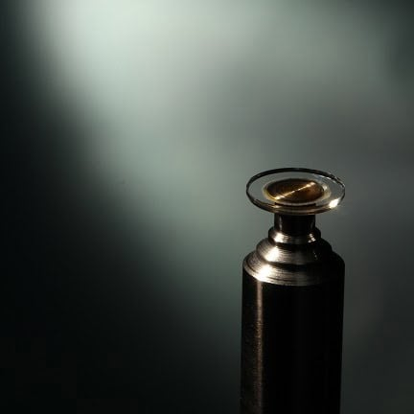
Optical-based Temperature Sensors: Resonators
Resonators (cavities) are able to confine light with certain characteristics inside of their structure for a certain time. Common geometries for resonators are:
Whispering Gallery Mode resonator WGMr (Oewaves)
Fabry Perot (FP) resonator for LIRA Project.
Notes:
If you want to use light to measure temperature you need some device that can interact with light in a certain way. MIRRORS. Wgmr nice name. This kind of resonators are have high temperature sensitivities. Their name comes from acoustic waves that were found to be bouncing inside of st paul cathedral in London I believe it was. So they found that sound ‘whispers’ was travelling around the dome ‘gallery’. The same for light, it stays bouncing inside the resonator for “long times”.

Slide 5
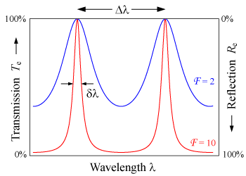
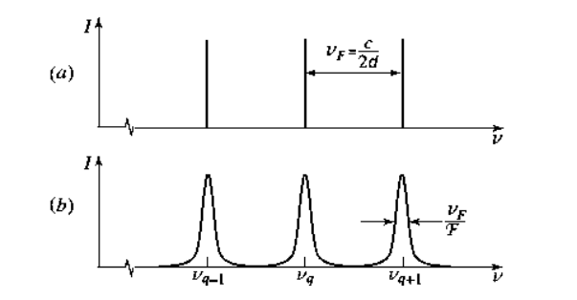
Optical-based Temperature Sensors: Quality Factor
Similarly to what is found in electronics resonance circuits, we can define a quality factor Q for an optical resonator as,
It is understood to be the storage time of the resonator in units of the optical period.
Whispering gallery mode resonators can have Q factors reaching 10¹¹ . They are used as stable frequency reference sources.
Notes:
What I have just said Is how the quality factor for a resonator is defined.

Slide 6
Optical-based Temperature Sensors: Thermometry
The frequency of the mode of the WGMr depends on temperature through:
Thermooptic effect: the temperature dependence of the refractive index.
Thermal expansion of the resonator.

Slide 7
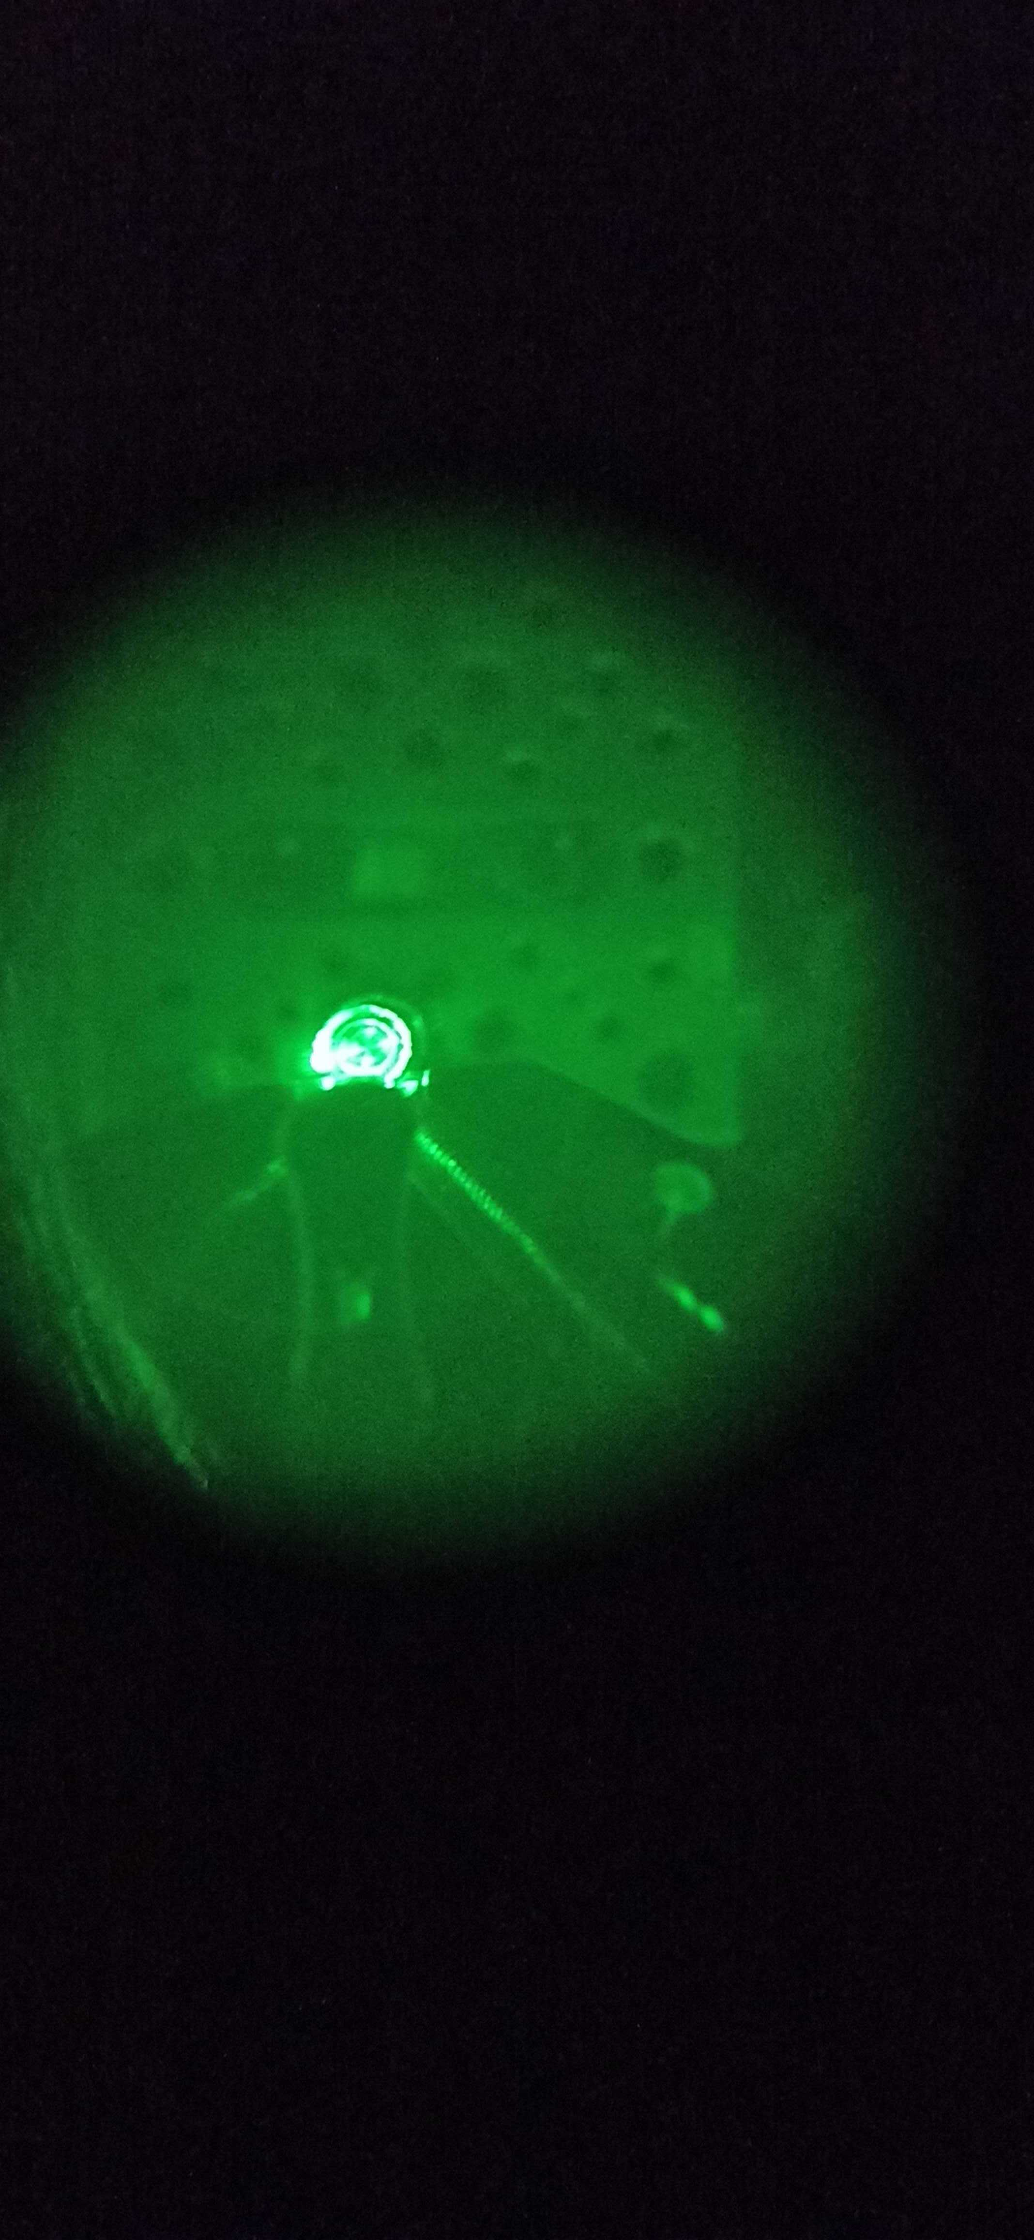
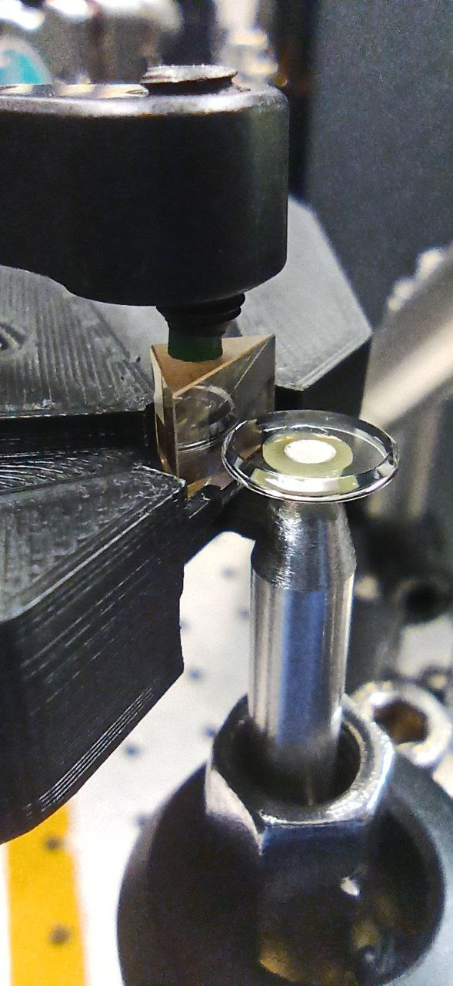
What is ?
GLOW is a project aiming at developing an ultra-high precision temperature sensing system, at the 𝒏𝑲∕√𝑯𝒛 at the LISA range.
For that, we use dual-mode thermometry with crystalline Whispering Gallery Mode resonators (WGMr).

Slide 8
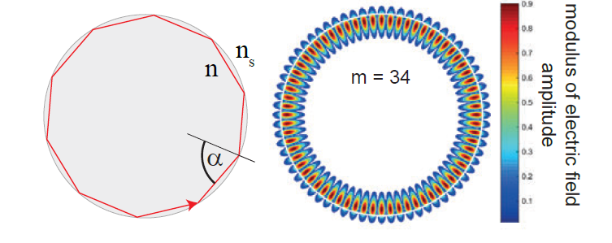
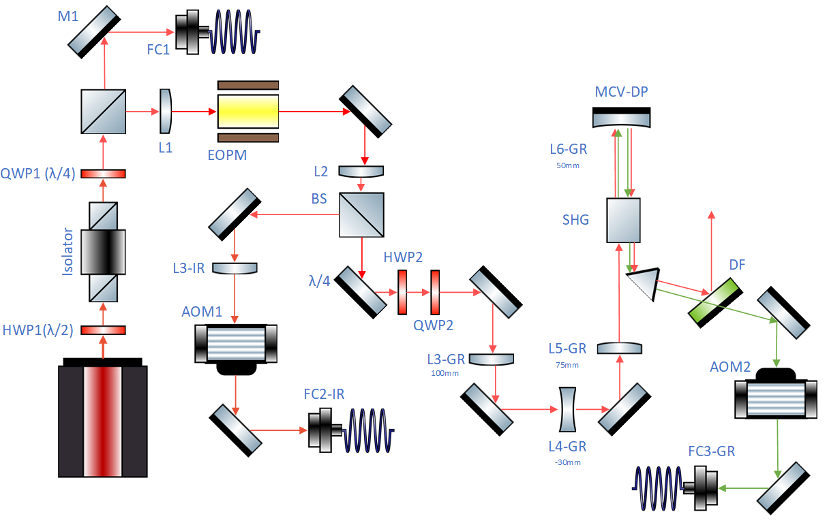
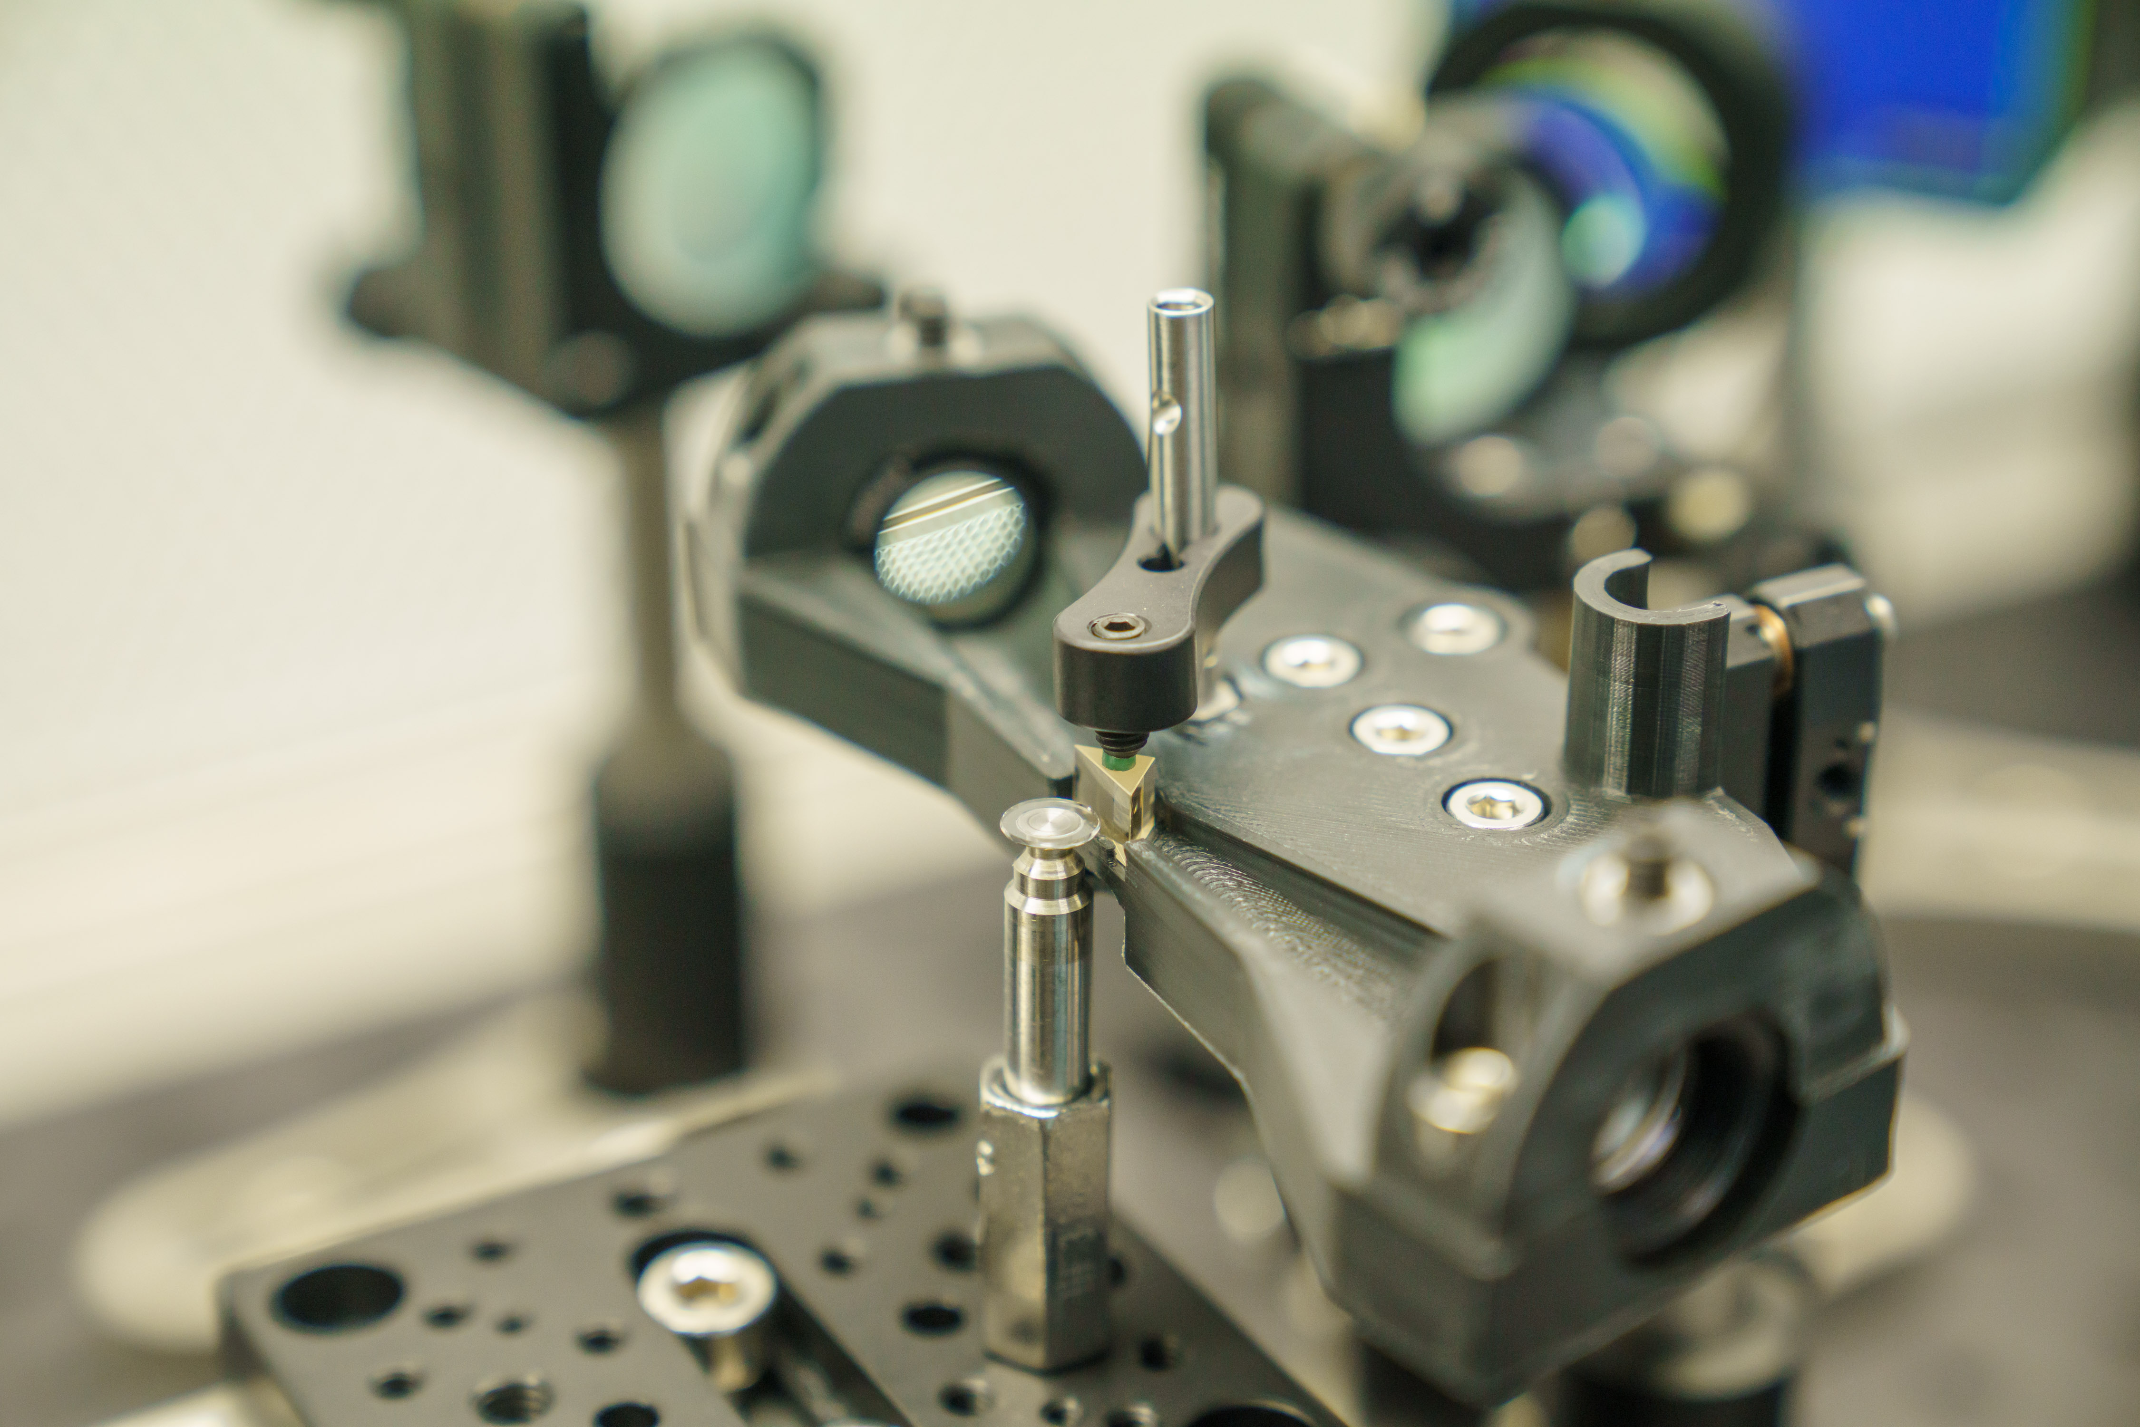
: Measurement concept
As discussed earlier, WGMr have narrow resonance peaks, these peaks are narrower than any commercial laser source. Therefore, our first goal is to couple light into the resonator and lock the laser to this narrow peak.
The main principle of thermometry with this resonators is to use two optical resonances with distinct polarizations or wavelengths
Because of birefringent or dispersive effects, the thermooptic coefficients of the resonances differ, leading to an approximate linear change of the mode difference frequency with the resonator temperature.
Notes:
Laser source is 1kHz linewidth.
Now this is the setup that is used to couple to the resonator and to lock the laser to the resonance, I will not extend on this. Just wanted to tell you that we were using a dual color technique, as you can see we were using green light through this path we were frequency doubling the beam, but we are no longer using wavelength as the distinctive refractive index source but polarization.

Slide 9
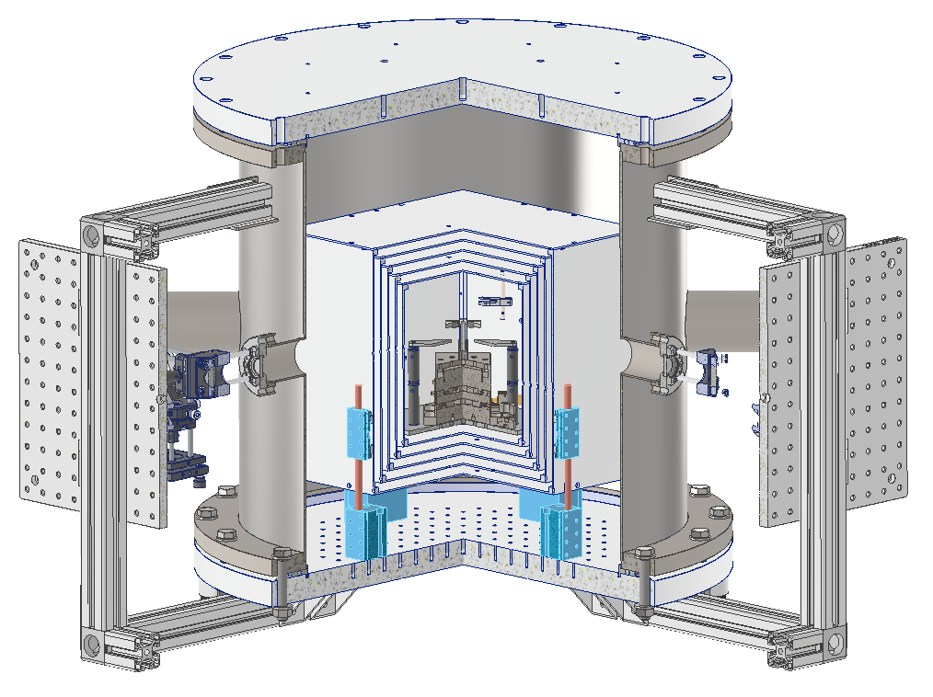
: Measurement concept
To reach 𝒏𝑲∕√𝑯𝒛 precision and specially at low frequencies, there is a need to shield the sensors from temperature instabilities of the environment.
In this regard, we designed a thermal vacuum chamber with an expected thermal stability at the core of at least 0.1 nK ∕√Hz
Notes:
Highly shielded from outside perturbations. Damped. Designed with 5 passive thermal shields that act as low pass filters and allow temperature damping to those levels.

Slide 10
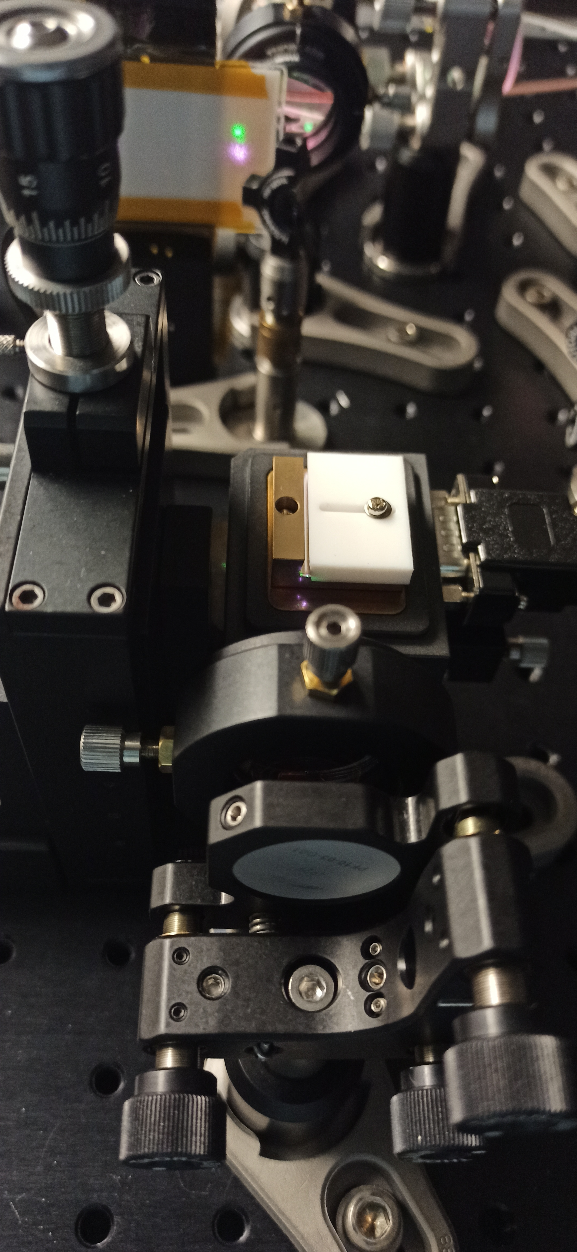
: M Current development
We were using a Second Harmonic Generator (SHG) crystal to generate green (532 nm) light out of infrared (1064 nm).
We tried several configurations but had really low efficiencies (µW) and not enough light was making it through the fiber optics to the resonator.
Notes:
Laser source is 1kHz linewidth.

Slide 11
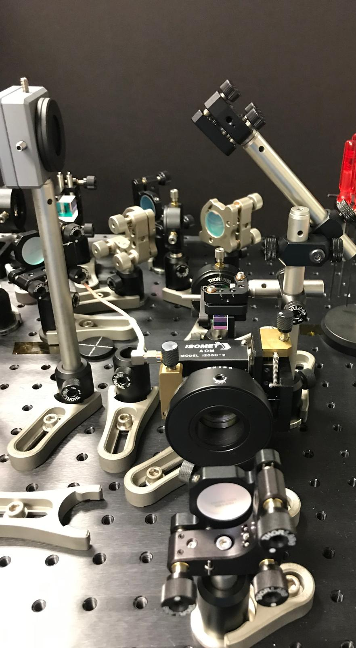
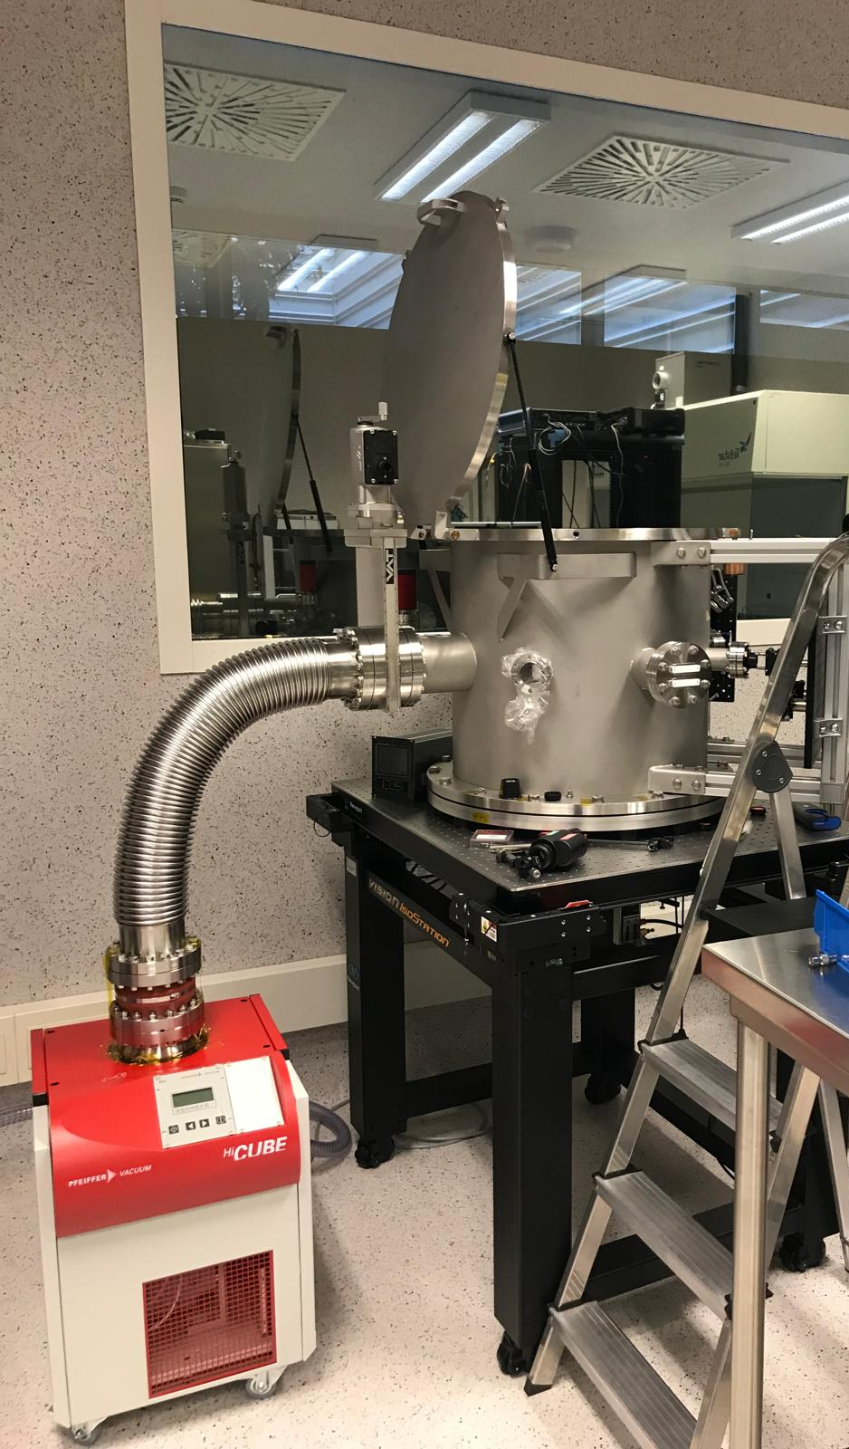
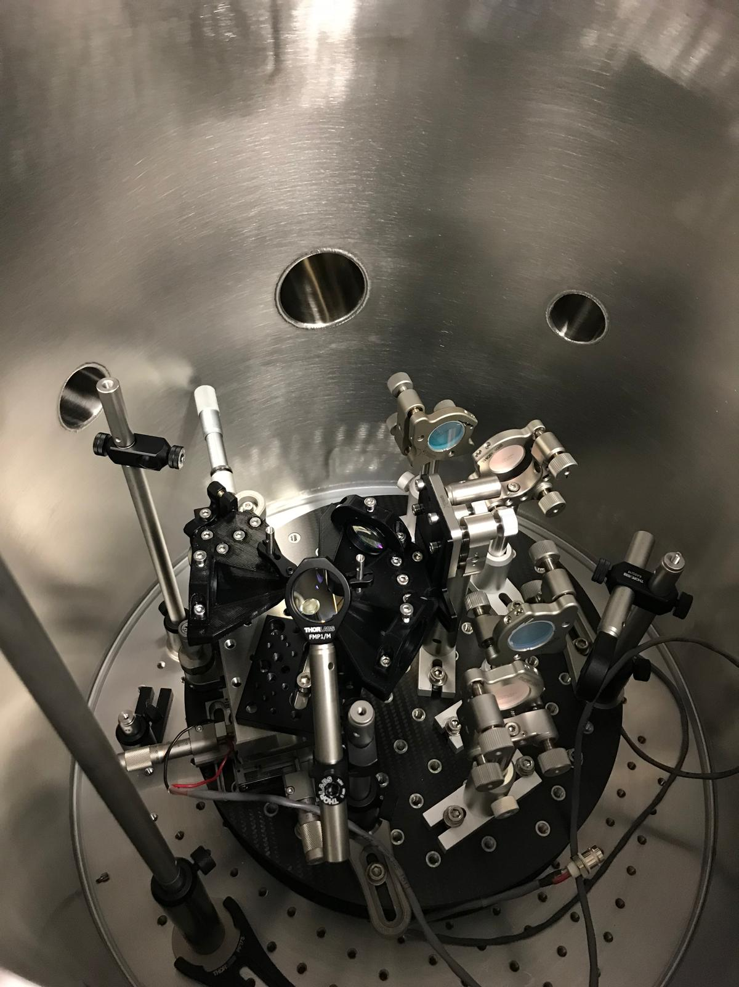
: M Current development
Big change on design implemented in August: No longer using dual-color measurement, we will use dual-polarization.
The thermooptic coefficients of orthogonally polarized modes in a MgF2 resonator are significantly different.
Therefore, frequency spacing between ordinary and extraordinary modes depends on temperature.
Notes:
We might be getting worse performance since noise cancellation should be better using two different wavelengths respond differently.

Slide 12
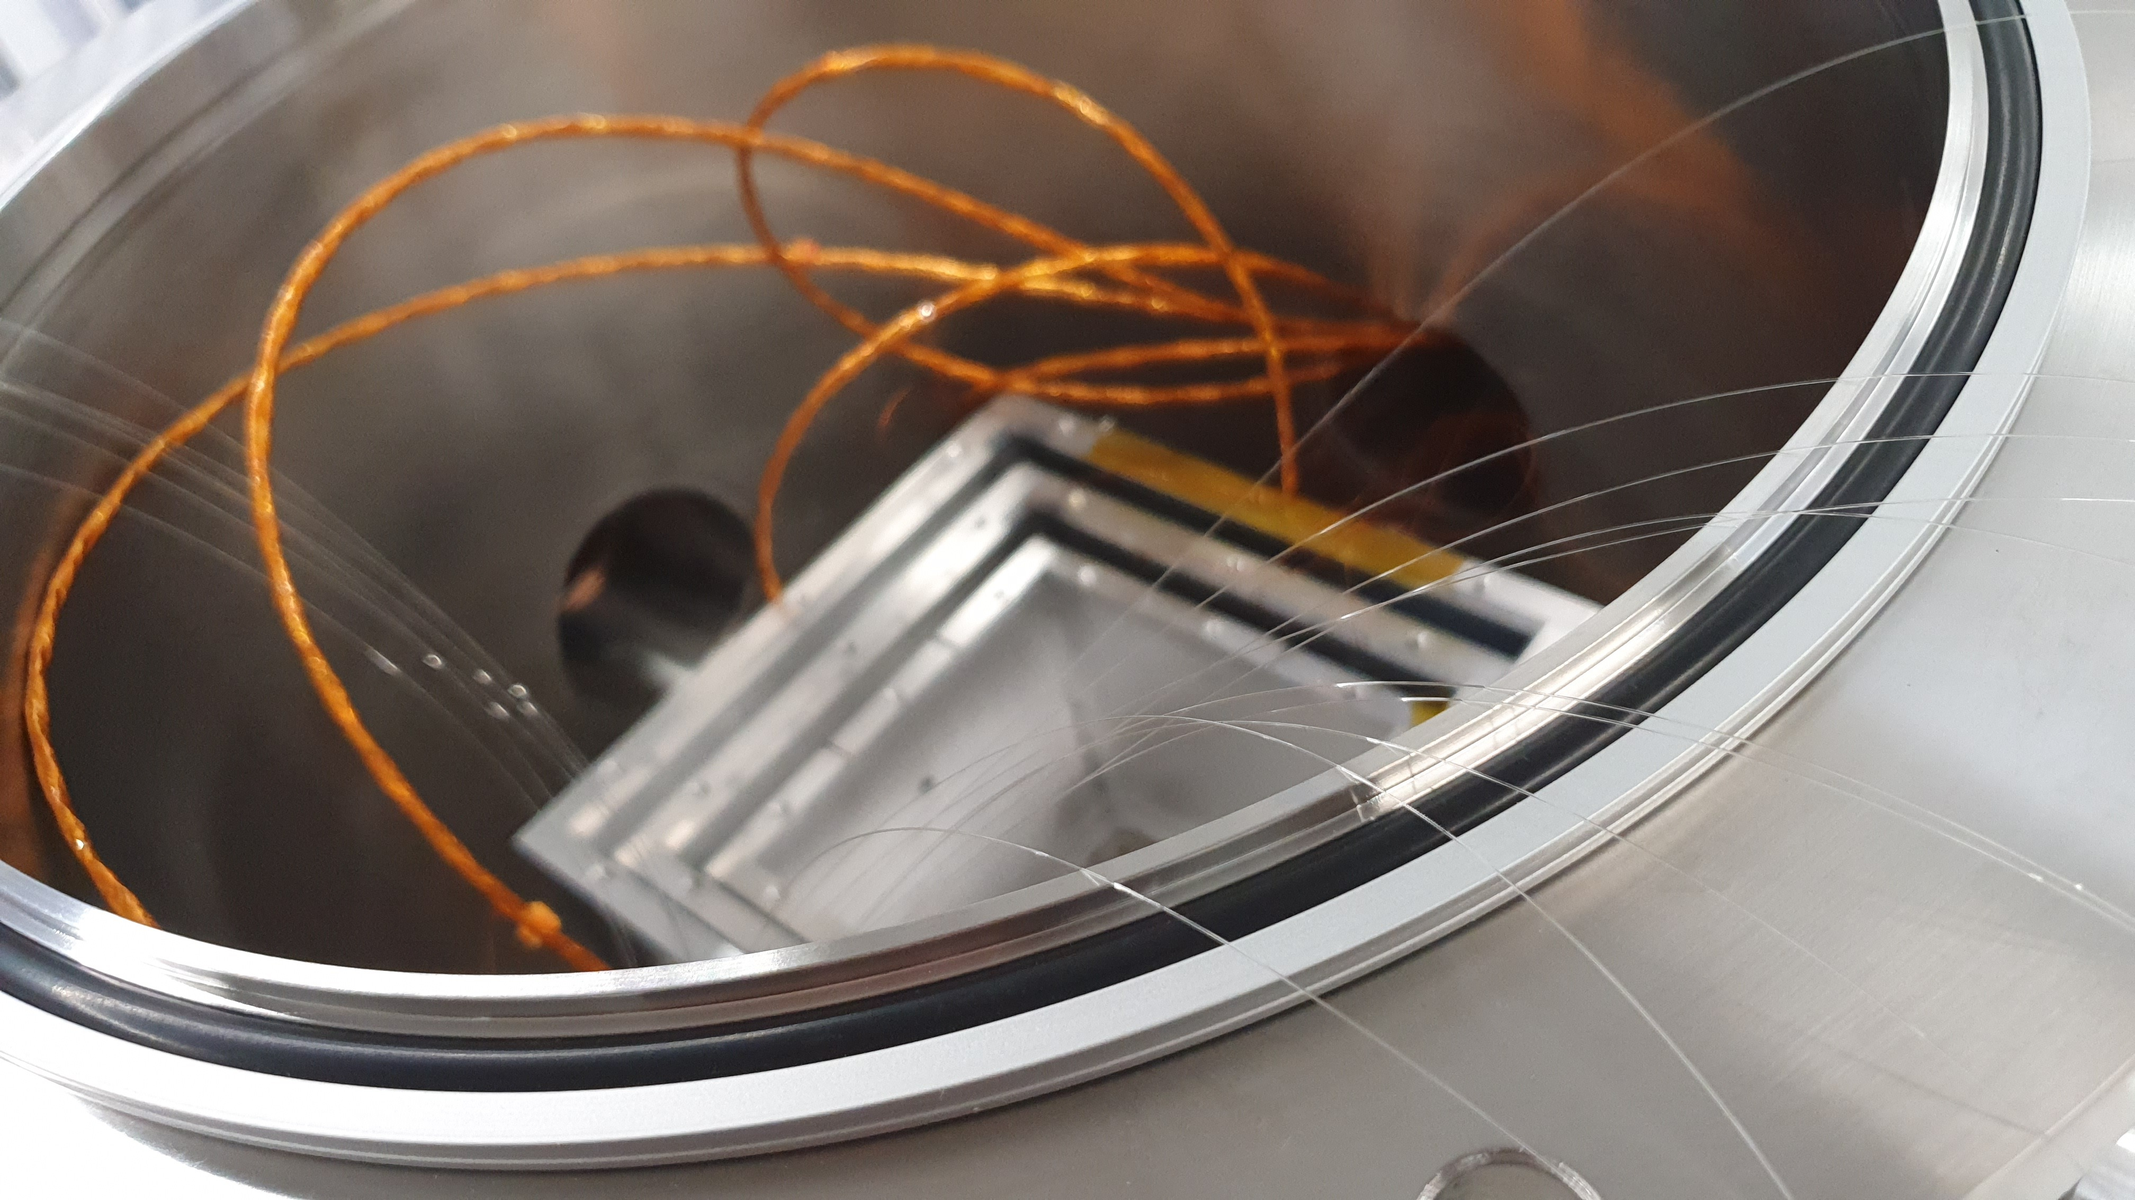
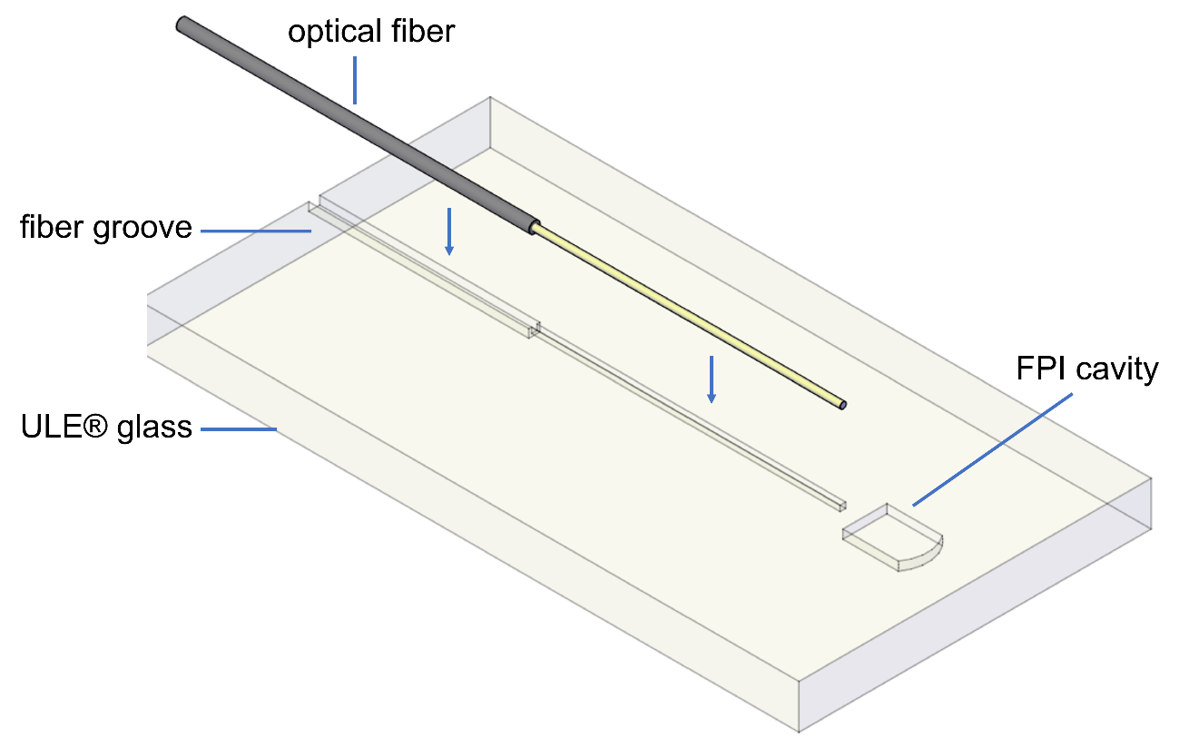
What is LIRA?
ESA contract (Optical fiber micro-kelvin temperature sensor network for sensitive optical payloads, in collaboration with INESTEC) which aims to 1 µK/√𝐻𝑧 at 1 mHz by means of optical sensors. The working principle is based on a differential measurement between a reference cavity (insensitive to temperature) and a sensor cavity (size sensitive to temperature).
Among optical technologies, the use of a fiber optic harness is of particular interest as it is both non-magnetic and also a relatively poor conductor, both qualities of particular interest for LISA.
We are right now entering the testing phase, which is expected to finish at the end of this year.
(1) Sleeve: aluminium tube
(2) Glass ferrule
(3) Glass rod with aluminum coating >90%
(4) Optical fiber SMF28e

Slide 13
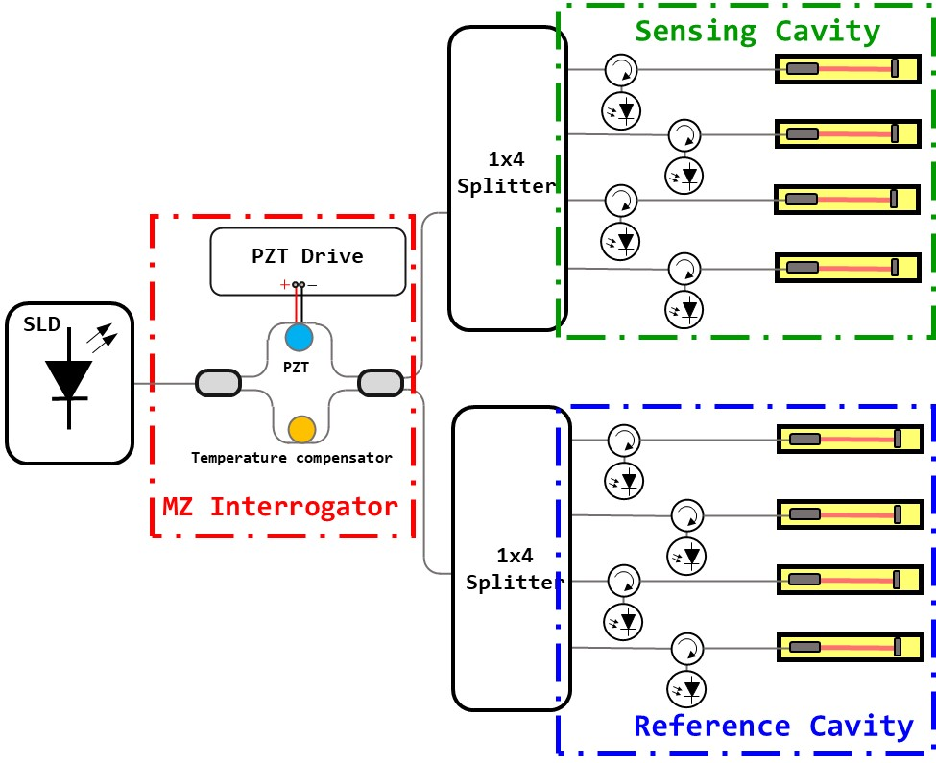
LIRA: Measurement concept
The proposed system consists of three fiber optic interferometers. One Mach Zehnder Interferometer (MZI) used as an optical interrogator, and two Fabry Perot Interferometers (FPI) which are Fabry Perot (FP) cavities whose material substrate has different temperature dependencies. One is used as a sensing interferometer (aluminum) and the other as a reference interferometer (Corning ULE® 7972 glass).
The measurement relies on the principle of White Light Interferometry (WLI) where a 1550 nm broadband light source (Superluminescent Diode, SLD) is used in order to achieve a narrow interference peak.

Slide 14
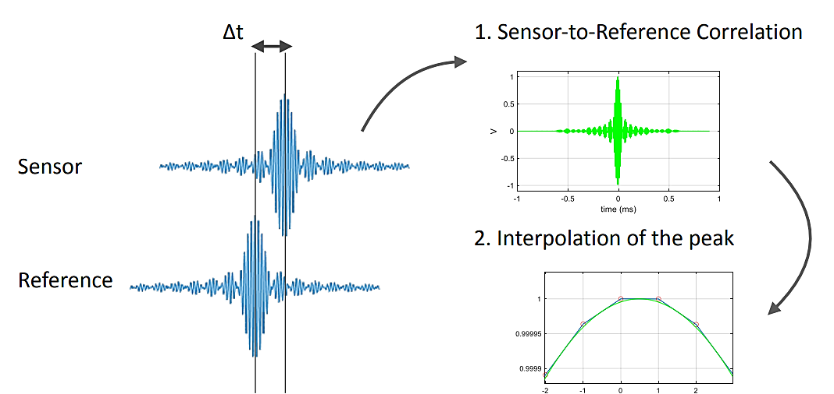
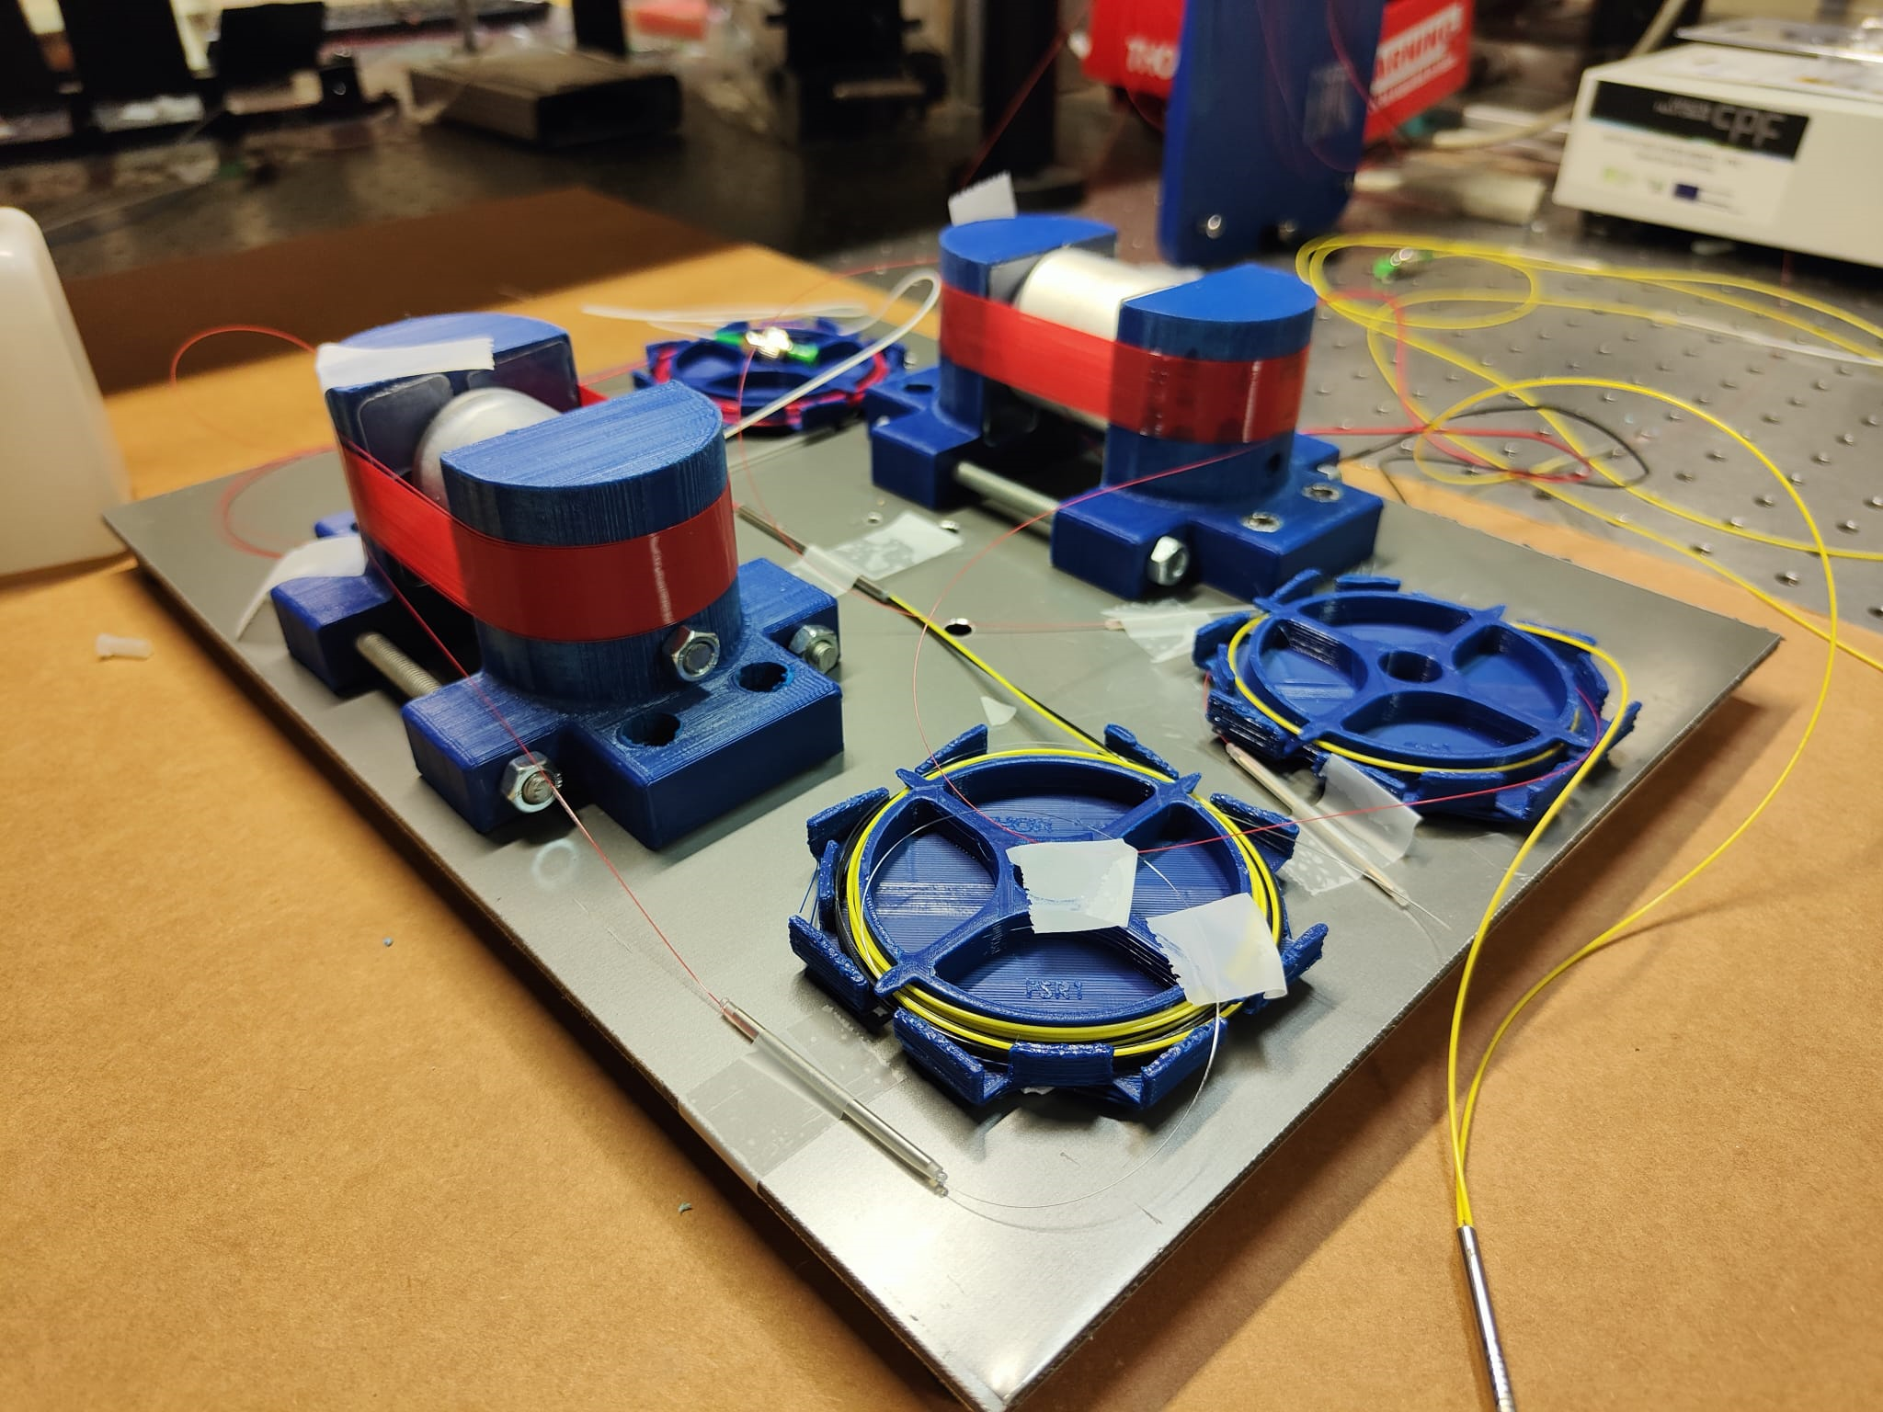
LIRA: Measurement concept
One of the arms of the MZI has a piezo electric actuator (PZT) attached to it which applies a certain strain to the fiber and therefore effectively changes the Optical Path Length of light traveling through it. The OPD varies following a linear driving signal applied to the PZT which performs an optical interrogation of the cavity’s length over a defined range. The signal’s maximum is achieved when the path of the arm of the interrogator and the path of the FPI are equal. By correlating the sensing FPI to the reference FPI signal we can estimate the time delay which can then be mapped to temperature.
A cross-correlation of the sensor and reference signals is performed.
The peak of the cross- correlation is the time-delay of light going through the reference versus light going through the sensor.
This time delay can be converted into temperature by means of the sensitivity of the sensor-reference pair.

Slide 15
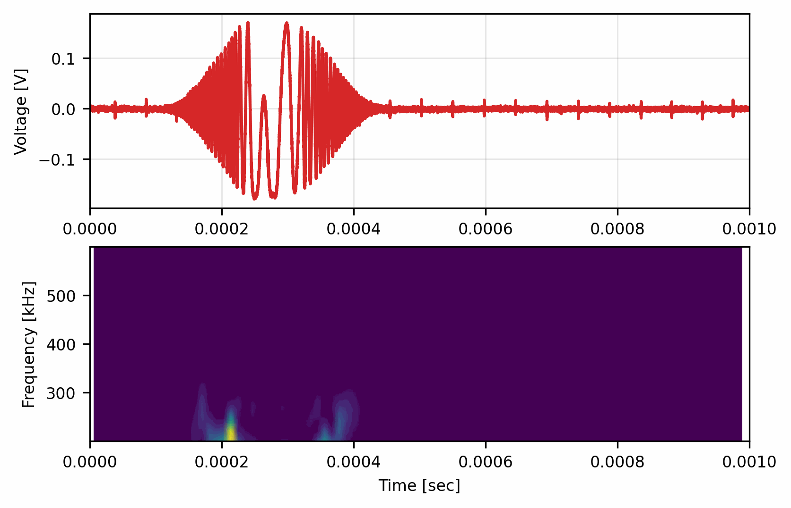
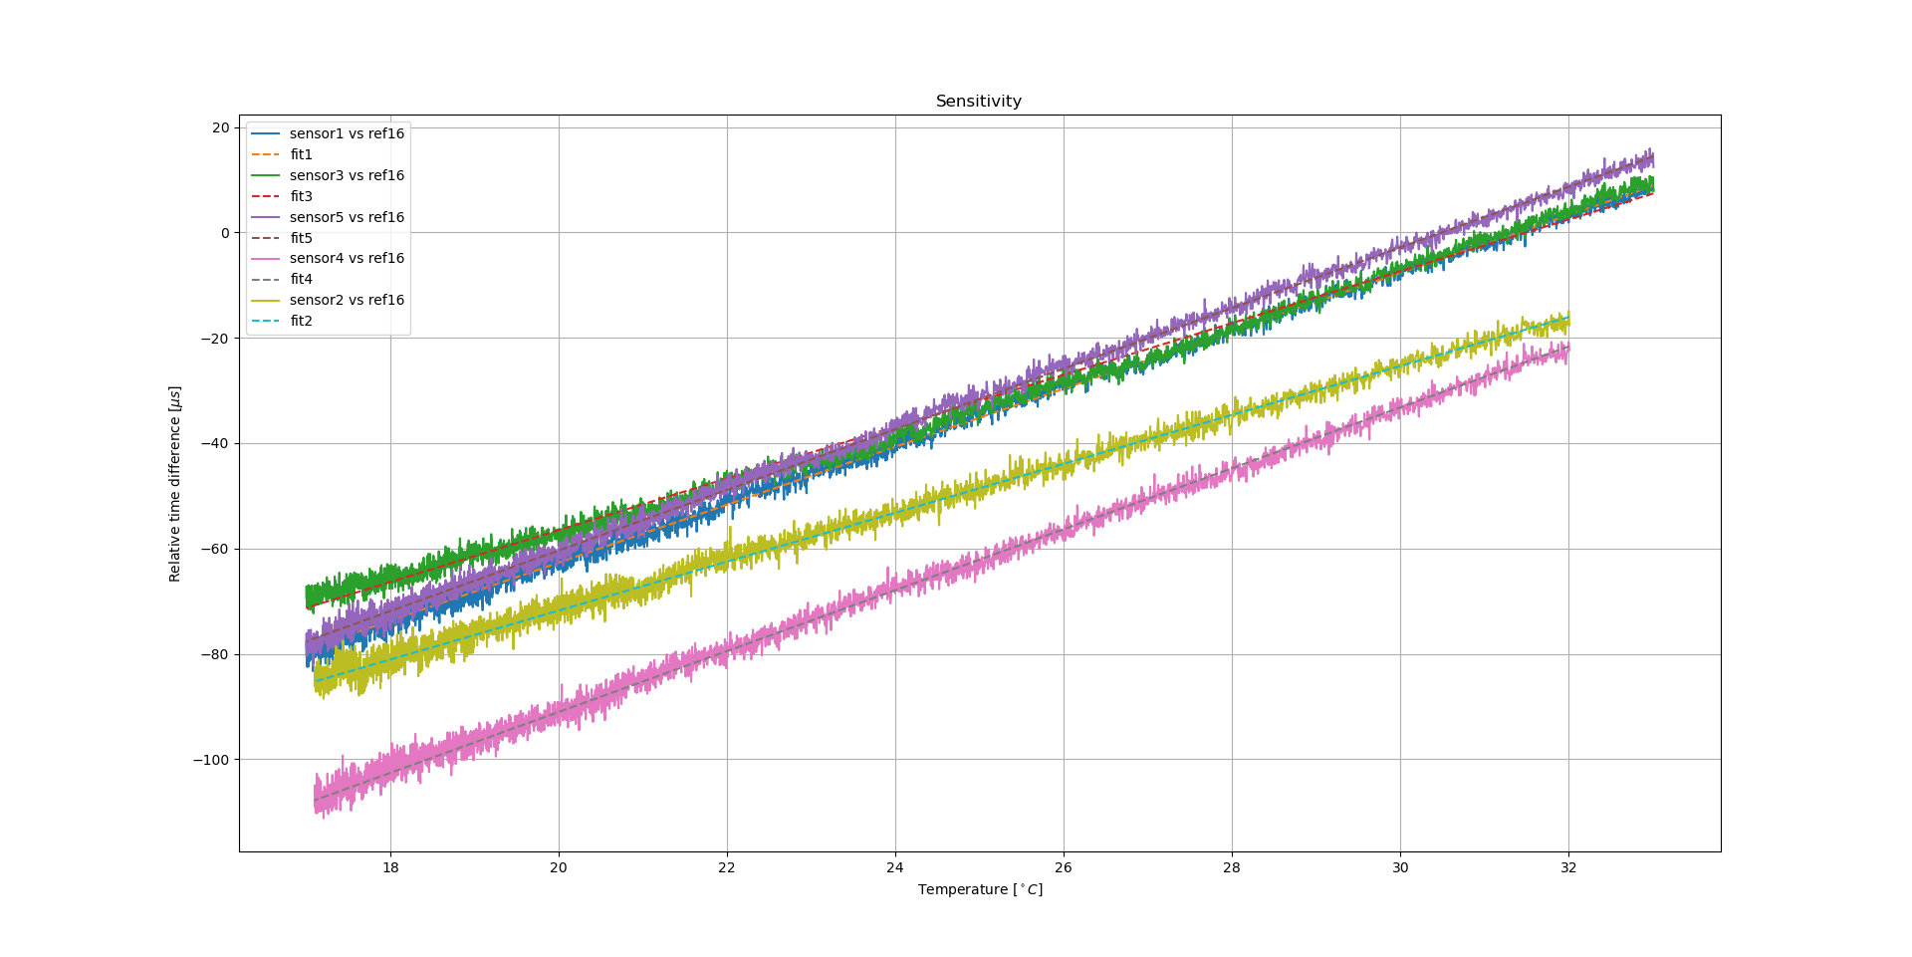
LIRA: Current development
Optical system suffers from nonlinearity caused by the interrogator, this directly affects the carrier of our signal which is not constant in frequency during the whole interrogation range.
This situation places serious difficulties in the cross-correlation performance, mainly affecting our capacity to measure a 50 K range.
Calculated sensitivity plot for each sensor gives us poorer results than expected by design: ~ 5 µs/K (real) to 20 µs/K (design).
Overall, electronics were designed with different requirements.

Slide 16
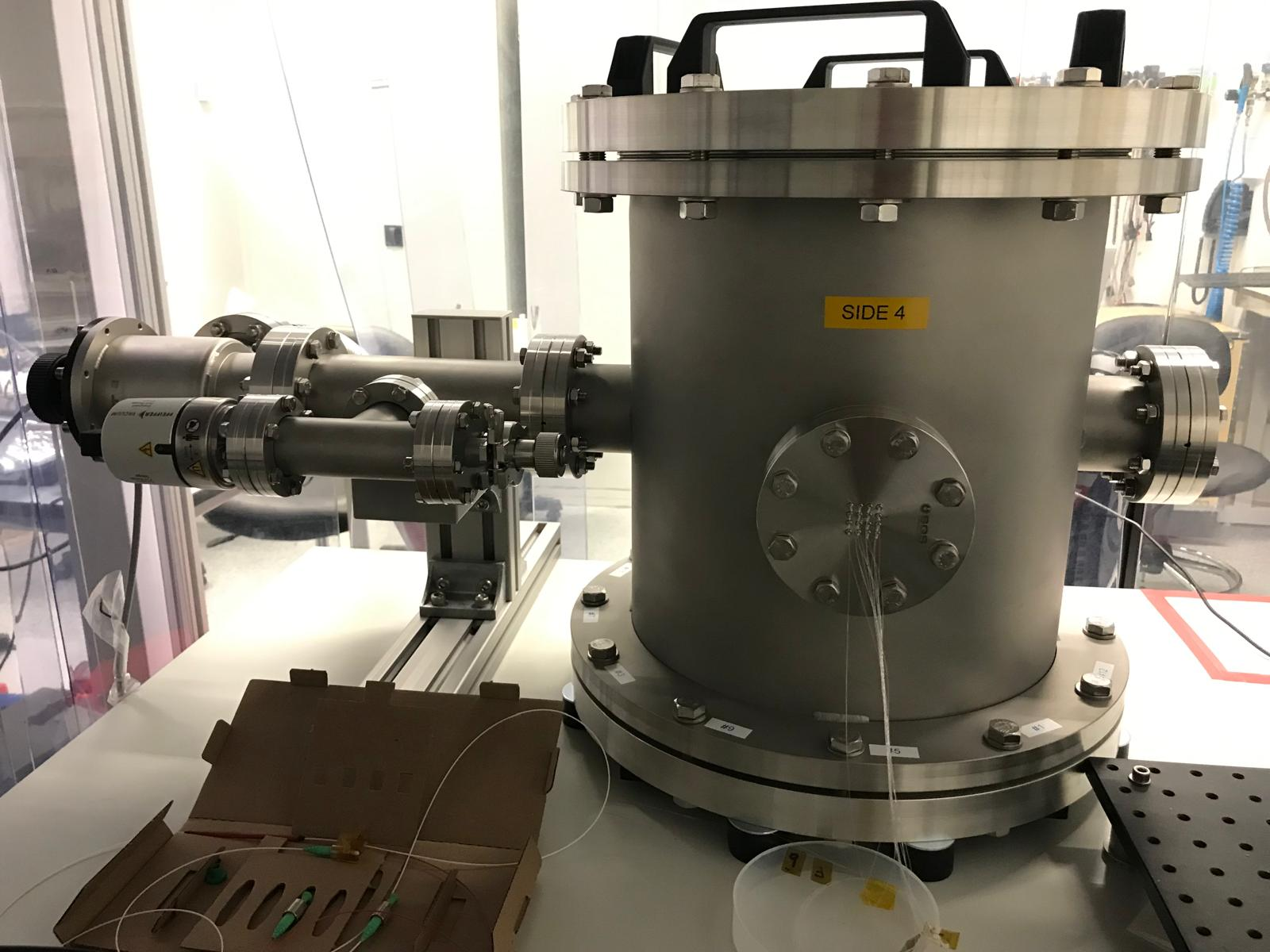
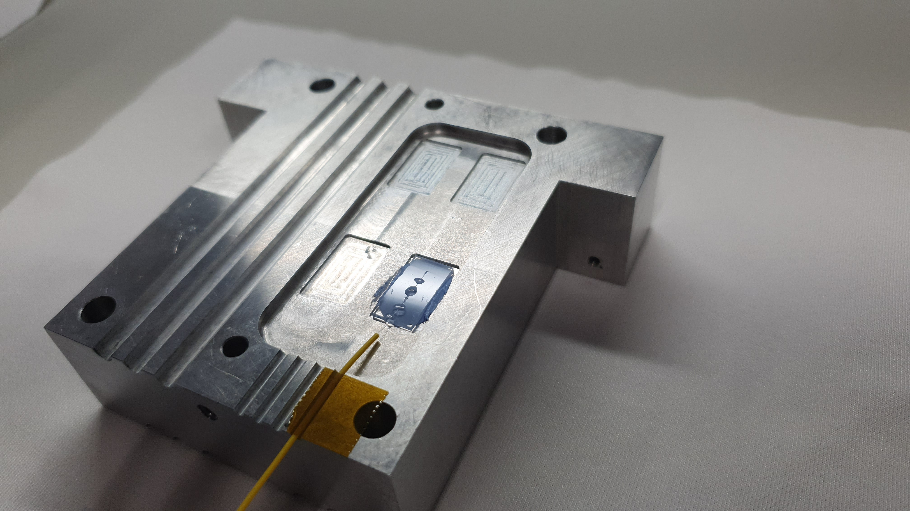
LIRA: Current development
Started running planned final tests:
RT-001 Basic system requirements
RT-002 Absolute accuracy
RT-003 Performance
RT-004 Ramp
TB-001 TBS Performance
Next steps include final presentation by December 2024

Slide 17
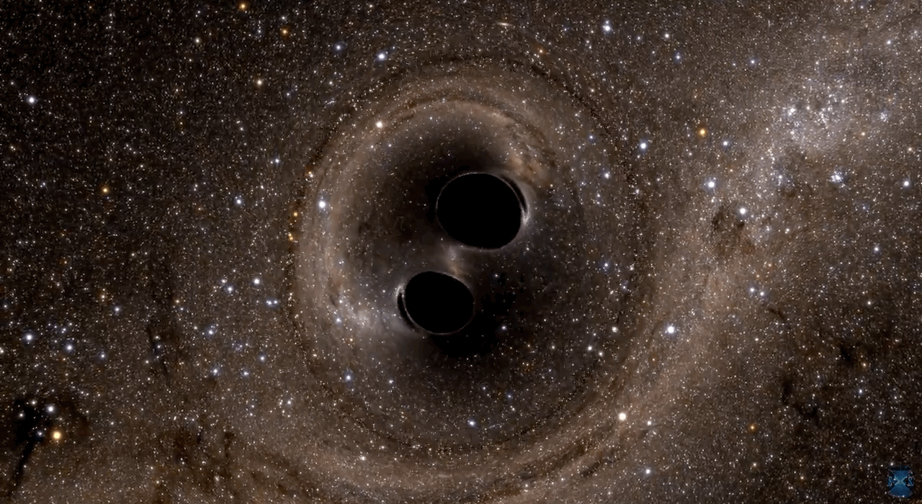
Final Thoughts
Optical-based temperature sensors are a promising technology to be used in space exploration.
However, there is still much progress to be made before these sensors can be implemented in a compact and practical form for space missions.
Key challenges include miniaturization and also addressing the inherent mechanical fragility of some resonators, which poses a risk during launch and operation in space.
Notes:
I hope i have convinced you that optical temperatura sensors are a promising tech.

Slide 18
Questions

