Slide 1
Funding opportunities from
the European Research Council
Javier L Albacete, ERC Executive Agency
(on leave from U. Granada) Scientific Officer
Unit B4 Physical Sciences & Engineering
Strong and Electroweak Matter
Conference
Barcelona, 29 June 2018

Slide 2
Outline
Brief overview on ERC
Grants and Evaluation process
How to get ready and prepare your proposal
Some Statistics

Slide 3
What is the ERC?
Funding body established in 2007 by the EC with the mission of encouraging highest quality research in Europe
Support for the individual scientist – no networks!
Global peer-review
No predetermined subjects (bottom-up)
Support of frontier research in all fields of science and humanities
Strategy
Notes:
3

Slide 4
What is the ERC?
Funding body founded in 2007 by the EC with the mission of encouraging highest quality research in Europe
Scientific Council
The ERC Executive Agency
22 distinguished scientists
Full authority over the funding strategy
President: Prof. Bourguignon
Implements the mandate of the SC
Organises peer review evaluation
Manages grant agreements
Administers scientific & financial aspects
Notes:
4

Slide 5
The ERC Scientific Council
President
BOURGUIGNON Jean-Pierre
BOVOLENTA
Paola
DONALD
Athene
MEHLHORN
Kurt
TAVERNARAKIS
Nektarios
WIEVIORKA
Michel
Vice President
BOCK Klaus
BUCKINGHAM Margaret
JAJSZCZYK
Andrzej
ROMANOWICZ
Barbara
THORNTON
Janet
ZWIRNER
Fabio
Vice President
KONDOROSI Eva
CLARK Christopher
JUNGWIRTH
Tomas
STENSETH
Nils
VERNOS
Isabelle
Vice President
STOKHOF Martin
CRONE
Eveline
KRAMER Michael
SUPERTI-FURGA
Giulio
VEUGELERS
Reinhilde
Notes:
Outline of presentation

Slide 6
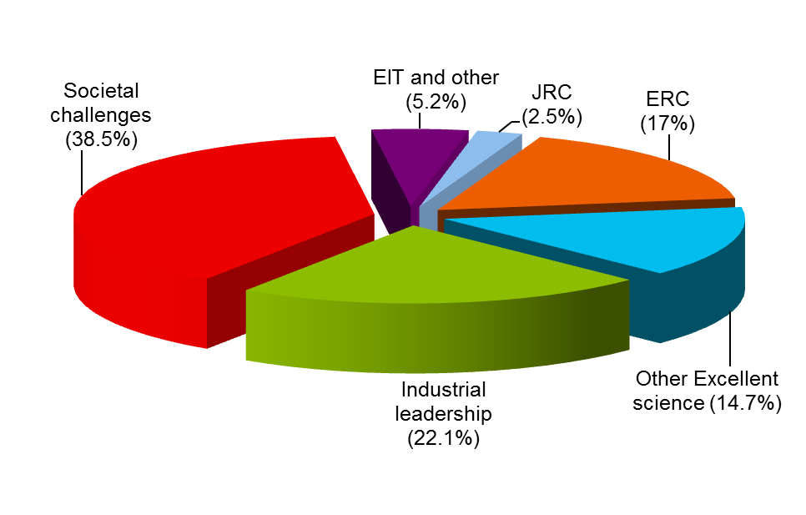
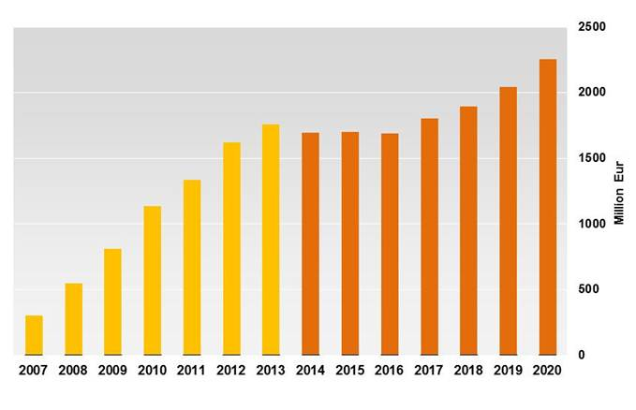
What is the ERC? Horizon 2020 (2014-2020) Budget € 77 billion ERC Budget € 13 billion (1.8 billion / year)
FP7
H2020

Slide 7
What is the ERC? Horizon 2020 (2014-2020) Budget € 77 billion ERC Budget € 13 billion (1.8 billion / year)
Proposal of the EC for Horizon Europe (2021-2027) Horizon Europe (2021-2027) Budget € 100 billion (No UK contribution) ERC Budget € 16.6 billion (2.4 billion / year)

Slide 8
What is the ERC? Horizon 2020 (2014-2020) Budget € 77 billion ERC Budget € 13 billion (1.8 billion / year)
Proposal of the EC for Horizon Europe (2021-2027) Horizon Europe (2021-2027) Budget € 100 billion (No UK contribution) ERC Budget € 16.6 billion (2.4 billion / year)
TBC!!!!

Slide 9
Brief overview on ERC
Grants and Evaluation process
How to get ready and prepare your proposal
Some Statistics

Slide 10
Who can apply?
Excellent Researchers of
any nationality,
any age
any current working place in the world
any topic (bottom-up)
Only requirement - letter of support from a Host Institution (HI) based in EU or associated countries
│ 10

Slide 11
What does ERC offer?
ERC Grant Schemes
Starting Grants
starters
2-7 years after PhD
(≥ 50% commitment)
up to €1.5 Million
for 5 years
Consolidator Grants
consolidators
7-12 years after PhD
(≥ 40% commitment)
up to €2 Million
for 5 years
Advanced Grants
track-record of
significant research
achievements in the
last 10 years
(≥ 30% commitment)
up to €2.5 Million
for 5 years

Slide 12
What does ERC offer?
ERC Grant Schemes
Starting Grants
starters
2-7 years after PhD
(≥ 50% commitment)
up to €1.5 Million
for 5 years
Consolidator Grants
consolidators
7-12 years after PhD
(≥ 40% commitment)
up to €2 Million
for 5 years
Advanced Grants
track-record of
significant research
achievements in the
last 10 years
(≥ 30% commitment)
up to €2.5 Million
for 5 years
Proof-of-Concept
bridging gap between research - earliest stage of marketable innovation up to €150,000 for ERC grant holders only
Synergy Grants
2-4 PIs up to €10 million for 6 years
to lead to breakthroughs that cannot be achieved by a PI working alone

Slide 13
Additional funding
Additional funding:
Start-Up costs for scientists moving to EU / Associated Countries
Purchase of major equipment
Access to large facilities
Up to €500 000 for Starting
Up to €750 000 for Consolidator
Up to €1 Million for Advanced grantees
Up to €4 Million for SyG PIs
│ 13

Slide 14
Extensions of eligibility window
Extensions of eligibility window possible for StG and CoG for documented cases of:
Maternity – 18 months per child (before or after PhD)
Paternity – actual time taken off
Military service
Medical speciality training
Caring for seriously ill family members
No limit to the total extension
Notes:
14

Slide 15
How to prepare & submit an ERC research proposal
Proposal structure
PART A – online forms
A1 Proposal info
A2 Host Institution and PI info
A3 Budget
A4 Ethics Issues
A5 Call Specific Info (doctoral training,
extensions, excluded reviewers etc.)
PART B1 – submitted as .pdf
Extended Synopsis 5 p.
CV 2 p.
Early Achievements Record 2 p.
(incl. up to 10 publications)
Funding ID 1p
administrative
Annexes – submitted as .pdf
HI support letter
Copy of PhD title
Documents for extension of
eligibility window
PART B2 – submitted as .pdf
Scientific Proposal 15 p.
State of the Art & Objectives
Methodology
Resources
Read the Information to Applicants

Slide 16
How to prepare & submit an ERC research proposal
ERC Panel structure
Each panel :
Panel Chair and 10-16 Panel Members
Social Sciences and Humanities
SH1 Individuals, Markets and Organisations
SH2 Institutions, Values, Environment and Space
SH3 The Social World, Diversity, Population
SH4 The Human Mind and Its Complexity
SH5 Cultures and Cultural Production
SH6 The Study of the Human Past
Life Sciences
LS1 Molecular and Structural Biology and Biochemistry
LS2 Genetics, Genomics, Bioinformatics and Systems Biology
LS3 Cellular and Developmental Biology
LS4 Physiology, Pathophysiology and Endocrinology
LS5 Neurosciences and Neural Disorders
LS6 Immunity and Infection
LS7 Diagnostic Tools, Therapies & Public Health
LS8 Evolutionary, Population and Environmental Biology
LS9 Applied Life Sciences and Biotechnology
Physical Sciences & Engineering
PE1 Mathematics
PE2 Fundamental Constituents of Matter
PE3 Condensed Matter Physics
PE4 Physical & Analytical Chemical Sciences
PE5 Synthetic Chemistry and Materials
PE6 Computer Science & Informatics
PE7 Systems & Communication Engineering
PE8 Products & Process Engineering
PE9 Universe Sciences
PE10 Earth System Science

Slide 17
ERC Panel structure

Slide 18
Who evaluates your proposal?
Panel members: typically 600 PMs
involved per call
High-level scientists
Nominated by the Scientific Council worldwide
About 11-16 members
Steps 1 and 2
Remote Referees: typically 2000 / call
Step 2
Other
US
(7%)
(7%)
EU and
Associated
Countries
(86%)

Slide 19
Evaluation process
Starting, Consolidator and Advanced Grants
STEP 1
STEP 2
Remote assessment by Panel members of section 1 – PI and synopsis
Remote assessment by Panel members and reviewers of full proposals
Panel meeting
Panel meeting + interview (StG and CoG)
Proposals retained
for step 2
Ranked list of proposals

Slide 20
Evaluation process
Starting, Consolidator and Advanced Grants
STEP 1
STEP 2
Remote assessment by Panel members of section 1 – PI and synopsis
Remote assessment by Panel members and reviewers of full proposals
Panel meeting
Panel meeting + interview (StG and CoG)
A proposals: maximum of 3 x the panel budget
Proposals retained
for step 2
Ranked list of proposals
Feedback to
applicants
B proposals: 1-year submission restriction
C proposals: 2-years submission restriction

Slide 21
Evaluation process
Starting, Consolidator and Advanced Grants
STEP 1
STEP 2
Remote assessment by Panel members of section 1 – PI and synopsis
Remote assessment by Panel members and external reviewers of full proposals
Panel meeting
Panel meeting + interview (StG and CoG)
Proposals retained
for step 2
Ranked list of proposals

Slide 22
Evaluation process
Starting, Consolidator and Advanced Grants
STEP 1
STEP 2
Remote assessment by Panel members of section 1 – PI and synopsis
Remote assessment by Panel members and reviewers of full proposals
Panel meeting
Panel meeting + interview (StG and CoG)
B proposals
Proposals retained
for step 2
Ranked list of proposals
Feedback to
applicants
A proposals: Ranked list
Proposed for funding
Reserve list
Not funded

Slide 23
The European Research Council
Brief overview on ERC
Grants and Evaluation process
How to get ready and prepare your proposal
Some Statistics

Slide 24
How ERC research proposals are evaluated
Excellence is the sole evaluation criterion
Evaluation of excellence at two levels:
Excellence of the Research Project
Ground breaking nature
Potential impact
Scientific Approach
Excellence of the Principal Investigator
Intellectual capacity
Creativity
Commitment
Notes:
24

Slide 25
Preparing your proposal
Part B1: the research project
Is my project new, innovative, bringing in new solutions/theories?
Does it promise to go substantially beyond the state of the art? – no incremental research.
How can I prove/support my case? Have I proven the project's feasibility? Are my goals realistic?
What's the risk?

Slide 26
Preparing your proposal
Part B1: the principal investigator
Why am I the best/only person to carry it out? Know your competitors
Am I able to work independently, and to manage a 5-year project with a substantial budget?
Am I competitive?
Have I shown my scientific leadership in my CV?

Slide 27
Preparing your proposal
Part B2
In Step 2, both part B1 and B2 are read by Panel Members and specialists around the world (specialised external referees) so in Part B2:
Do not repeat the synopsis, go into details on your methodology and work plan
Make sure that the quantitative and qualitative differences to the state of the art are clear and referenced - show you did your homework.
Provide alternative strategies to mitigate risks
Justify requested resources – explain your budget properly

Slide 28
Typical reasons for rejection
Research Project
Scope: Too narrow ←→ too broad/unfocussed
Incremental research
Collaborative project, several PIs
Work plan not detailed enough/unclear
Insufficient risk management
Principle Investigator (PI)
Insufficient track-record
Insufficient (potential for) independence
Before Redressing: see what you could you have done/explained/ presented better before blaming the process!
Diverting scientific opinion is not a motivation for redress
An obvious mistake however might result in a re-evaluation
Notes:
10/08/12
28
09/16/12
28

Slide 29
The European Research Council
Brief overview on ERC
Grants and Evaluation process
How to get ready and prepare your proposal
Some Statistics

Slide 30
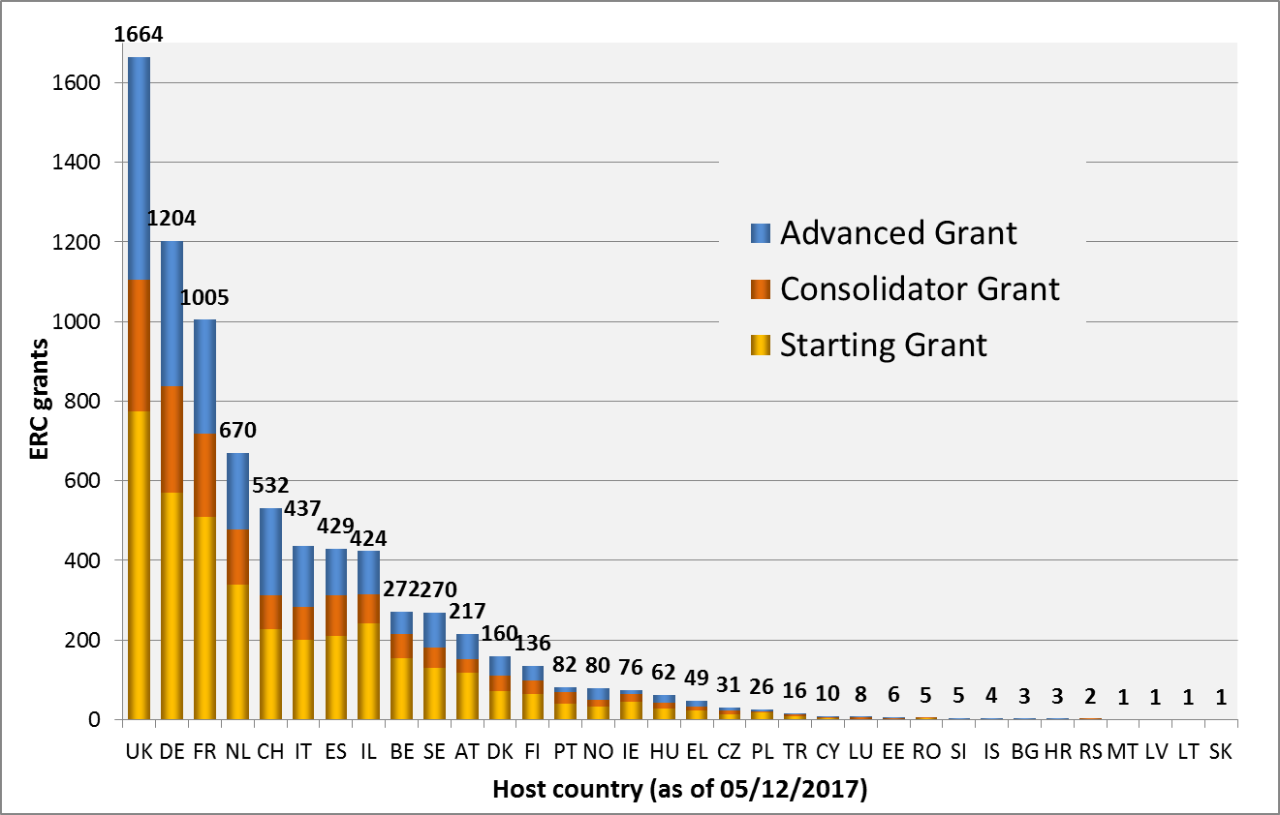
ERC Funded Projects
by Country of Host Institution

Slide 31
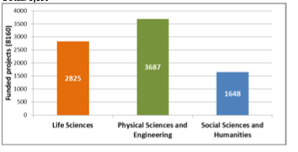
ERC Funded Projects
by Country of Host Institution

Slide 32
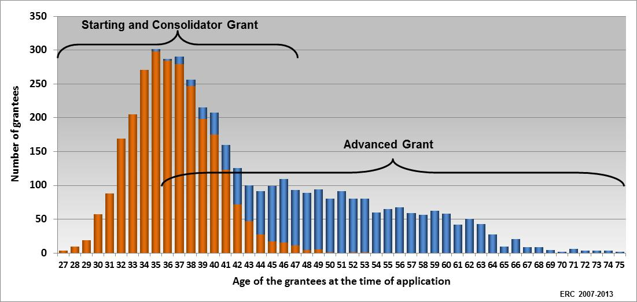
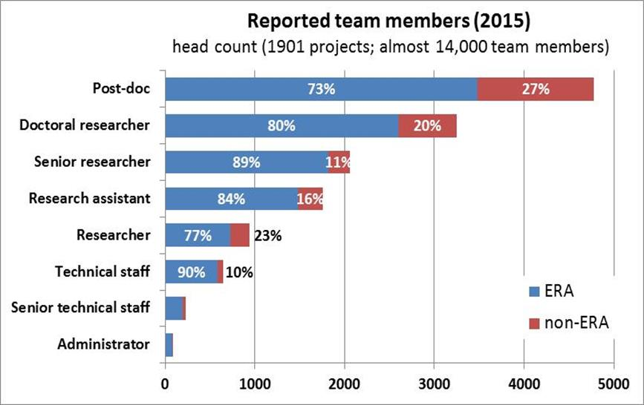
Priority to Young Scientists
+ 30 000 PhD and post-doc researchers working in ERC teams.
Two-thirds of ERC grants to early-stage Principal Investigators.

Slide 33
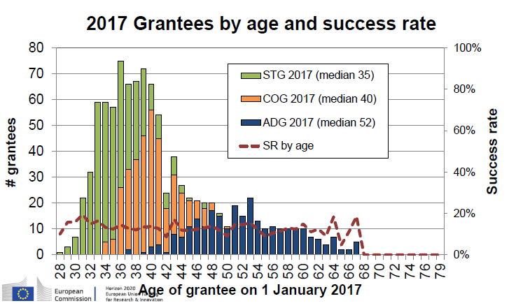
'Flat' success rate with age

Slide 34
ERC PE2 (2007-2017)
443 projects funded to date: ~ 750 million euros
Success rate of applications ~ 15%
~ 15 projects funder per year and per call (StG, CoG, AdV)
~ Approximately half of the proposals go to High-Energy Physics (exp & theo)

Slide 35
More info at
ERC website for latest funding opportunities : https://erc.europa.eu/
Register early, get familiar with the European Commission's Participant Portal system, download the templates and start filling in the forms
http://ec.europa.eu/research/participants/portal/desktop/en/home.html
Use the help tools and call documents (Information for Applicants, Work Programme, Frequently Asked Questions) to prepare your proposal
Read the guidelines carefully!
Find out about the formatting rules and page limits to respect!
Talk to your Institution's grant office and contact your National Contact Point
Check the funded projects: https://erc.europa.eu/projects-and-results/erc-funded-projects
Thanks!

Slide 36
Back up

Slide 37
Indicative summary main calls 2018 budget
ERC Calls | Call date | Submission Deadline | Budget € M (est. grants)
Starting Grants ERC-2018-StG | 3 August 2017 | 17 October 2017 | 581 (391)
Consolidator Grants ERC-2018-CoG | 24 October 2017 | 15 February 2018 | 550 (287)
Advanced Grants ERC-2018-AdG | 17 May 2018 | 30 August 2018 | 450 (194)
Synergy Grants ERC-2018-SyG | 3 August 2017 | 14 November 2017 | 250 (30)
│ 37

Slide 38
ERC Synergy Grants
Objective: breakthroughs that would not be possible by the individual Pis working alone
Grant size: Up to €10M over 6 years (possibility of additional €4M)
Synergy Details
2-4 PIs of any nationality at any career stage
One PI designated as corresponding PI (cPI)
Ambitious research projects - new methods, approaches, techniques, research at the interface between disciplines, unconventional approaches, cross-fertilising scientific fields etc
30% of PI's time in the project + 50% in the EU or AC
Notes:
38

Slide 39
ERC 2013-2017 Frontier Calls
Notes:
Overall the submissions from F are substantially higher than from M
Generally STG = 36 %, COG = 30 %, and ADG 17 %

Slide 40
ERC 2013-2017 Frontier Calls
Submissions by call and domain
Notes:
Overall submission from PT indicate high number (%) from SH and LS, and low from PE
Portugal had our oldest STG grantee in 2016

